Slide 1
Data Publication
EDS213 - Databases & Data Management
Week 10
Renata Curty & Greg Janée
Research Data Services, UCSB Library
rds@library.ucsb.edu

Slide 2
Learning Objectives
Understand the importance of publishing research data
Identify and select appropriate approaches to data publication
Explain the role of persistent identifiers

Slide 3
Why Publishing Data?
Citation Counts
Prestige
Conditional Funding
Promotion
Visibility
Conditional Publication
New Partnerships
Accountability!

Slide 4
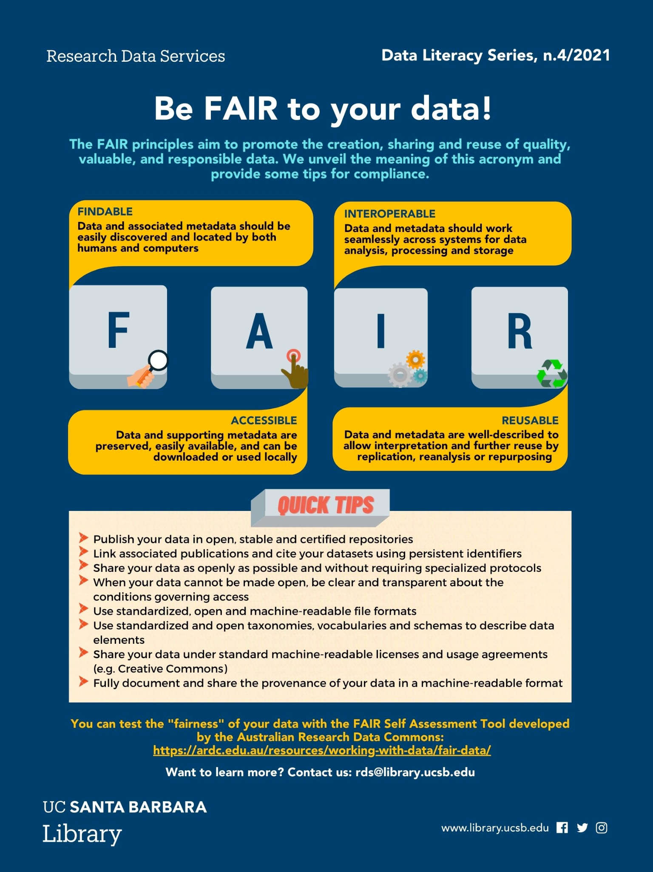
Not any data!
FAIR!
Well-documented (README + metadata)
Open format
With link to the code if any
With a explicit license
With a persistent identifier

Slide 5
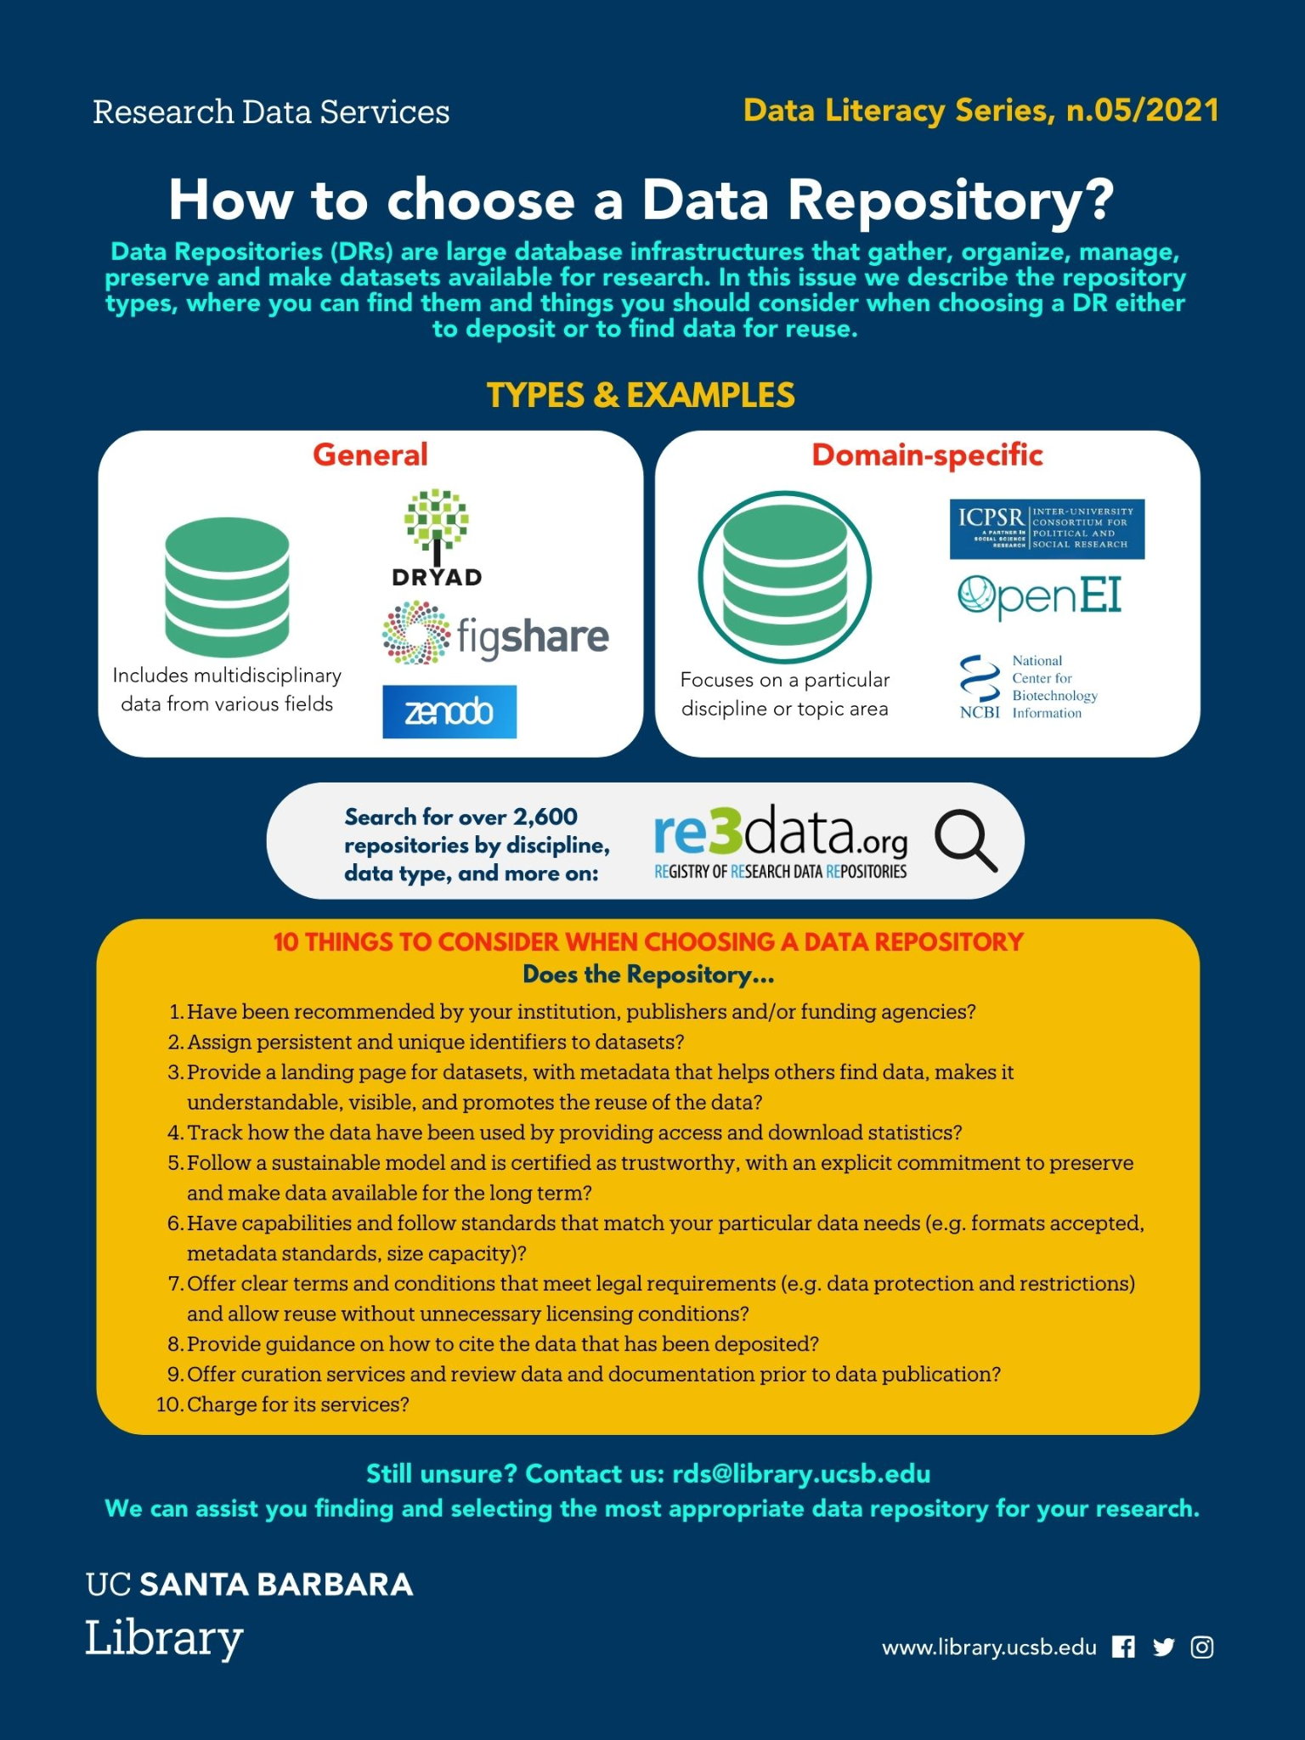
Publishing your Data
Why a Data Repository?
You can’t lose data that’s in a public data repository
Public data repositories support understanding, reanalysis and reuse
Public data repositories facilitate discovery
Public data demonstrates rigor
Research with data in public data repositories attracts more citations
Disciplinary repo examples (US).

Slide 6
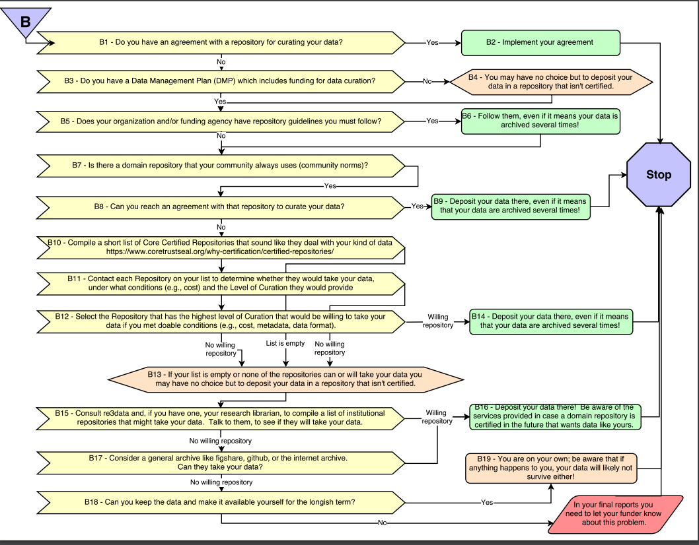
Decision Tree for
ES&ES
Enabling FAIR Data Community, Ruth Duerr, Danie Kinkade, Michael Witt, & Lynn Yarmey. (2018). Data Repository Selection Decision Tree for Researchers in the Earth, Space, and Environmental Sciences. Zenodo. https://doi.org/10.5281/zenodo.1475430

Slide 7
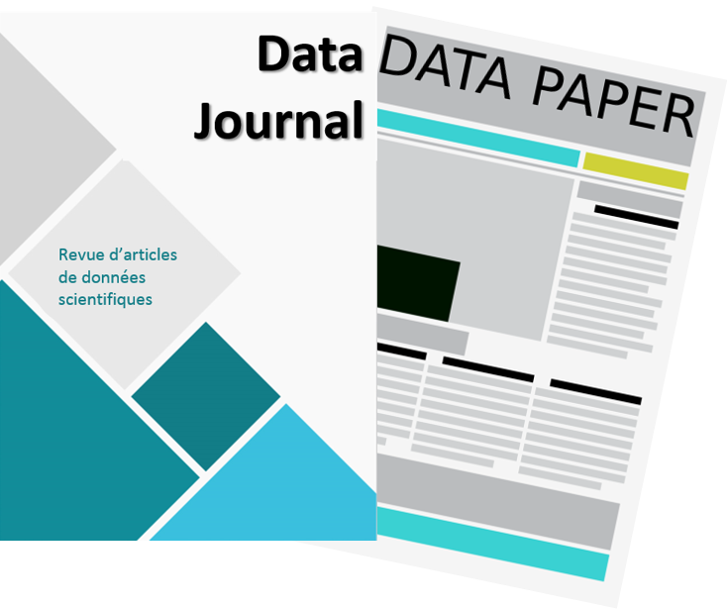
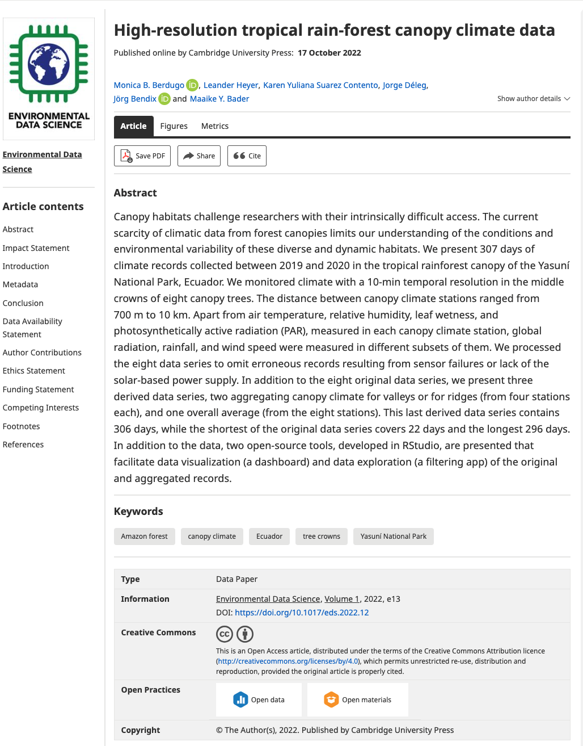
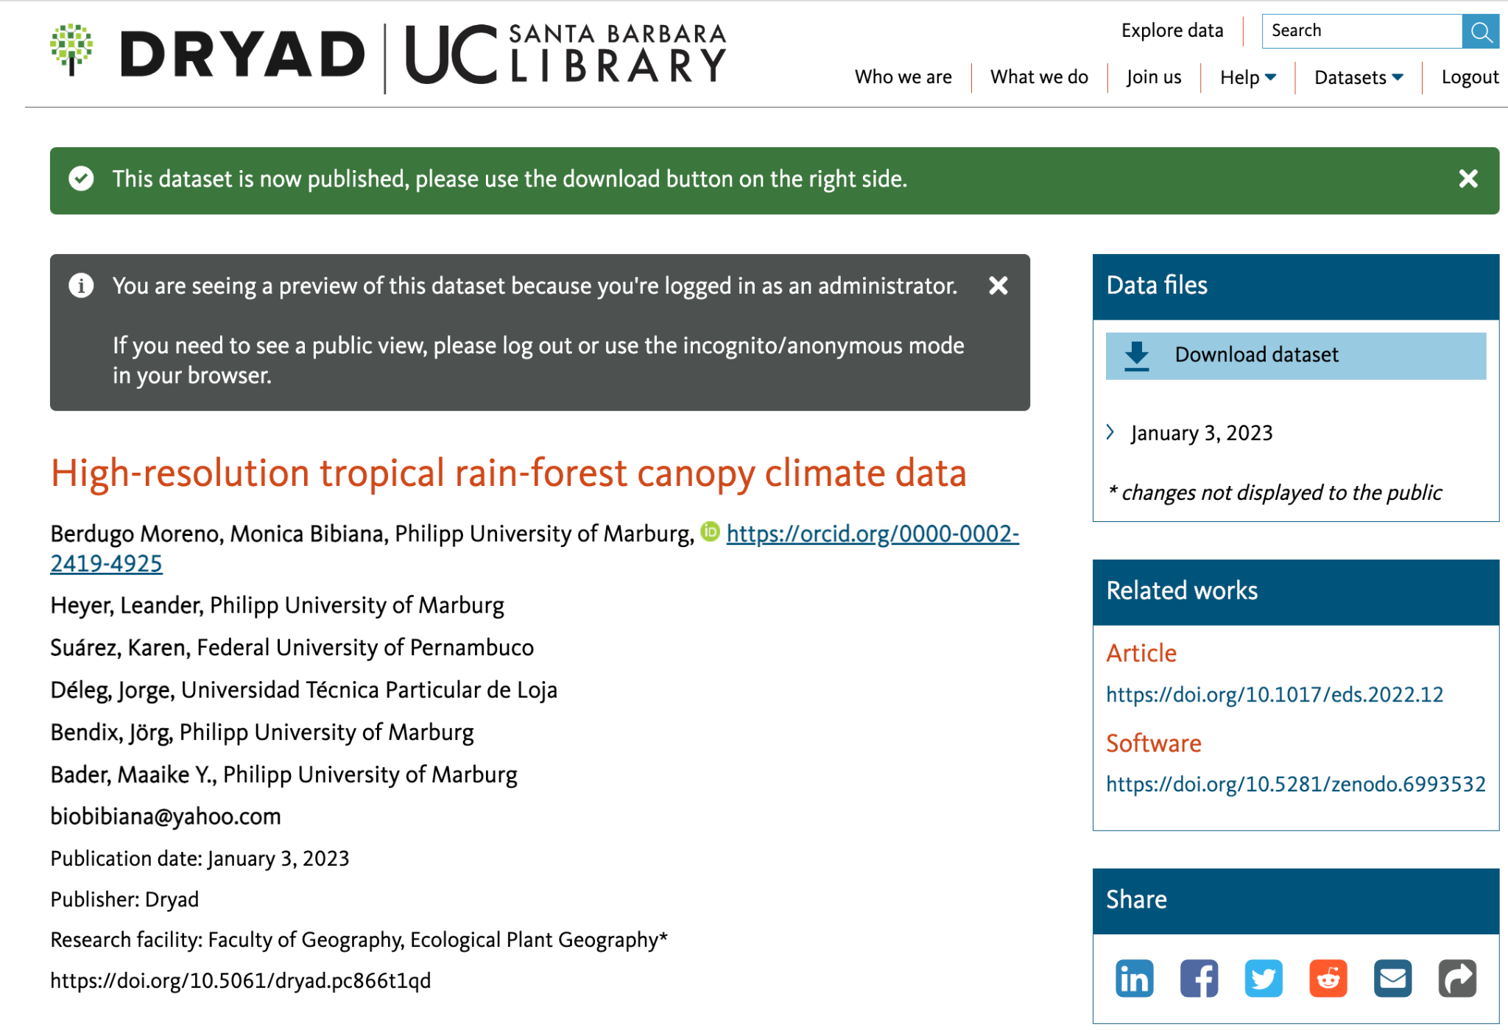
Data Papers
Cross-referenced, using persistent identifiers.
https://doi.org/10.5061/dryad.pc866t1qd
https://doi.org/10.1017/eds.2022.12

Slide 8
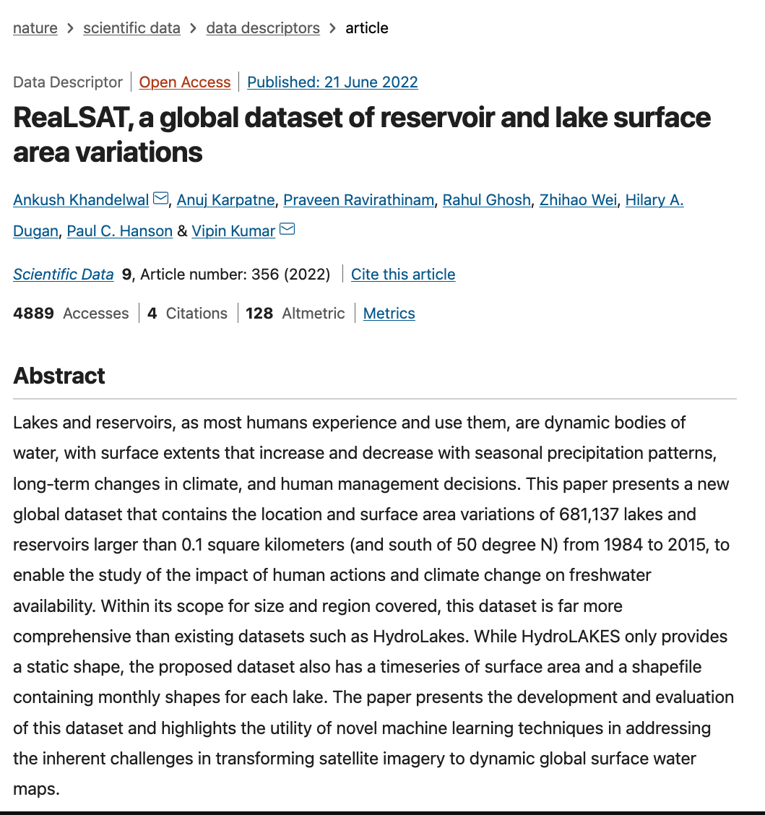
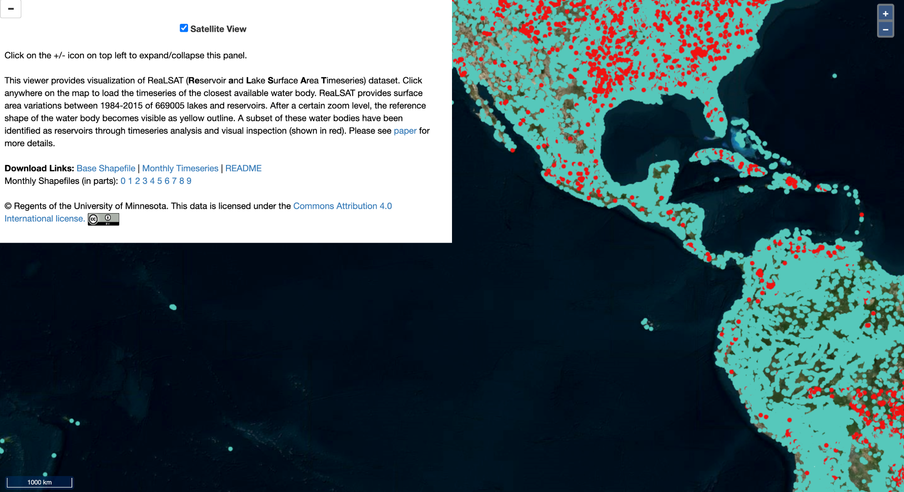
Another example
http://umnlcc.cs.umn.edu/realsat/
https://doi.org/10.1038/s41597-022-01449-5

Slide 9
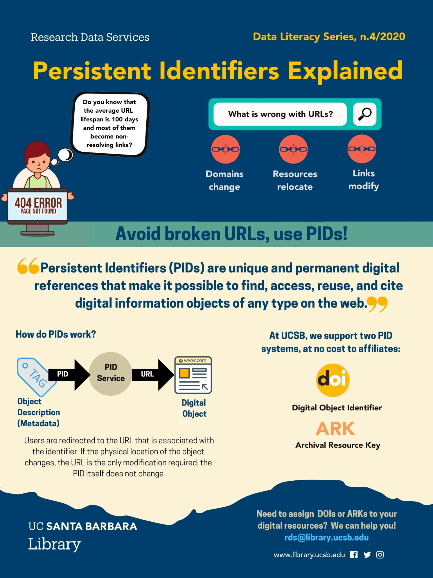
Persistent Identifiers
Most repositories will mint a PId to datasets!
Most journals will mint a PId for papers!
Some repos such as Zenodo and Figshare also create PIds for a variety of other scholarly digital objects (slides, images, code/software)
Released repos on GitHub are assigned a DOI via a Zenodo integration (See)

