Slide 1
Metadata Standards
Documentation - Part 2
EDS213 - Databases & Data Management
Week 6
Renata Curty
Research Data Services, UCSB Library
rds@library.ucsb.edu

Slide 2
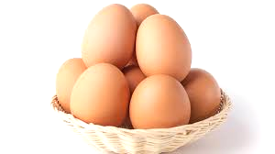
From data to research deliverables
Arranged, labelled and with provenance info
Other related items packed together
You may combine them to make something tasty
Research Deliverables
Data
Data + Rich Metadata
Data Repository
Software/Code

Slide 3
Learning Objectives
Understand the role of metadata in facilitating the management, discovery, interoperability, and reuse of digital resources and research data.
Recognize the importance of adhering to domain-specific metadata standards and determining which standard should be used.
Acquire familiarity with the overall structure of the Ecological Metadata Language (EML) schema and the anatomy of an EML record.
Programmatically create EML metadata records using R.

Slide 4
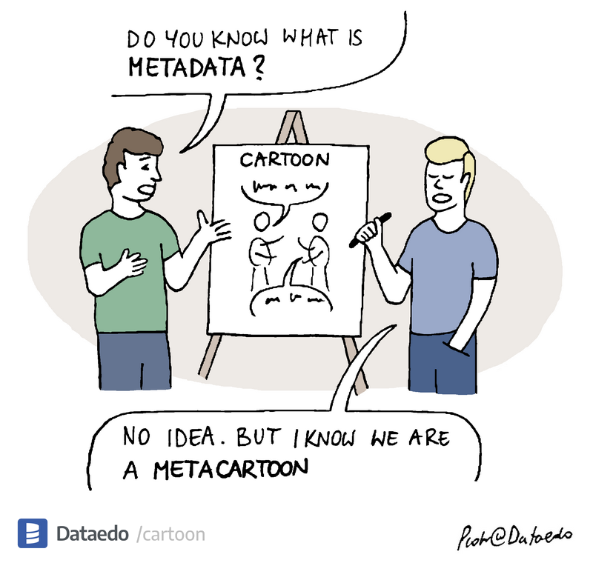
Metadata
“Data about data”

Slide 5
Metadata
Descriptors for digital objects help in understanding what they are, where to find them, how to access them, and more.
The extent of metadata varies depending on the type of digital object being described.
The depth and breadth of metadata differ based on their purpose and system requirements.
The more comprehensive the metadata, the greater the reusability of the data.

Slide 6
Study Level Metadata + Data Level Metadata

Slide 7
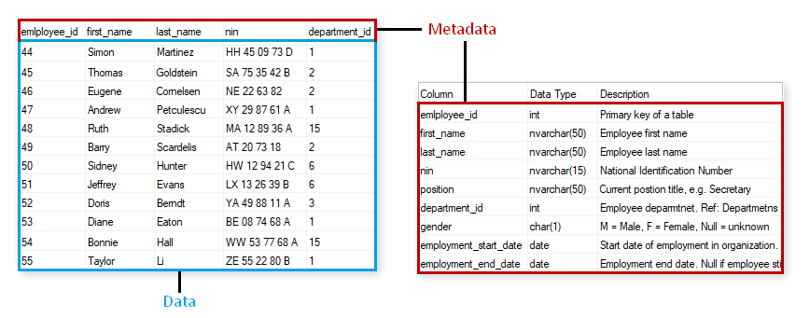
Metadata?

Slide 8
Metadata?

Slide 9
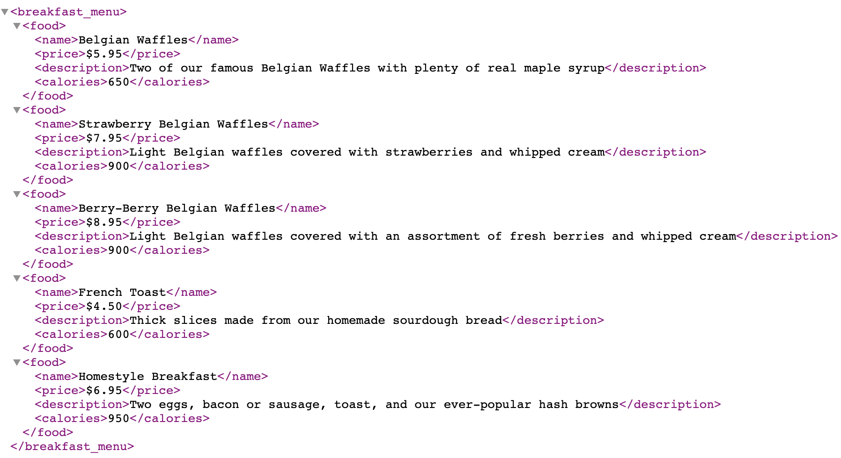
Metadata?

Slide 10
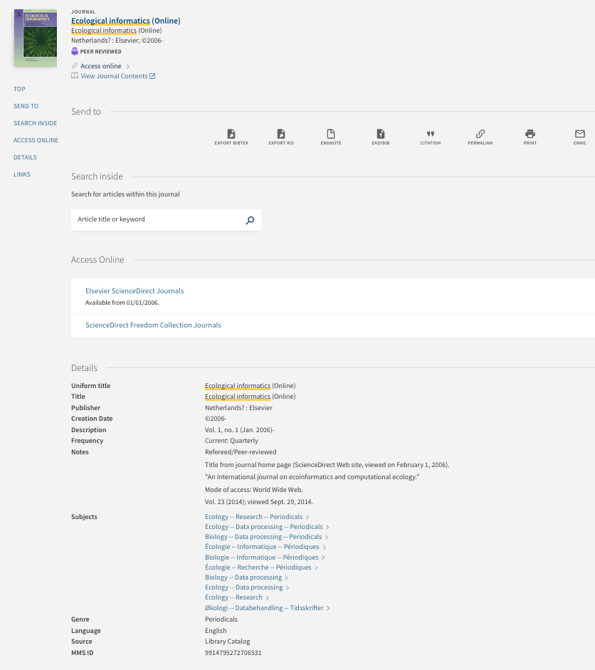
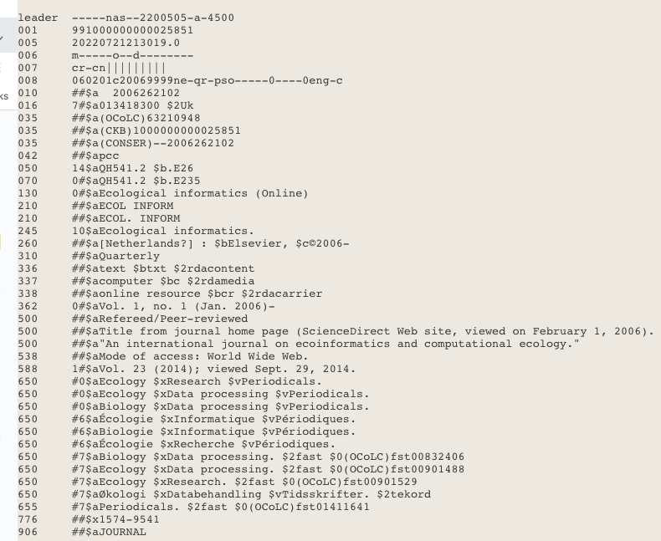
Metadata?

Slide 11
All metadata!
Human-readable/ Manually Created
Not as easy for machines to parse
Machine & Human Readable. Generic. No specific standard.
Automatically Created
Both Machine and Human Readable
Behind the “scenes”
Both Human and Machine Readable Following a convention/standard

Slide 12
FAIR Data
Wilkinson, M. D., Dumontier, M., Aalbersberg, I. J., Appleton, G., Axton, M., Baak, A., Blomberg, N., Boiten, J. W., da Silva Santos, L. B., Bourne, P. E., Bouwman, J., Brookes, A. J., Clark, T., Crosas, M., Dillo, I., Dumon, O., Edmunds, S., Evelo, C. T., Finkers, R., Gonzalez-Beltran, A., … Mons, B. (2016). The FAIR Guiding Principles for scientific data management and stewardship. Scientific data, 3, 160018. https://doi.org/10.1038/sdata.2016.18

Slide 13
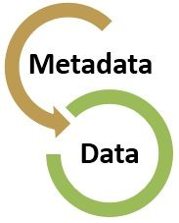
Metadata Best Practices
Keep data entry consistent
Define the parameters and the units on the parameter
Explain the formats for dates, time, geographic coordinates, and other parameters
Define any coded values
Describe quality flags or qualifying values
Define missing values
Always use an established metadata standard

Slide 14
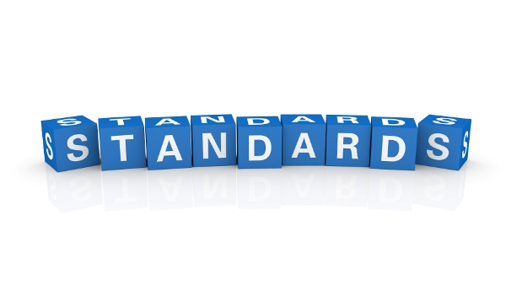
Metadata Standard
Establishes a common way of structuring and understanding data, and includes principles and implementation issues for utilizing the standard.
Provides a structure to describe and retrieve data!
Common terms to allow consistency between records
Common structure to quickly locate components
Reliable and predictable format for computer interpretation
A uniform summary description of the dataset

Slide 15
Which Metadata Standard?
https://rdamsc.bath.ac.uk/

Slide 16
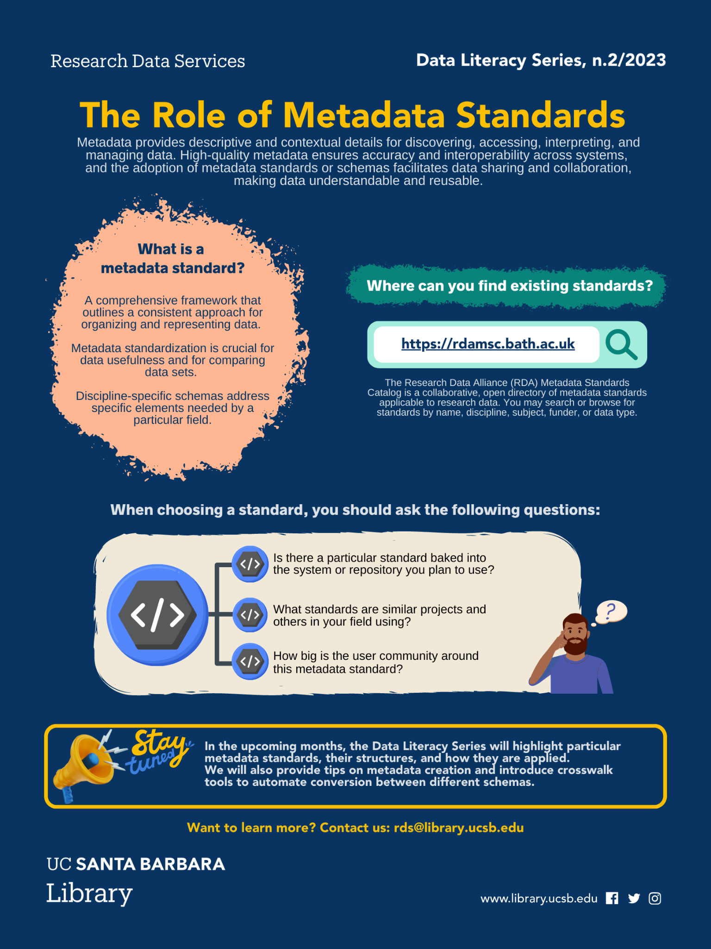
Choosing a Metadata Standard
Is there a particular standard baked into the system or repository you plan to use?
What standards are similar projects and others in your field using?
How big is the user community around this metadata standard?

Slide 17
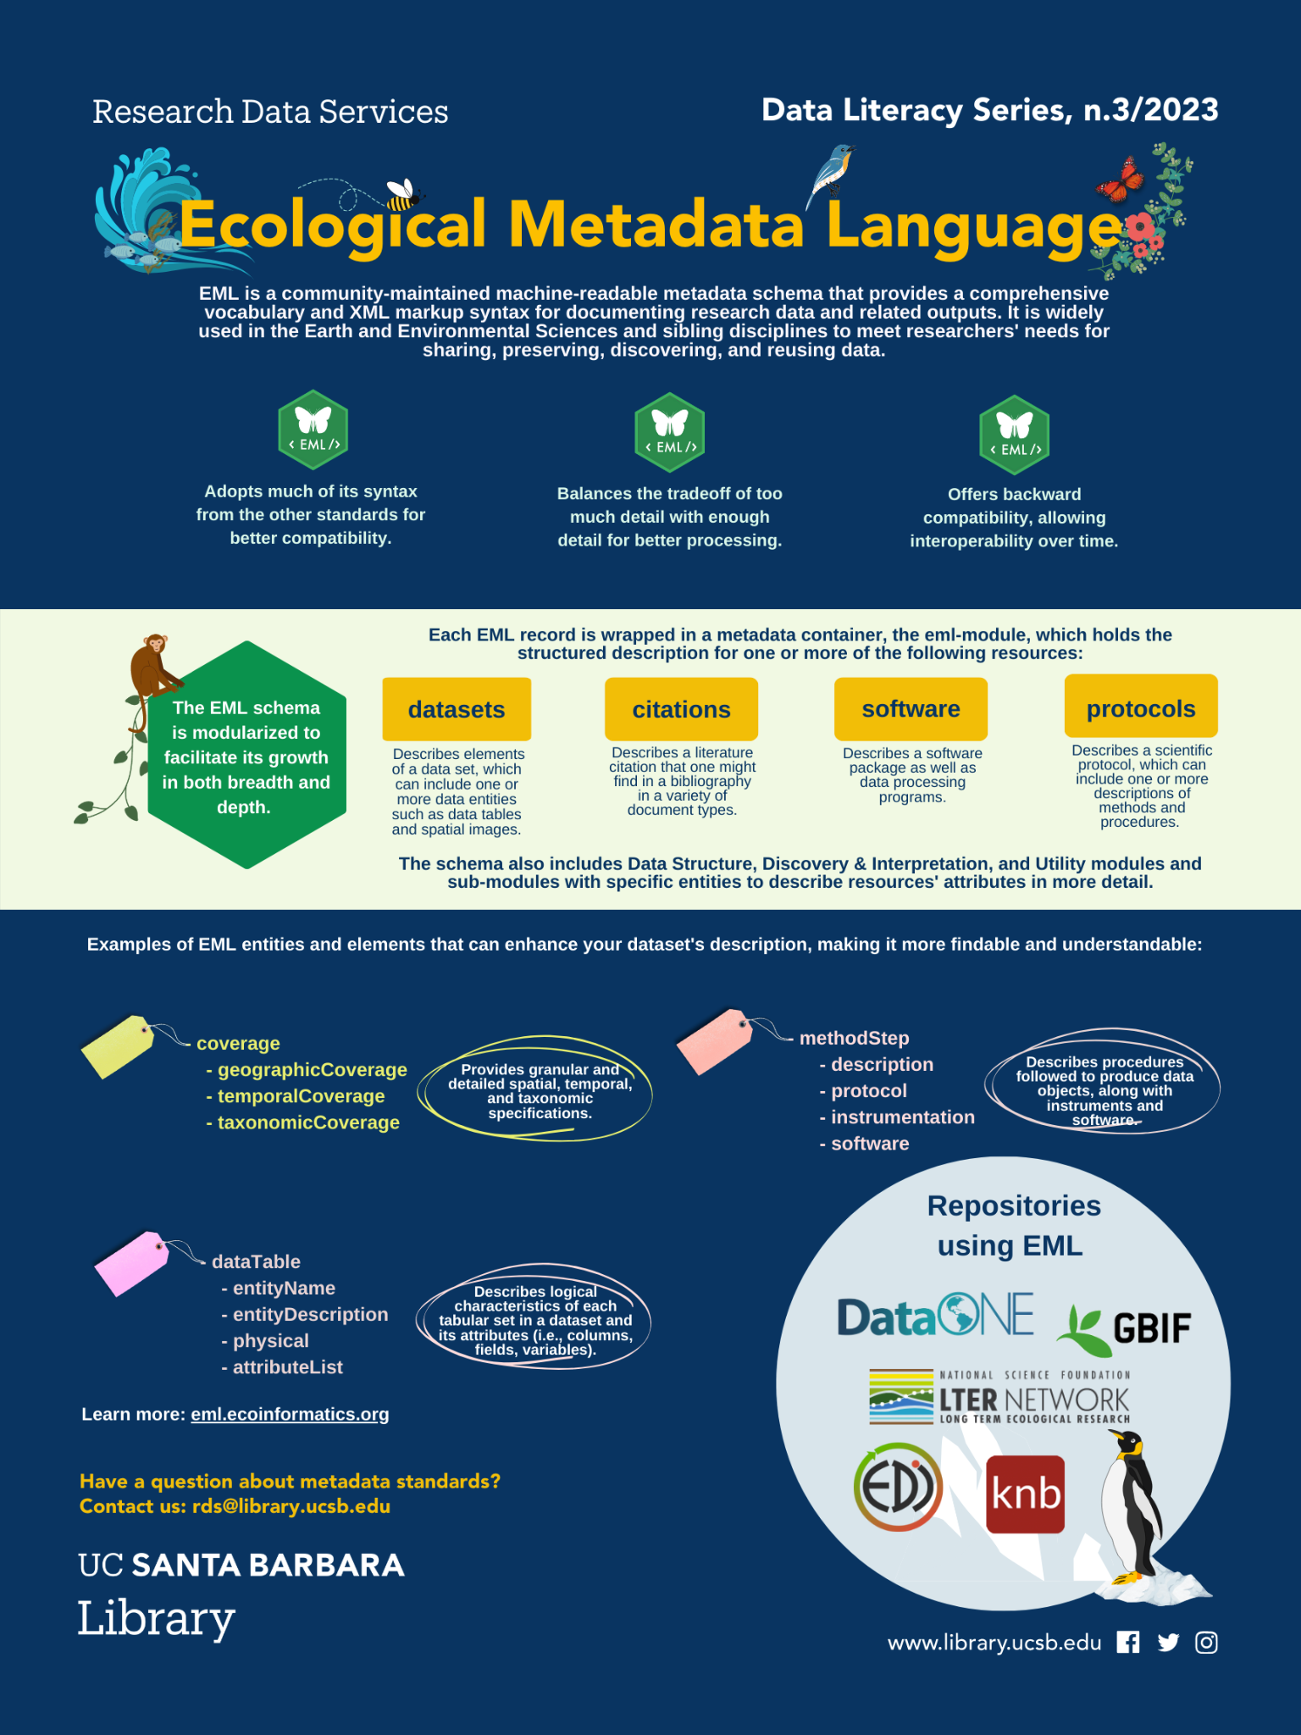
Current version EML 2.2.0
Developed at NCEAS (Mat Jones)
Compatible with other standards (DCMI, CSDGM/FGDC, ISO19115 )
A “dialect” for XML
Modular
Detailed structure
Strong Typing
Uses tags aligned with the requirements and needs from the ecology and environmental community
Used by some of the most relevant data repositories in the field
https://eml.ecoinformatics.org/

Slide 18
More on XML
Extensible Markup Language (XML) is a flexible markup language that provides rules to define any data using sets of codes/tags
Concerns with how information is organized (nested as a russian doll!)
The XML tag names are readable and convey the meaning of the data. The information structure is easily discerned by both humans and computers as each XML tag immediately precedes the associated data. The data structure follows a noticeable and useful pattern, making it easy to manipulate and exchange the data
Unlike other programming languages, XML cannot perform computing operations by itself

Slide 19
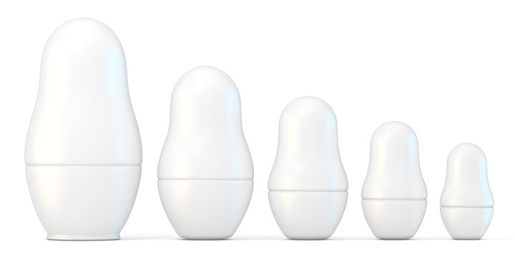
EML in XML
EML Record
Dataset
Data Table
Attribute
List
Attribute

Slide 20
Suppose you have a dataset on soil temperature, with EML you could assign predefined terms and units to an otherwise undocumented column, such as “Celsius.” With a structured metadata language like this, many metadata records can be combined into a single database, which allows for the creation of search interfaces for finding data.
The result is like a Google for data, allowing users to query their specific interests, such as “datasets with soil temperatures north of 50° latitude.
More attributes of data become visible and searchable, while also maintaining greater consistency
https://www.nceas.ucsb.edu/news/why-you-never-knew-how-much-you-needed-ecological-metadata-language

Slide 21
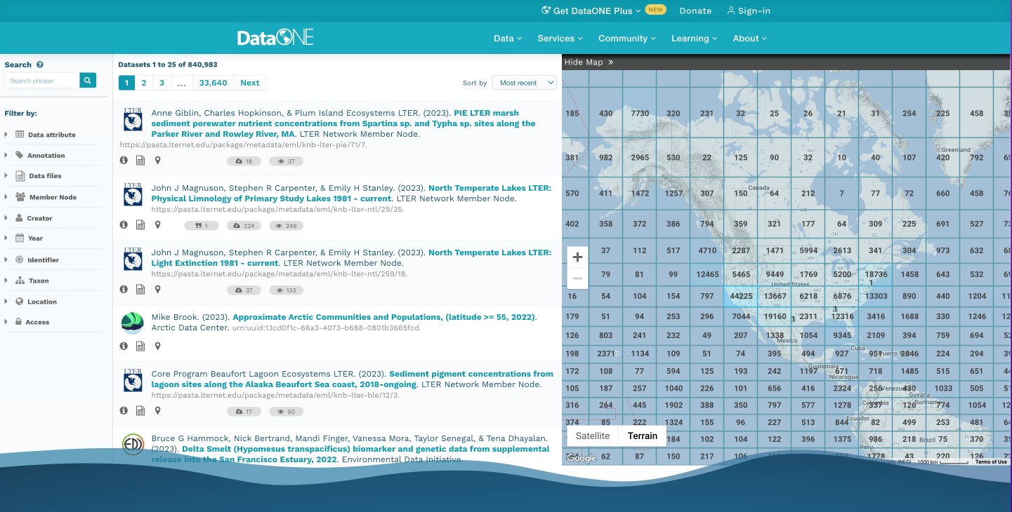
Metadata Standard In Action https://search.dataone.org/data
Let’s try it!

Slide 22
A good enough EML record
- eml
- dataset
- title*
- creator(s)*
- publisher
- pubDate
- keywords
- abstract
- intellectualRights
- contact*
- methods
- coverage (e.g., geographic/temporal/taxonomic)
- dataTable
- entityName
- entityDescription
- physical
- attributeList
*A minimum valid record (but not as useful)

Slide 23
Creating an EML Record
Simple text editor (e.g., Atom) - painful! Only recommended for small edits. Not for creating a whole record.
EzEML (EDI Web Form) - GUI for non-tech people, useful tool, but can be time consuming, lots of clicks!
An EML R package for you’all data-savys!*
If you become a data manager and need to create multiple records in a bulk, there is a Excel to EML option! Not worth it for one at a time!
Notes:
Open ExML form

Slide 24
Closing Thoughts
Both machine and human-readable metadata are needed to describe digital objects such as datasets
Without a standardized metadata format, each individual or organization may create and use their own metadata schema or structure. This lack of consistency makes it challenging to locate, compare, combine, or integrate datasets from different sources
Metadata standards like EML are instrumental for efficient data management, to promote interoperability and data discovery
Data scientists are expected to comply with metadata standards

