Slide 1
Reproducible & FAIR Data
Documentation - Part 1
EDS213 - Databases & Data Management
Week 4
Renata Curty
Research Data Services, UCSB Library
rds@library.ucsb.edu

Slide 2
Learning Objectives
Understand the implications of data management and organization for reproducible and FAIR (Findable, Accessible, Interoperable, and Reusable) data science.
Operationalize reproducibility and the FAIR principles by adopting good and responsible data management, code, and workflow documentation practices in your daily work.
Apply strategies to mitigate issues that could prevent reproducibility.

Slide 3
The Problem
Traditional scientific reporting approaches aren’t sufficient for full transparency and understandability of the data and workflows
Space/format constraints
Selected content
Hidden processes

Slide 4
FAIR Data
Wilkinson, M. D., Dumontier, M., Aalbersberg, I. J., Appleton, G., Axton, M., Baak, A., Blomberg, N., Boiten, J. W., da Silva Santos, L. B., Bourne, P. E., Bouwman, J., Brookes, A. J., Clark, T., Crosas, M., Dillo, I., Dumon, O., Edmunds, S., Evelo, C. T., Finkers, R., Gonzalez-Beltran, A., … Mons, B. (2016). The FAIR Guiding Principles for scientific data management and stewardship. Scientific data, 3, 160018. https://doi.org/10.1038/sdata.2016.18

Slide 5
FAIR data?
Ghent University Data Stewards (2020). Knowledge clip: FAIR data principles. Available at: https://youtu.be/2uZxFu9SFi8

Slide 6
Reproducibility
Convey clear, specific, and complete
information about any computational
methods and data products that support
their published results in order to enable
other researchers to repeat the analysis,
unless such information is restricted by
nonpublic data policies. That information
should include the data, study methods, and
computational environment.
National Academies of Sciences, Engineering, and Medicine. (2019). Reproducibility and replicability in science. National Academies Press. https://doi.org/10.17226/25303

Slide 7
Reusable vs. Reproducible
Terms (Attributes) | Research Question | Researchers | Data | Procedures/ Methods | Results | Goal
Reusability (Reusable) | Same or Different | Same or Different | Same (Part or Whole) | Same or Different | Same or Different | Expand Applicability
Reproducibility (Reproducible) | Same | Different | Same | Same | Same | Validity/ Inspectability

Slide 8
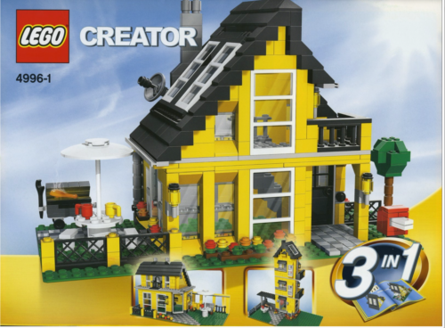
Reproducibility
Reusability
All components + instructions = expected outcome
Repurposing the data=New applications, insights

Slide 9
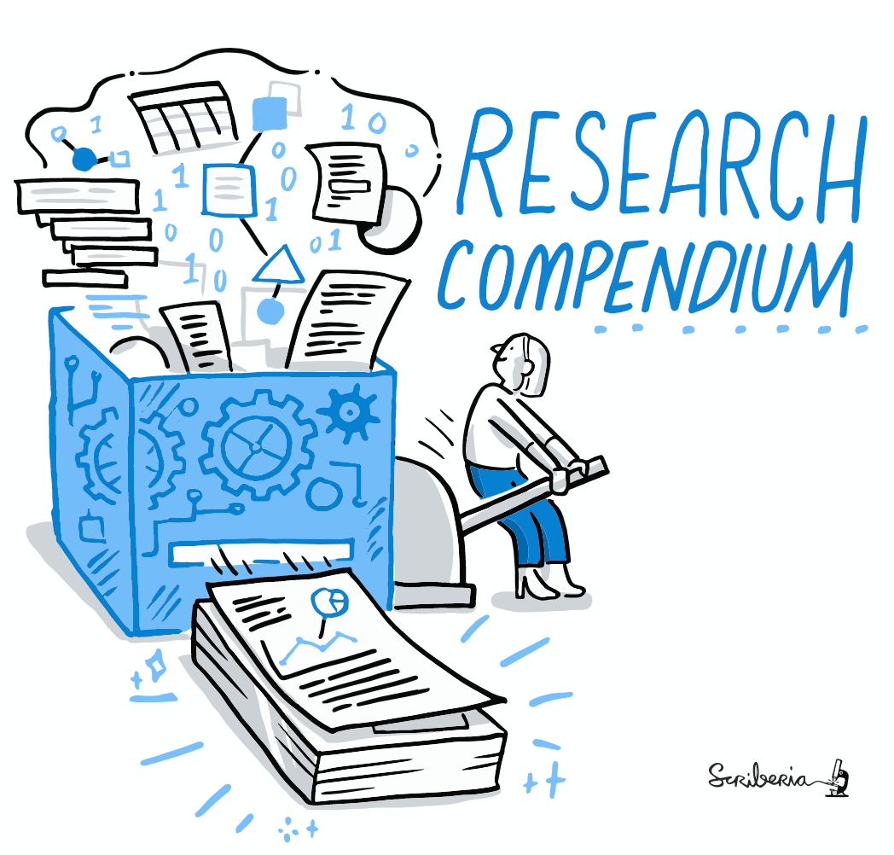
Seeking reproducibility
A research compendium accompanies, enhances, or is a standalone scientific publication providing data, code, and documentation for reproducing the whole project workflow.

Slide 10
What to save?
Raw data
untouched!
often not re-obtainable
supports inspection, backtracking
contains information lost in aggregation process
Intermediate data
if has reusable value
especially cleaned-up versions of raw data
transformations and aggregations
Analysis-ready data
Final products
including data behind graphs, maps, visualizations
Scripts/Code
with data, or link to GitHub or Zenodo

Slide 11
How to save?
Choose preservation-friendly formats
Open formats
Formats supported by lots of (open source) tools
Save in multiple formats if possible
Proprietary + open, e.g., Excel + CSV
Separate acquired data from generated data
Name files respecting good conventions
Backups - following the 3-2-1 rule

Slide 12
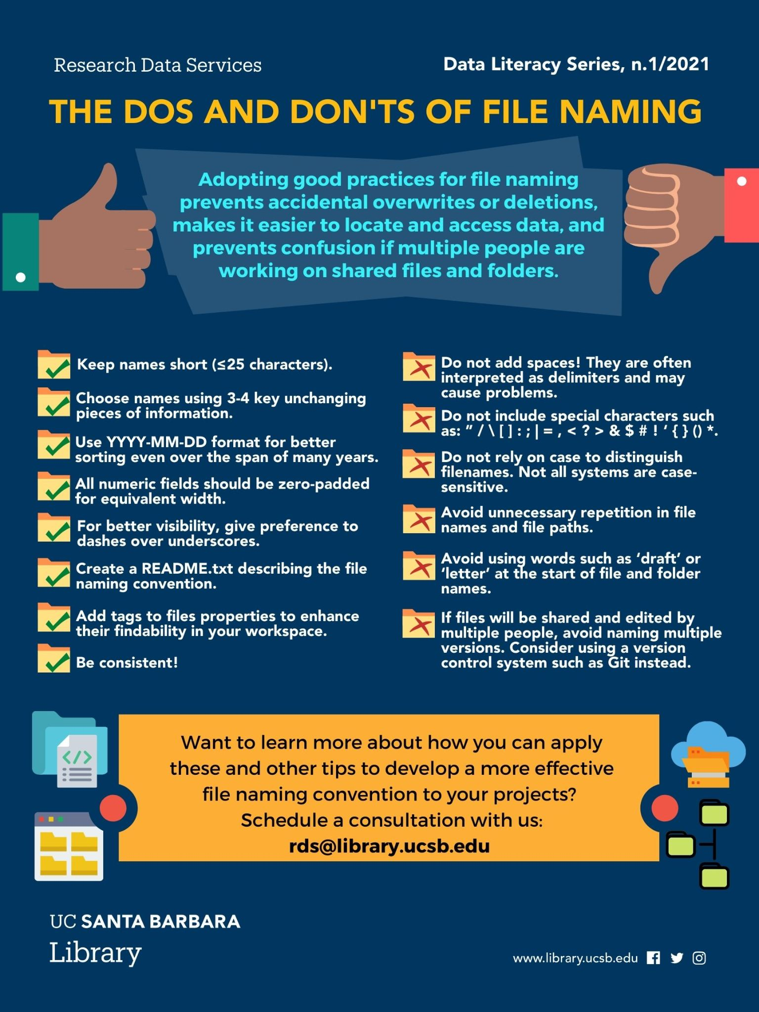
File Naming
Determine a convention with your team (and stick to that!)
Include that convention in the README
DLS series: https://www.library.ucsb.edu/data-literacy-series

Slide 13
File Naming
Human Readable
File names should reflect the contents of the file and include enough information to uniquely and easily identify the data file.
Possible units/pieces:
Date of reference
Document Type
Location
Origin
Author/Creator
Project name or number
Instrument
Sample
Analysis Type
Version number
Informative, concise and consistent naming conventions
Bad names:
2021-09-30_report_final_final_v2.docx
OUTPUT2.csv
Important.document.doc
Notes.txt
Document_final_final_v2.pdf
My_important_document_1_version_3.doc

Slide 14
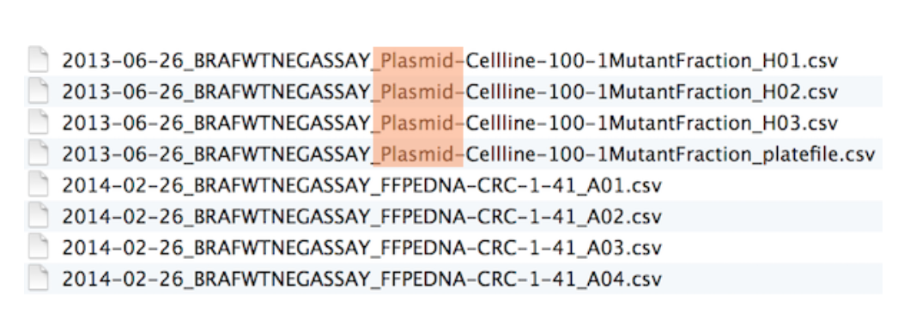
File Naming
Machine Readable
File names should be regular expressions, globbing friendly and easy to compute on
Don’t use spaces and special characters (only standard ASCII alphanumeric characters in file and directory names)
Avoid case sensitivity (lowercase is preferable - Unix)
Numeric information first, zero-padded for same width
ISO format for dates (YYYYMMDD)
Delimiters:
Despise the spaces and symbols
Avoid underscores*
Embrace the dashes
Be consistent!

Slide 15
File Naming
What could be improved?
10_final-figs-paper.R
1_data-cleaning.R
2_fit-model.R
Abr2021_SpeciesCount.csv
Dez2022_species_list.csv
Out2020_Species-List.csv

Slide 16
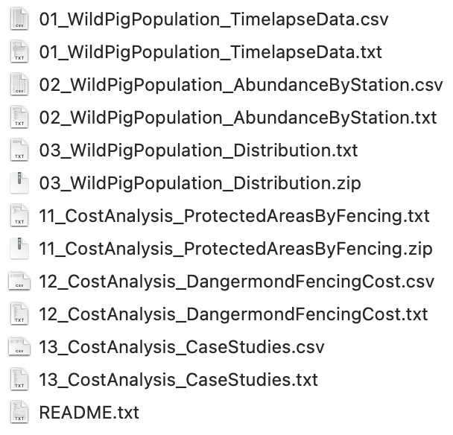
File Naming
What could be improved?
Note:
.txt files explain variables and units of measurement in corresponding .csv files.
The .zip files contain heatmap, tiff and metadata information for camera traps.

Slide 17
Project Organization & Documentation Worksheet
(PARTS A & B)

Slide 18
Data Documentation
Essential to establish a common understanding of the meaning or semantics of the data, to ensure correct and proper use and interpretation of the data by its owners and (re)users.

Slide 19
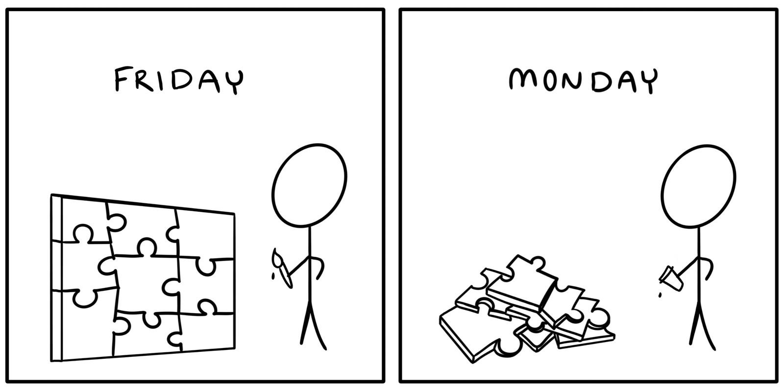

Slide 20
Having conversations across time, not needing a time machine, or spending extra time!

Slide 21
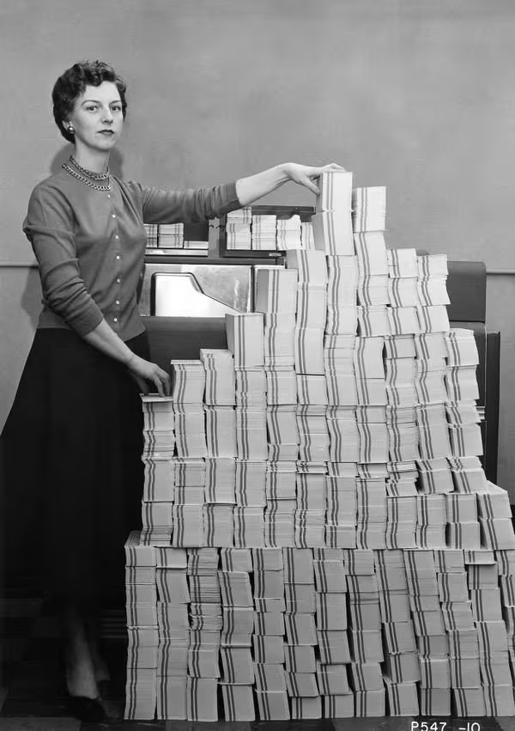
READMEs
Dates back to the 1970s
Early use - informative paper notes placed on stacks of punchcards, "READ ME!"
README in all-caps - in addition to the visual strikingness of using all-caps, UNIX systems would sort capitals before lower case letters, conveniently putting the README before the rest of the directory's content.
Intent: "This is important information for the user to read before proceeding."

Slide 22
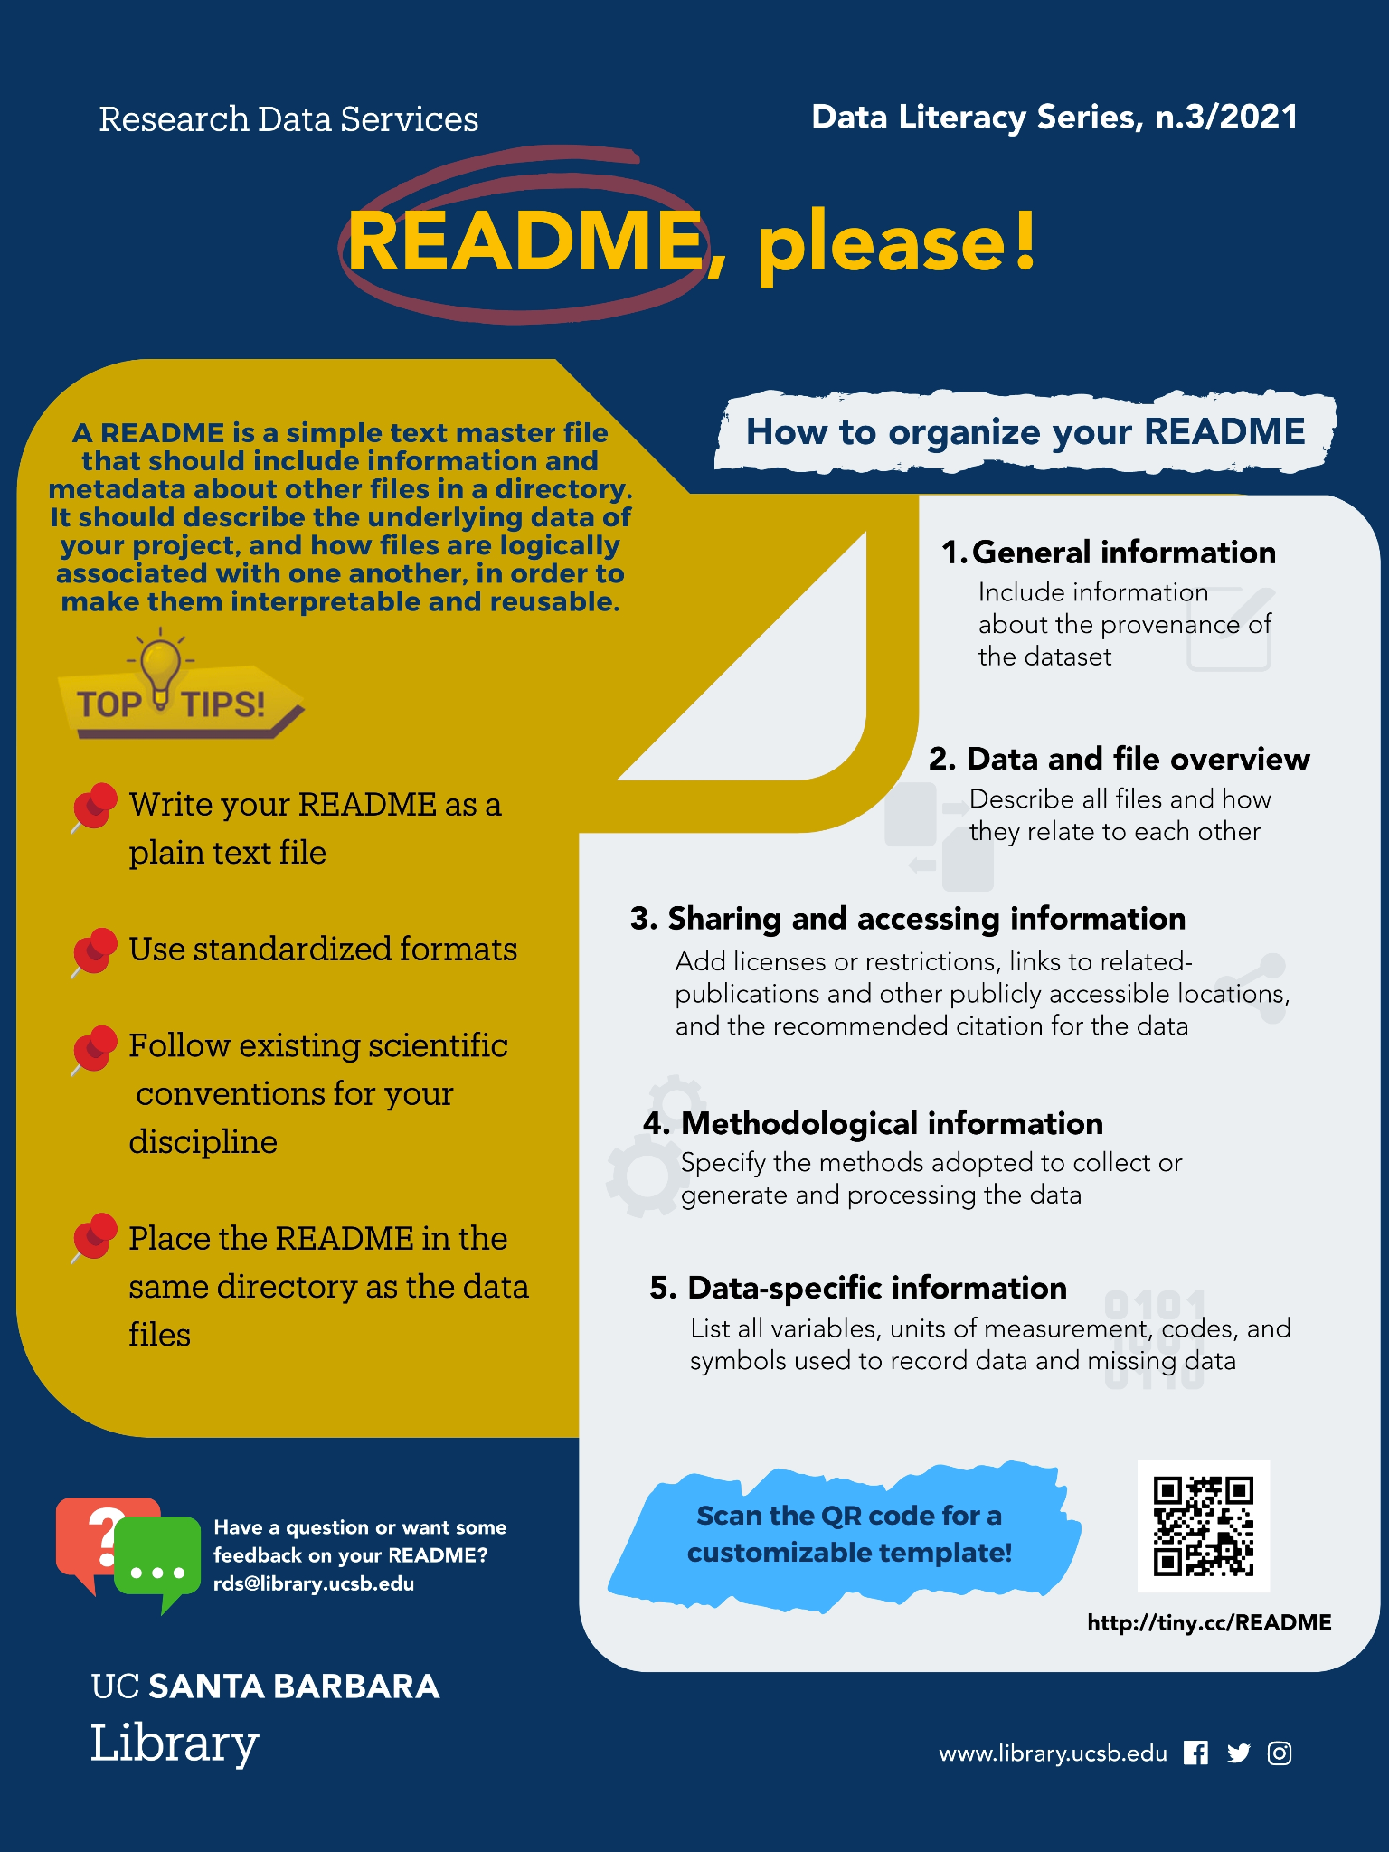
What to document?
At each directory level, answer: "What is this?”
README file
Who? What? Where? When? Why? How?
tiny.cc/README

Slide 23
Insufficient Context and Details
Files:
Camera_time-lapse_2017-09-01_2018-06-30.avi
Camera_time-lapse_2017-09-01_2018-06-30.mp4
Camera_time-lapse_2018-07-07_2018-08-29.avi
Camera_time-lapse_2018-07-07_2018-08-29.mp4
Camera_time-lapse_2018-10-12_2019-06-19.avi
Camera_time-lapse_2018-10-12_2019-06-19.mp4
Camera_time-lapse_2019-07-02_2019-10-05.avi
Camera_time-lapse_2019-07-02_2019-10-05.mp4
Camera_time-lapse_2019-10-05_2020-07-19.avi
Camera_time-lapse_2019-10-05_2020-07-19.mp4
Camera_time-lapse_2020-07-19_2020-10-21.avi
Camera_time-lapse_2020-07-19_2020-10-21.mp4
README.txt
Before “Time-lapse videos of camera traps”
After:
background and purpose
camera location (site name, lat/lon, elevation)
orientation
instrumentation
capture interval
other data captured

Slide 24
Documenting Code
For long tasks plan using diagrams or pseudocode first
Variables = nouns
Functions = verbs
Avoid using names of existing variables and functions
Spaces for better visual effect
Indentation (use spaces, not tabs or combination of both)
Comment “why” rather than “what”
Get feedback
Portability (Relative Paths!)
Use functions (self-contained blocks)
https://www.britishecologicalsociety.org/wp-content/uploads/2017/12/guide-to-reproducible-code.pdf
See: https://medium.com/@floyd.may/naming-variables-47507e10f1e5

Slide 25
Other
Code
Tips
https://www.library.ucsb.edu/sites/default/files/dls-n11-2021-codedocumentation-navy.pdf

Slide 26
Project Organization (don'ts)
Hard to tell what version of the data is the original and what is the modified
Mixes files with various extensions together
Hard to match the correct figures with code

Slide 27
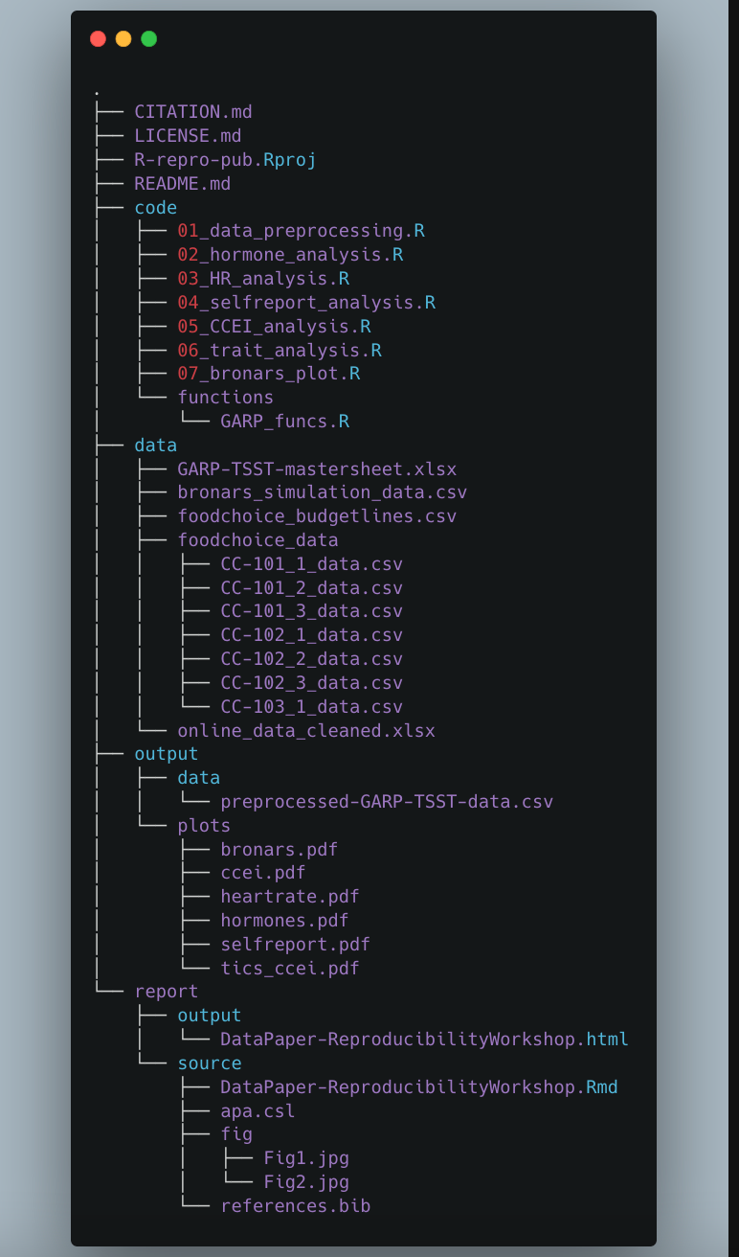
Project Organization (DO’s)
https://carbon.now.sh/
Example: https://github.com/carpentries-incubator/Reproducible-Publications-with-RStudio-Example

Slide 28
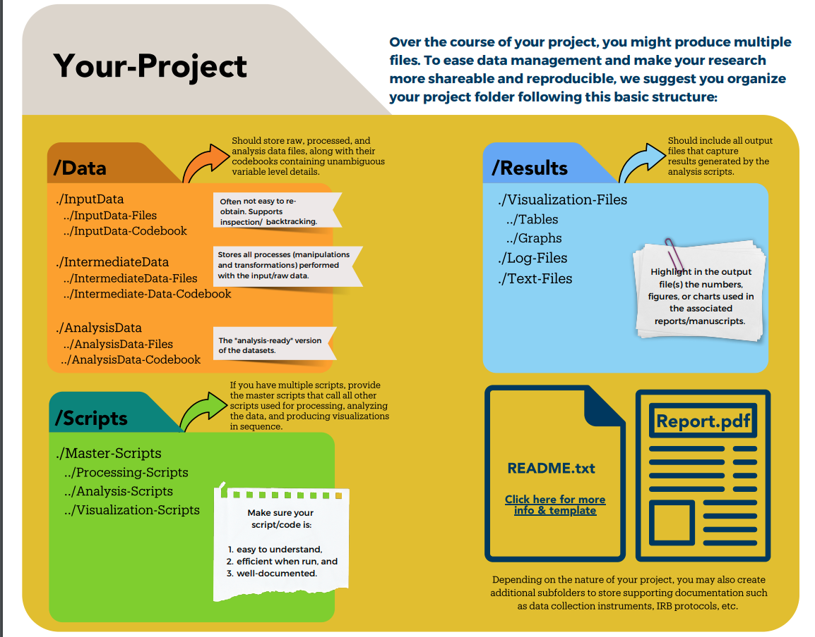
Organizing Project for Reproducibility
Embrace a one folder = one project mentality
If in R, than you should put an renv.lock on it!
DLS series: https://www.library.ucsb.edu/data-literacy-series

Slide 29
Project Organization & Documentation Worksheet
(PARTS C-E)

Slide 30
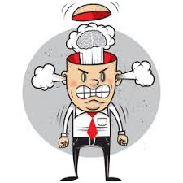
The Dependency Hell
Free and open-source software…
Clean and clear code…
Data well-organized and documented..
devtools/sessionInfo ( )...
Still...issues with the environment
Say “it works in my machine”, one more time!

Slide 31
The Dependency Hell
Why?
Package versions don’t match
R versions don’t match
Ask yourself:
What are the packages versions used for my project?
Will my project be usable on other system or in the future?
How to deal with projects requiring different versions of a package?

Slide 32
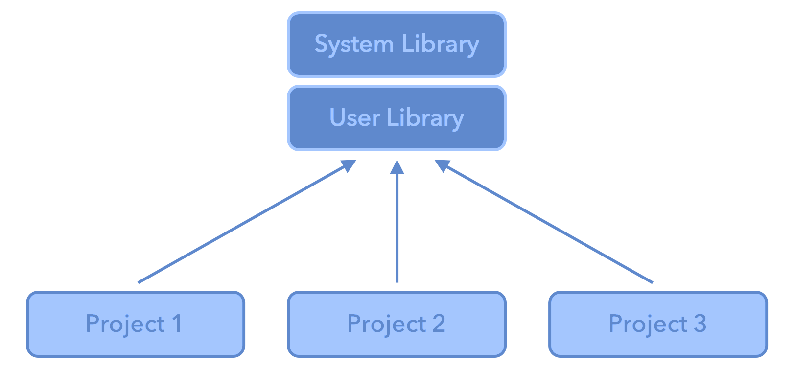
More into the problem - The R System
.libPaths gets/sets the library trees within which packages are looked for. Each R session can use multiple library paths (user and system)
Different projects, different dependencies, but calling from the same library. All projects share the same versions of installed packages.

Slide 33
Do you see this cube in Rstudio?
Have you ever used it?

Slide 34
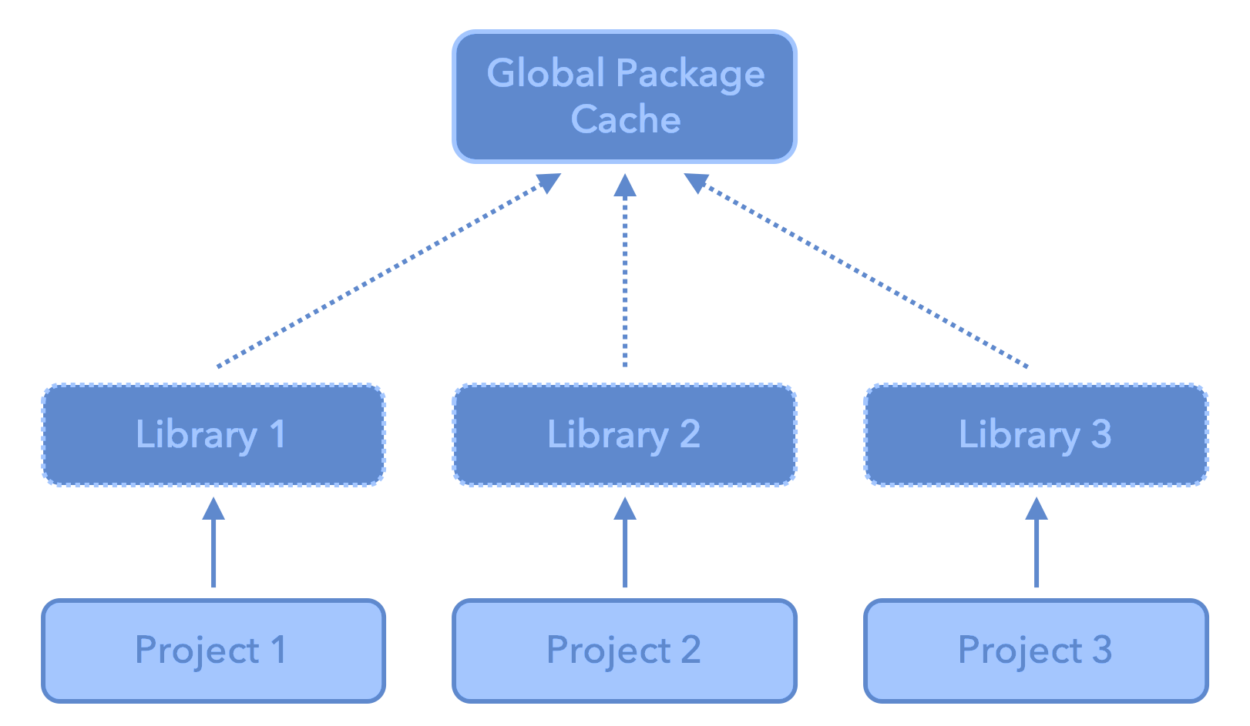
RENV
A project local library for each project

Slide 35
RENV
A dependency management toolkit for project-local libraries of R packages.
install.packages("renv")
Advantages:
Isolation: Each project gets its own library of R packages. In this way, you can upgrade and change package versions in one project without worrying about your other projects.
Portability: You can more easily share and collaborate on projects while ensuring all are sharing the same common base, by sharing a lockfile (renv.lock) which captures the state of your R packages.
Reproducibility: You can restore your R library exactly as specified in the renv.lock file.
https://rstudio.github.io/renv/articles/renv.html

Slide 36
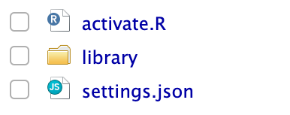
RENV Infrastructure
Used to activate renv for new R sessions launched in the project.
The activation script run by the project .Rprofile.
The private project library
Project-local settings that can be used to adjust the behavior of renv with your particular project.
The lockfile, describing the state of your project’s library at some point in time.

Slide 37
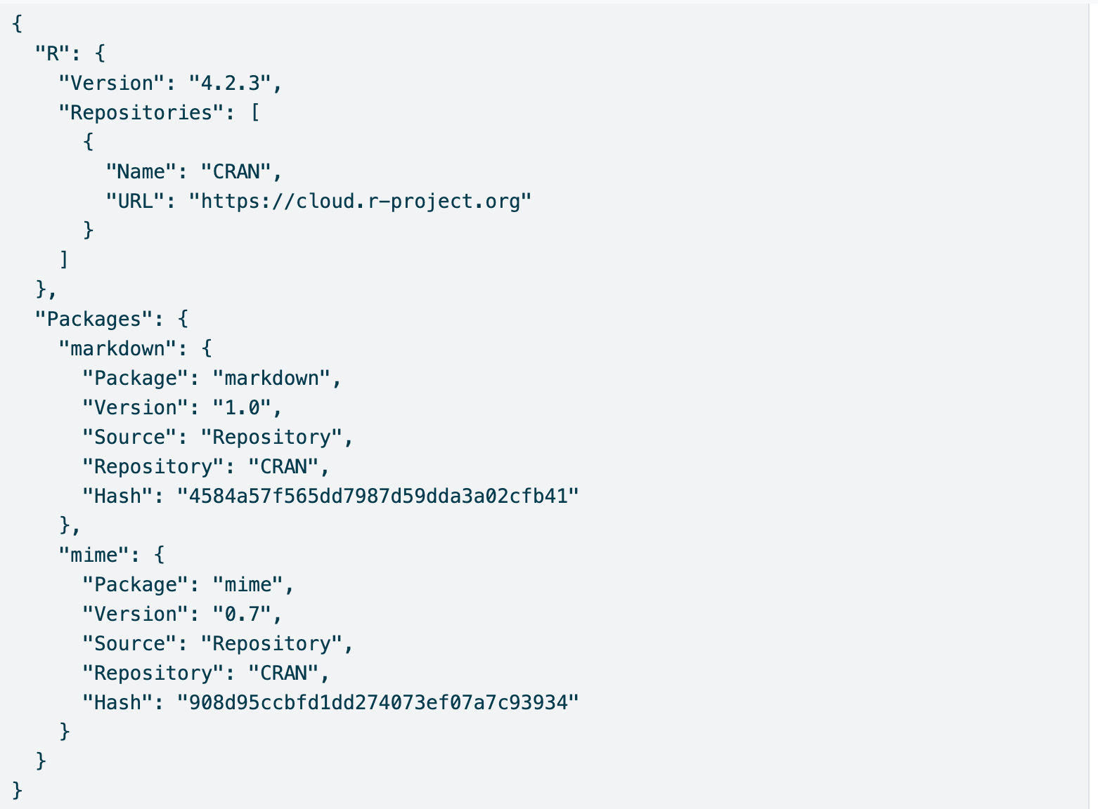
Anatomy of renv.lock file
The version of R used in that project;
The R repositories that were active when the lockfile was created;
Package records defining each R package, their version, and their installation source.
1
2
3
3

Slide 38
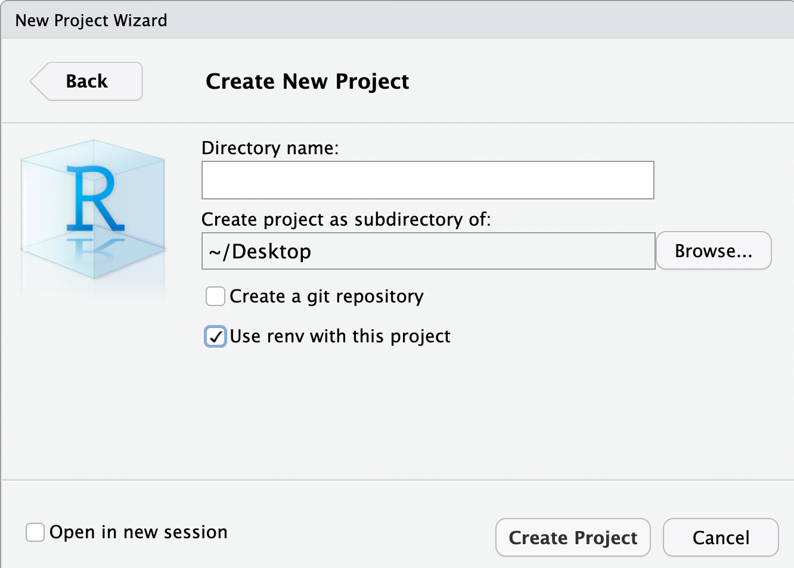
Get it right from the start

Slide 39
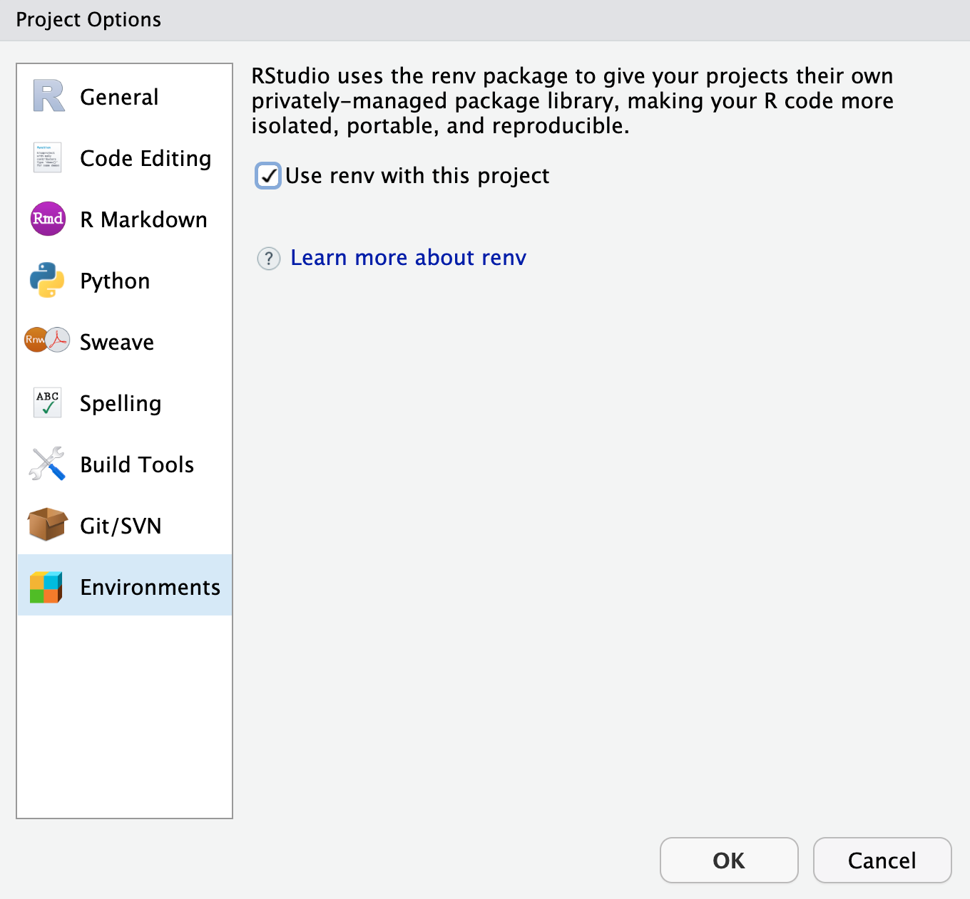
But never too late…

Slide 40
But never too late…
renv::init( )
renv::snapshot( )
renv::restore( )
Initialize a new project-local environment with a private R library
After updates, save the state of the project library to the lockfile (renv.lock)
Restore the state of your project from renv.lock. It examines your project’s R files to determine which packages are used in your project, and will include only those packages (alongside their recursive dependencies) in the lockfile.

Slide 41
Collaborating with RENV
Initialize renv in your project using renv::init( )
Share your project sources, including renv.lock, .Rprofile, and renv/activate.R and ensure that collaborators download and install the right version of renv when starting the project.
When a collaborator opens the project, renv will automatically bootstrap and download the appropriate version of renv.
If updates are made save them with renv::snapshot( )
After that, collaborators can use renv::restore( ) to restore the project library on their machine.

Slide 42
Our turn!
https://github.com/UCSB-Library-Research-Data-Services/bren-meds213-class-data

Slide 43
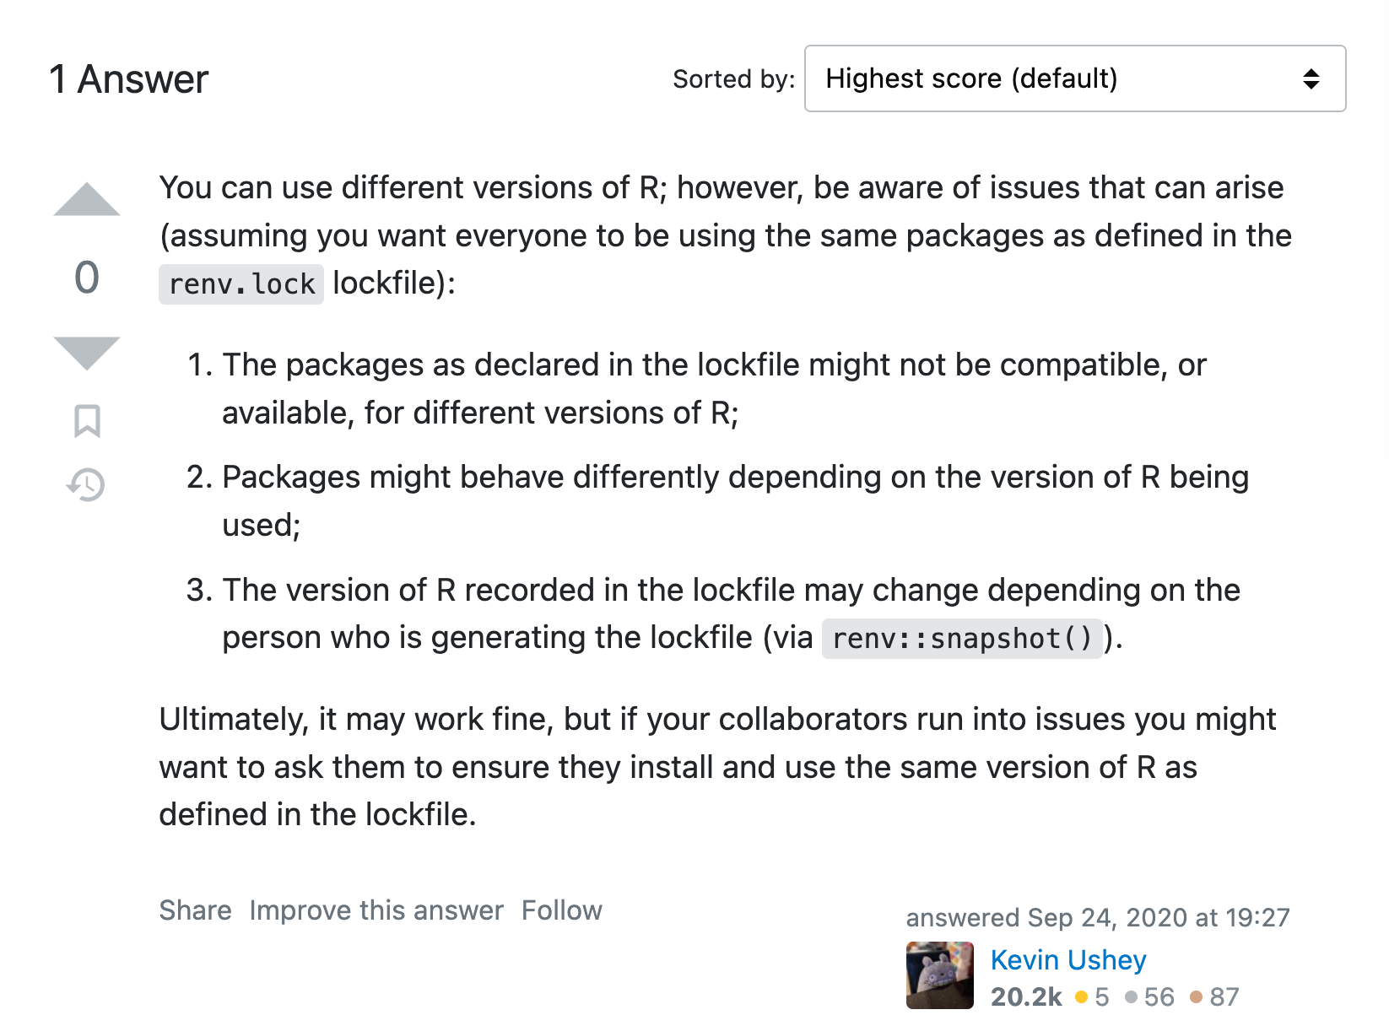
Wait…What if not the same R version?

Slide 44
Another option
Binderize your project
If on repository (GitHub, Fighshare, Zenodo, Dataverse, etc.)
Let others and your future self avoid the dependency hell
Allow anyone access an environment containing your code and data right in the browser

Slide 45
Binderize your project
We need to add two files to the repo:
“runtime.txt” - enter the R version
E.g., r-2023-03-15
“install.R” and contains the list of R packages that need to be installed in order for your script to run.
E.g., install.packages(c(“car”, “effects”, “emmeans”, “igraph”, “lme4, “picante”)
And then:
https://mybinder.org/ To create a badge and include it in the README

Slide 46
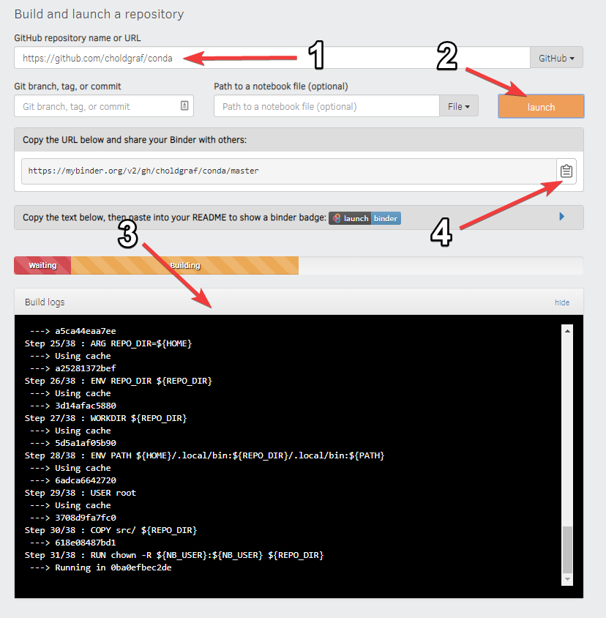

Slide 47
Your turn!

Slide 48
Binder - Limitations
Not for heavy computing
The repository should be public
The repository should not require any personal or sensitive information (such as passwords)

Slide 49
Closing Thoughts
Reproducible and FAIR research require planning and action throughout the project lifecycle. Key components of this process include good organization and documentation.
Strategies to better manage the computational environment include isolating dependencies and creating containers to make your project more portable and reproducible.

