Slide 1
Ethical and Responsible Data Management
EDS213 - Databases & Data Management
Week 2
Renata Curty
Research Data Services, UCSB Library
rds@library.ucsb.edu

Slide 2
Learning Objectives
Understand key ethical and responsible data management principles, focusing on the importance of data documentation, preventing bias and harm, properly handling sensitive data, ownership, and licensing issues.
Apply ethical and responsible data management principles to real-world scenarios.

Slide 3
Common DM Challenges in Environmental Data Science
Manage the variety and heterogeneity of multiple underlying data sources, including achieving interoperability across datasets
Reduce the long tail of science and make data open, accessible and reproducible
Ensure all data are enhanced with appropriate semantic metadata capturing, rich information about the data and important inter-relationships
Record and reason about the veracity and credibility of the data
Find appropriate mechanisms and techniques to support integration of different datasets to enhance scientific discovery, while constraining uncertainty
Blair, G. S., Henrys, P., Leeson, A., Watkins, J., Eastoe, E., Jarvis, S., & Young, P. J. (2019). Data science of the natural environment: a research roadmap. Frontiers in Environmental Science, 7, 121. doi: https://doi.org/10.3389/fenvs.2019.00121

Slide 4
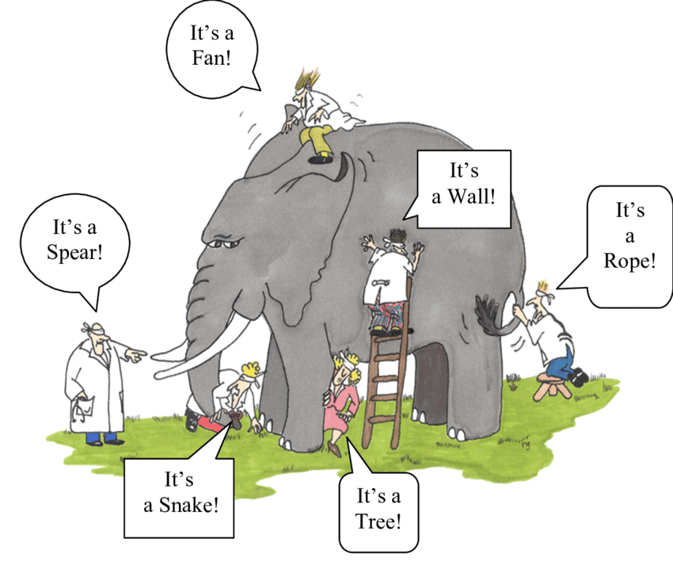
Data Management
Encompasses social, legal and technical aspects
Comprises the gathering, organization, storage, manipulation, access, preservation, and sharing of data
Includes logistics and methods to oversee data
Seeks better efficiency, productivity and reusability
Requires an integrative view of the project and the data lifecycle
Image: Renee Guzlas

Slide 5
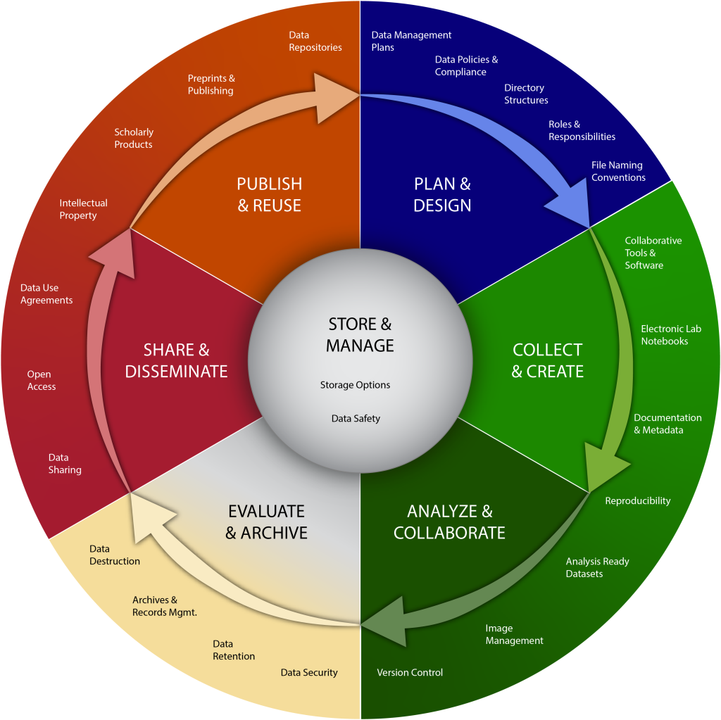
Data
Management
(Lifecycle)
Ethically & Responsibly
Adapted from: LMA Research Data Management Working Group (2023)

Slide 6
Ethics
Standards or agreements of right or wrong, that morally (and often legally), orients behavior. It includes the rights and obligations considering benefits and fairness to society, or virtues of individuals or operations.

Slide 7
Key Guiding Principles
Fairness (diversity, inclusivity, no bias)
Accountability (moral and legal public “answerability” and compliance)
Transparency (understood from the outside)
Privacy/Protection (legal, against unauthorized disclosure)
Integrity (trustworthiness, accuracy and consistency)

Slide 8
Ethical and Responsible Data Management?
Existing norms, standards or understandings about how we should handle data.
Encompasses practices and processes used to collect, store, protect, share, and use data in a way that respects privacy, promotes transparency and accountability, and ensures data accuracy, and reliability.

Slide 9
Examples
Selection: provenance, credibility and fit to purpose
Quality control: accurate, complete, consistent
Storage: the amount of data, required infrastructure
Retention: the length of time data needs to be preserved
Protection/Security: privacy/confidentiality, access restrictions, disclosure agreements
Ownership: legal rights over the data and code, licenses governing them

Slide 10
Roles & Responsibilities
Actor | Role | Responsibilities
Researcher | Data “creator” | Manage data for the life of the project (meet standards) Generate sufficient documentation Share the data (if applicable) Be accountable
Institution | Support researchers | Set internal data management policies/expectations Provide training and advice to researchers for compliance Offer supporting infrastructure
Data Repository | Curation/Access to data | Meet standards for good practice Protect rights of data creators Preserve the data for long-term Provide tools and policies to unable re-use
Re(User) | Secondary data analyst | Abide by license conditions Acknowledge/attribute data creators Manage derived data ethically Reuse data responsibly
Adapted from: Lyon, L. (2007). Dealing with data: Roles, rights, responsibilities and relationships. Consultancy Report. UKOLN. https://purehost.bath.ac.uk/ws/portalfiles/portal/419529/dealing_with_data_report-final.pdf

Slide 11
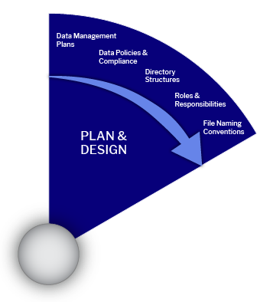
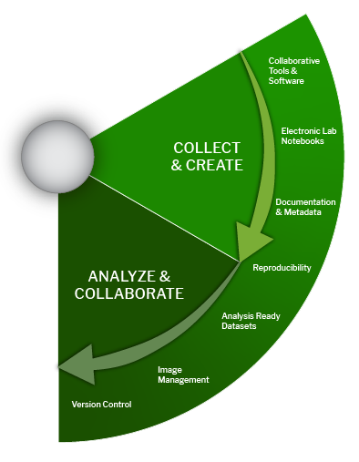
Potential DM Ethical Issues
PLAN & DESIGN
COLLECT & CREATE
ANALYZE & COLLABORATE
Causing or Perpetuating Harm or Injustice
Negative direct or indirect impact on individuals, groups or communities due to the lack of diversity and representation, existence of bias (unjustifiable concentration on a particular side), or unfairness (discriminating treatment of data and people) present in the data.
Ethically & Responsibly

Slide 12
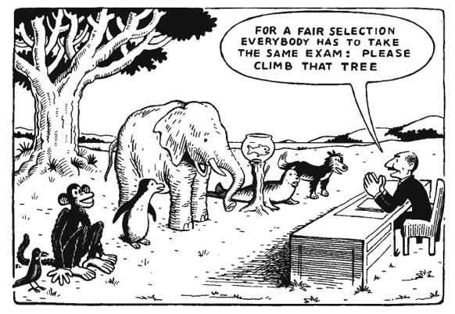
Fairness vs. Bias
Sorry girls, but we chose to include only males in our final test cause they are stronger.
Whoever climbs that tree passes the final test.
Fairness is the concept of impartiality, treating all people equally, and in a way that is reasonably right.
Bias can undermine fairness by introducing unfair treatment or decisions, but eliminating bias does not necessarily guarantee fairness.
Cartoon adapted from: Traxler (1976), “Climb that tree”

Slide 13
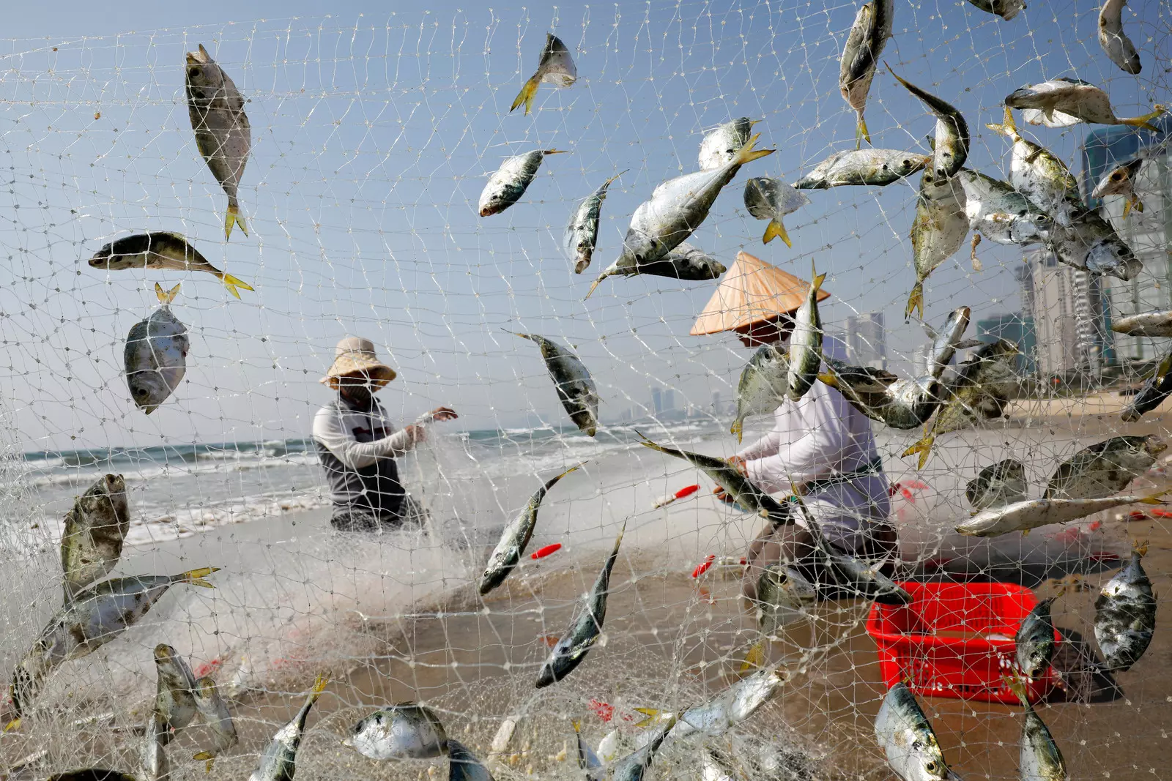
Example: Local Fishing Communities
Bycatch and overfishing prevention
New fishing methods and technology using hydroacoustic sensors, sonar and ML technology
Social and economic impacts on local fishing communities (opportunities and challenges for compliance)
Involve communities in the regulation debate
Minimize power imbalances
https://www.weforum.org/agenda/2020/11/overfishing-sustainable-technology-innovation

Slide 14
How data can magnify power imbalances?
“We can begin by asking what motivates environmental data collection. One aspect of Earth systems data that has potential to introduce bias is that data can be expensive to collect. That tends to mean that access to money drives when and where data collection happens. Even the recent trend in “citizen science” projects often favors participants with access to resources and, of course, access to scientists. The data that winds up being collected often reflects the priorities of those groups. It is in some ways a capital-driven model.”
Record, N., & Vera, L. (2021). Uncovering big data bias in sustainability science. Spire: the Maine journal of conservation and sustainability. https://umaine.edu/spire/category/spire-2021-issue/

Slide 15
Bias and Unfairness in ML/AI Research
The lack of discussion of potential harms especially with contentious application areas
Motivation often appealing to the needs of the ML research community and rarely focused on societal benefits
Omission of negative potentials and lack of documentation of shortcomings and limitations on data and data models
Efficiency often indicate the ability to scale up, not to save resources
Methods and technical novelty are most highly valued
Birhane, A., Kalluri, P., Card, D., Agnew, W., Dotan, R., & Bao, M. (2022, June). The values encoded in machine learning research. In 2022 ACM Conference on Fairness, Accountability, and Transparency (pp. 173-184). https://doi.org/10.1145/3531146.3533083

Slide 16
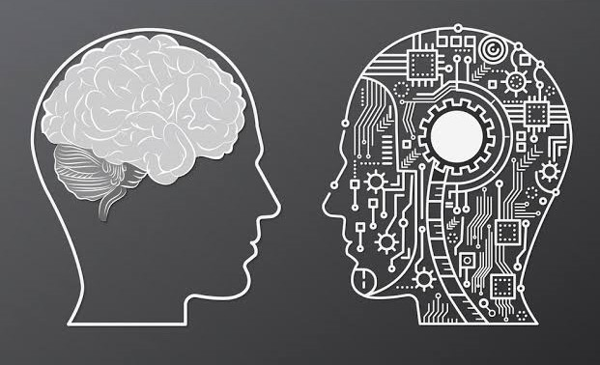
Whose Problem?
Fairness isn’t a technical problem, it’s an ethical and social issue first.
…And so is bias!
Van Zeeland, J. (Dec. 3, 2020). Fairness isn’t an AI problem: it is ours. https://towardsdatascience.com/fairness-isnt-an-ai-problem-5599510a2c2f

Slide 17
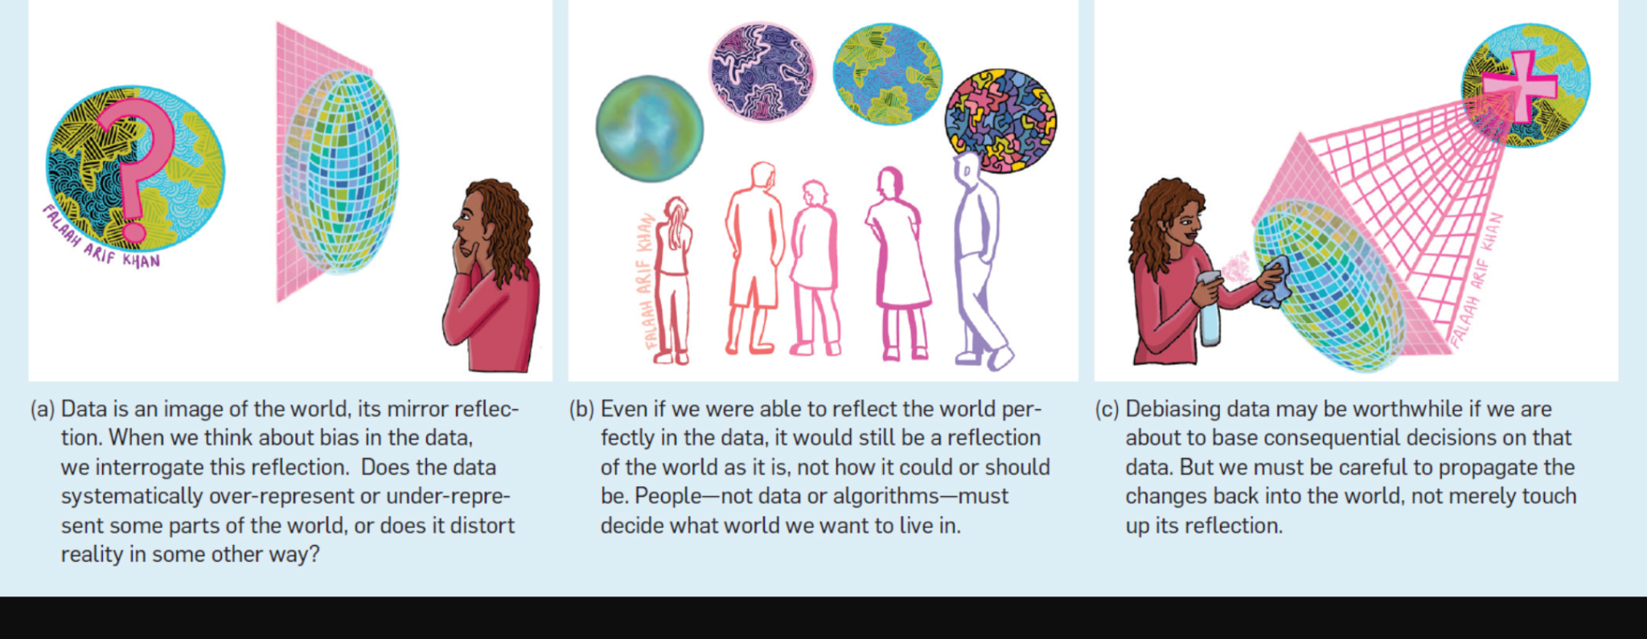
Responsible & Ethical DM
Debiasing data
Stoyanovich, J., Abiteboul, S., Howe, B., Jagadish, H. V., & Schelter, S. (2022). Responsible Data Management. Communication of the ACM, June 2022, Vol. 65 No. 6, Pages 64-74. https://doi.org/10.1145/3488717

Slide 18
Potential Ethical Issues
PLAN & DESIGN
COLLECT & CREATE
ANALYZE & COLLABORATE
EVALUATE & ARCHIVE
SHARE AND DISSEMINATE
PUBLISH & REUSE
Mishandling Sensitive Data
Responsible handling of sensitive data is crucial in protecting privacy and confidentiality and preventing unauthorized access to data. Mishandling sensitive data can result in serious consequences, such as financial loss, lack of trust, retraction, and legal liabilities. Individuals and organizations must maintain trust by safeguarding sensitive data and complying with policies and regulations. By implementing strong security measures, such as encryption and access controls, de-identification and anonymization techniques and regularly reviewing and updating policies, we can ensure that sensitive data is treated ethically and responsibly.
Ethically & Responsibly

Slide 19
Sensitive Data
Any human subject data that can potentially disclose people’s identity and damage individual or collective reputations, rights, or best interests.
It also includes data, which, if disclosed without precaution, may infringe upon ethical agreements and threaten the ownership, representation, and existence of vulnerable communities, protected lands and species.

Slide 20
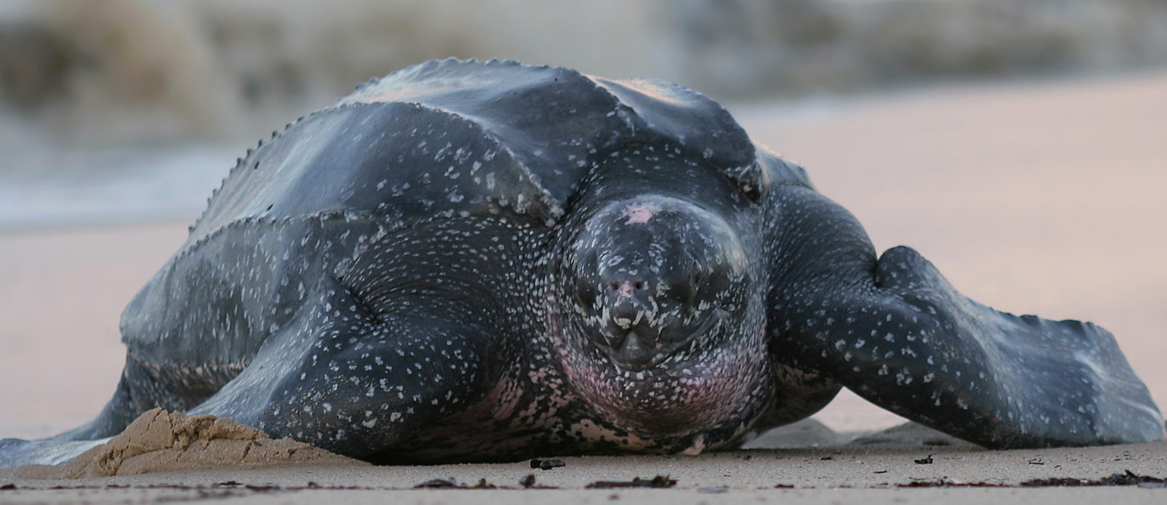
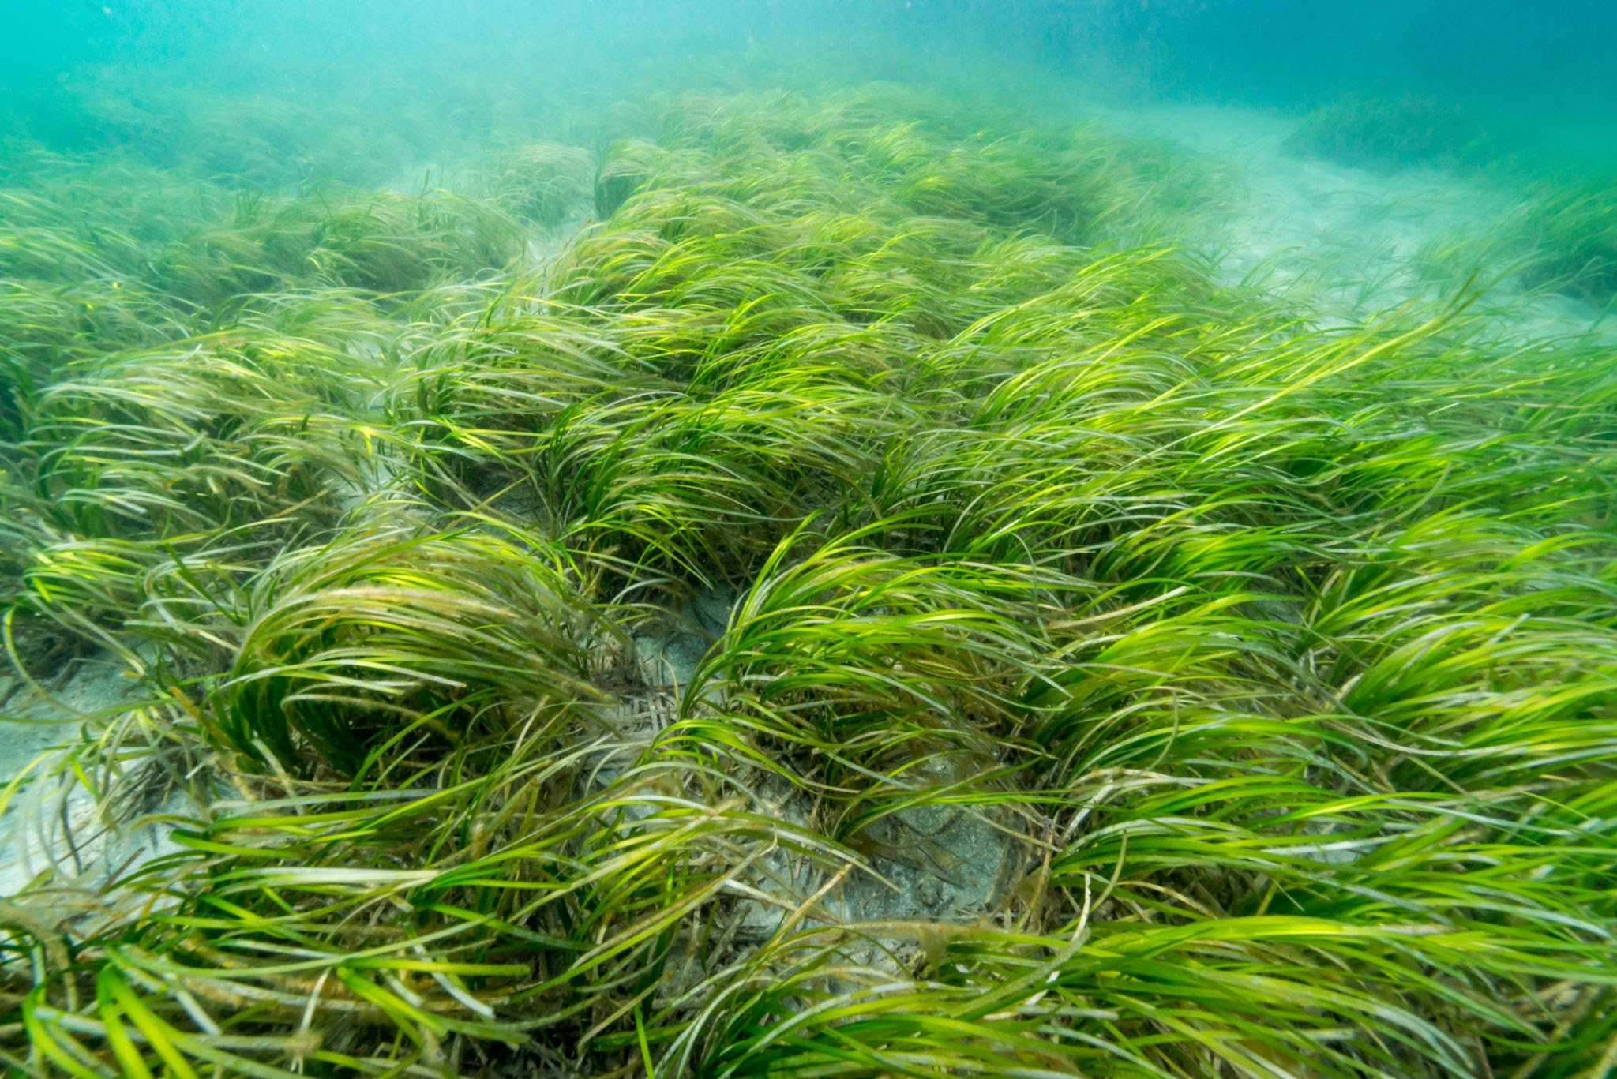
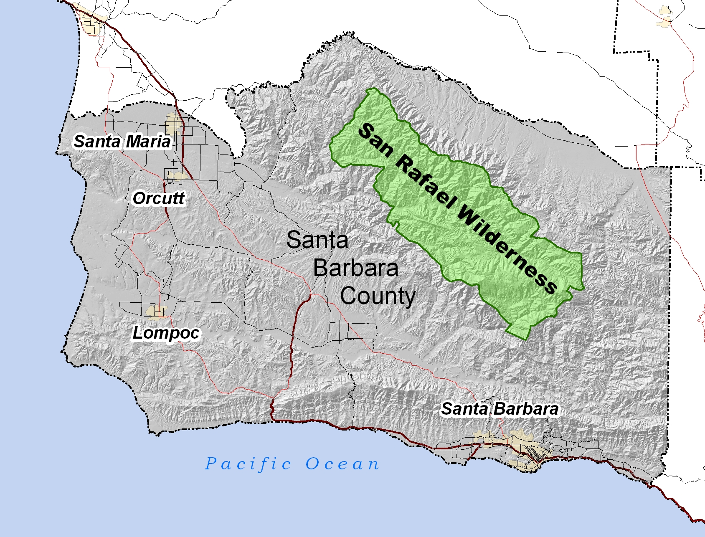
Endangered Species
Threatened or Commercially Exploited Plants
Protected Research Sites
Sensitive Data - Beyond Human Subjects!
Four levels of sensitivity (extreme to low) according to biological significance and exploitation threat.
Key recommendations:
Generalize the spatial locality or geographic coordinates.
Do not apply randomization!
Leatherback Turtle
Eelgrass
US. Fishery and Wildlife Service
Endangered Species Library
USGS - PAD-US
Terrestrial and Marine Protected Areas
Chapman AD (2020). Current Best Practices for Generalizing Sensitive Species Occurrence Data. Copenhagen: GBIF. https://doi.org/10.15468/doc-5jp4-5g10

Slide 21
Sensitive Data Management
Successful long-term management and sharing of sensitive environmental data requires:
Consistency
Trust (all parties involved)
Risk management
Clear policies and shared practices
Desire to share the best available data

Slide 22
Data De-identification & Anonymization
The process which removes direct and indirect (quasi) identifiers from data to mitigate privacy risks, while allowing data to be safely shared and reused.
How?
Wait for week 8!
Statistical Disclosure Control R Package SDC-micro

Slide 23
Recommended Approaches
Only collect/keep sensitive data if strictly necessary
Classify datasets according to their level of sensitiveness
Define security parameters for data access and control
Implement data de-identification and anonymization techniques while assessing information loss and risk for re-identification
Set guidelines for data retention and archival period
Establish Data Use Agreements (DUA) to specify use restrictions

Slide 24
What if anonymization is impossible?
Obtain consent
Regulate or restrict access

Slide 25
Open | Safeguarded | Controlled
Levels

Slide 26
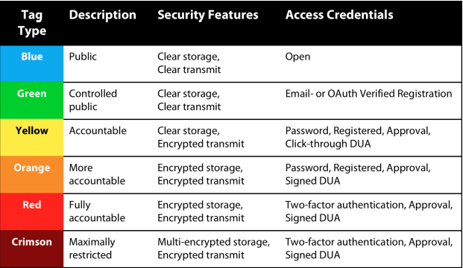
Data Access Restrictions
Sweeney L., Crosas M., Bar-Sinai M. (2015) Sharing Sensitive Data with Confidence: The DataTags System. Technology Science. http://techscience.org/a/2015101601

Slide 27
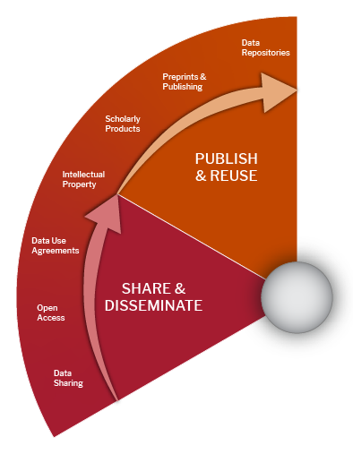
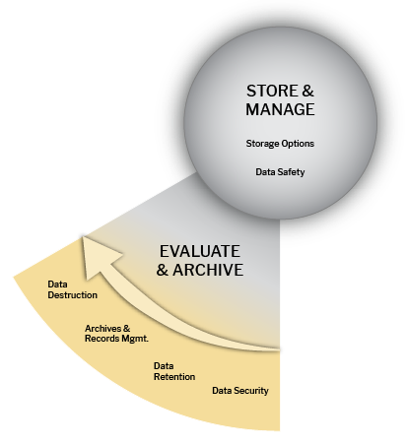
Potential Ethical Issues
COLLECT & CREATE
ANALYZE & COLLABORATE
EVALUATE & ARCHIVE
SHARE AND DISSEMINATE/PUBLISH & REUSE
Infringing rights and licensing
If you are using data that have been collected from another source, it’s important that you know from the beginning if there are any restrictions on how you can use and share the data. When generating new or derivative data you also have to make an informed decision about the licenses, roles and responsibilities and rights governing the data.
Ethically & Responsibly

Slide 28
Ownership & Licensing Restrictions
“Through data ownership, data subjects call for the satisfaction of material needs and entitlements, and thus articulate and negotiate claims on the redistribution of resources. And for social beings for whom a fulfilled life depends on intersubjective prerequisites, data ownership further encodes expectations and demands on the recognition of proclaimed data owners. Both of these spheres need to be considered to grasp claims related to data ownership, and negotiating them is necessary to facilitate informational self-determination of data subjects.”
Carroll M. W. (2015). Sharing Research Data and Intellectual Property Law: A Primer. PLoS biology, 13(8), e1002235. https://doi.org/10.1371/journal.pbio.1002235

Slide 29
Important points
In the U.S., facts by themselves are not protected by copyright. Therefore, data, are not protected by U.S. copyright law;
Databases as a whole can be protected by copyright as a compilation, but only under certain conditions.
Only sufficiently creative and/or original arrangement or selection of data can be protected as a compilation by copyright, the factual content will not be.
Legal protection for data may vary by national jurisdiction. When working with international partners or data providers, you should verify the legislation.
Leaving your dataset unlicensed creates uncertainty about the use and re-use of your data. So, an explicit license is recommended, even if CC BY 4.0.
Hummel, P., Braun, M., & Dabrock, P. (2021). Own Data? Ethical Reflections on Data Ownership. Philosophy & Technology, 34(3), 545-572. https://doi.org/10.1007/s13347-020-00404-9

Slide 30
Data Use Agreements
DUAs are legally binding agreements established between parties to define how data provided by one party (the “Provider”) can be used by the other party (the “Recipient”).
A DUA can have terms that are important to review carefully including, but not limited to, limitations on who can access the data, whether and how the data can be published in academic writing and how the data must be physically secured and/or accessed.

Slide 31
Recommendations
Always check for licenses and terms and conditions for the data
Having authorized access does not automatically grant you permission to reuse or redistribute data as you wish
Paying for the data does not necessarily grant you permission to reuse the data, share or redistribute the data
Verify existing policies for your organization, data providers, and any partner institutions (international requirements need special attention)

Slide 32
UC Research Data Policy
Principal Investigators are the primary stewards of Research Data. Research Data will be retained by the Principal Investigator of a research project.
The University may take custody of Research Data under certain circumstances, such as where necessary to perform any investigations associated with allegations of research misconduct, litigation, or to ensure continuity of research.
If a project collaborator leave the university, they may take a copy of the data if authorized by the PI. The ownership of the data remains at the university and with the PI.
If the PI leaves the university, the ownership of Research Data may be transferred or licensed to the new institution in accordance with a locally developed process.
https://policy.ucop.edu/doc/2500700/ResearchData

Slide 33
Potential DM Ethical Issues
COLLECT & CREATE
ANALYZE & COLLABORATE
SHARE AND DISSEMINATE
PUBLISH & REUSE
Inability to reproduce/lack of transparency
Poor documentation practices and absence of metadata can make it difficult to determine the accuracy, credibility and validity of the data, and may raise questions about whether the data has been manipulated or fabricated. It also prevents reproducibility and scientific advancement or lead to misuse and misinterpretation.
Ethically & Responsibly

Slide 34
How reusable?
Sampling Point | Sampling Collection | Polluant A | Polluant B | Polluant C
A | Jan. 10 2022 7:00 AM | 999 | 7 | 0.3
B | 10/1/2022 7:00 AM | 6 | 3 | 9
C | 10/1/2022 7:00 AM | 4 | 4 | 5
D | Oct. 1 2022 7:00 AM | 3 | 500 | 4
E | 10/1/2022 7:00 AM | 2 | 6 | 7

Slide 35
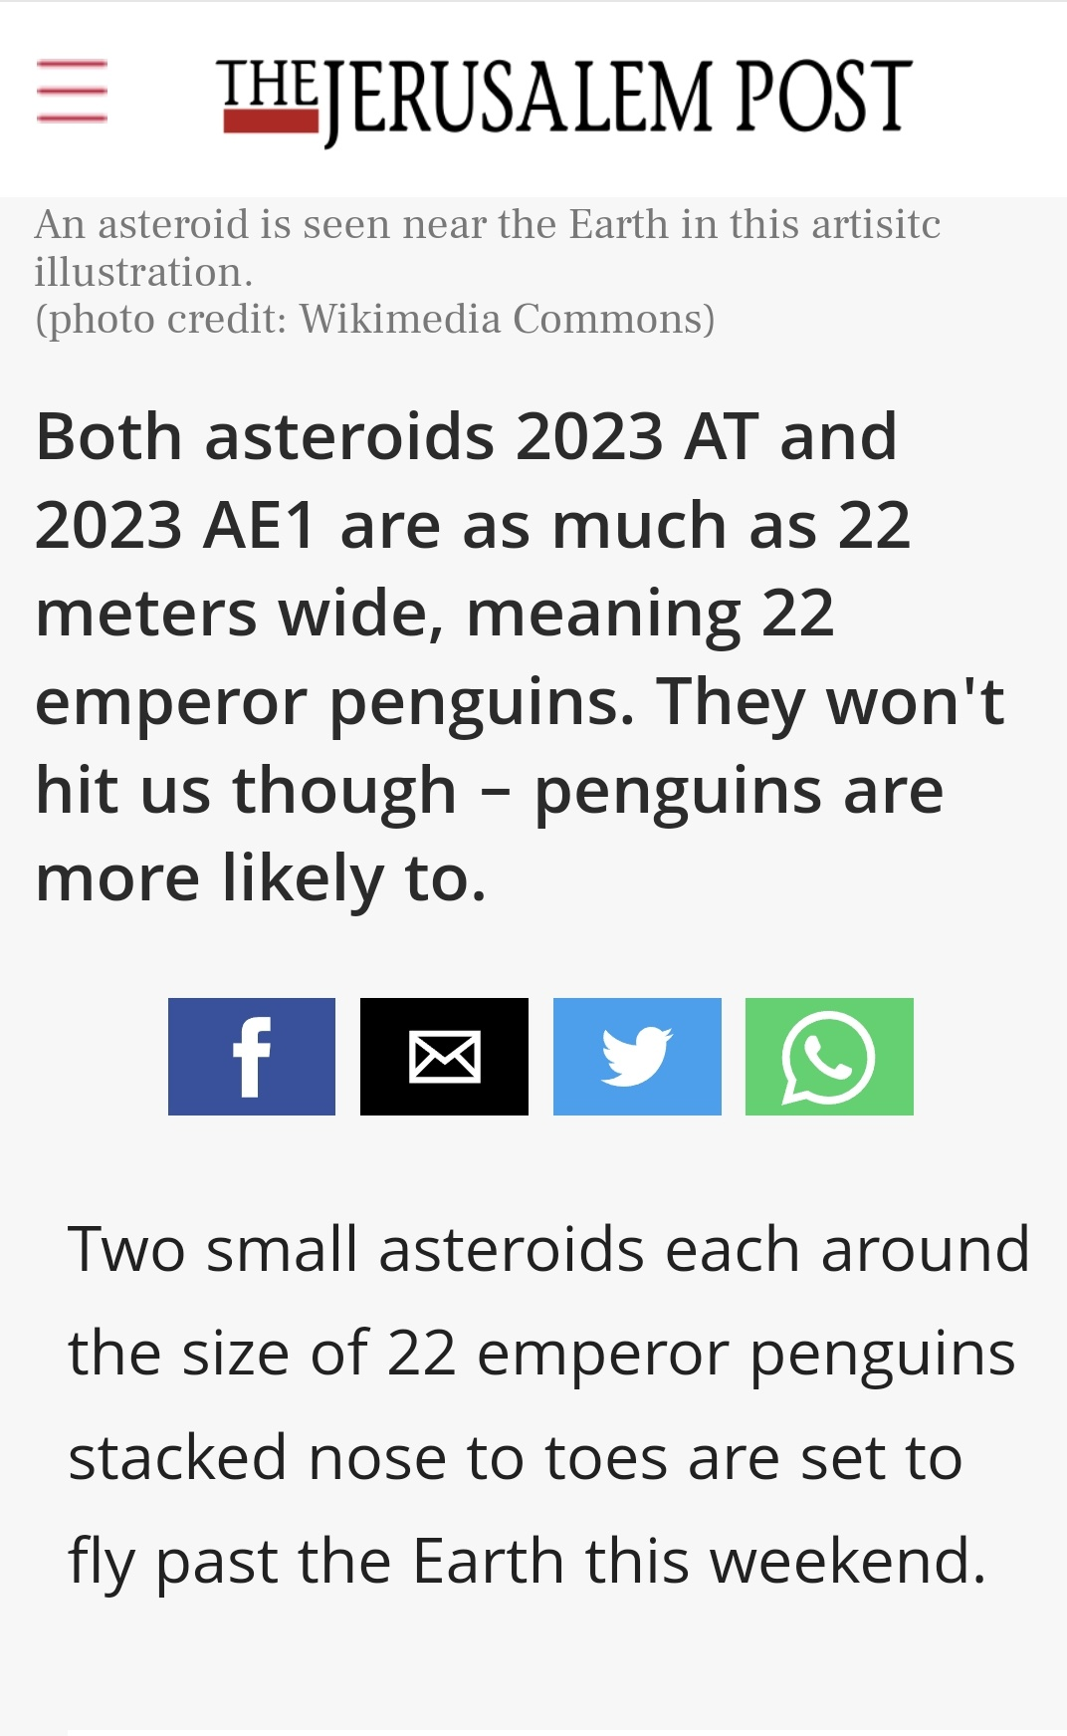
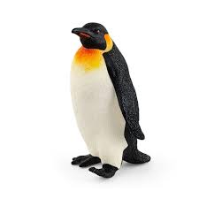
Reminder: Importance of standards
“What ISO number is emperor penguins? Stacked nose to toes, mind you, not side by side. That's a different standard.”
https://twitter.com/Helena_LB/status/1616511815575343127

Slide 36
A Real Scenario
I emailed one of the authors to request the georeferencing projection file to geographically orient the data correctly and allow for re-analysis. The associate author replied to my request stating that “The data were released without geographic coordinates to comply with regulations and protect the sites. We believed any statistical analysis could be replicated this way. We do hope one day to be able to share the full LiDAR (Light Detection and Ranging) dataset.”
I then followed up with another email questioning the value of the data without georeferencing and that the distribution of settlement and its relationship to soil and vegetation was important to my study and required georeferenced data that was shared in Dryad. The author recognized the limitations of replication based on the provided data and once again stated that the data were released without geographic coordinates to comply with regulations and protect the sites. He ended his email saying he hopes to be able to share the full dataset in the future.

Slide 37
Recapping
Responsible data management involves incorporating ethical and legal considerations across the lifecycle of data collection, analysis and use in all data-intensive systems, whether they involve AI/ML or not
Any assumed or verified sources of distortion must be explicitly acknowledged and followed by strategies to mitigate them
As data managers, we must protect vulnerable populations, marginalized communities, endangered species and protected sites
When reusing someone else's data, we should observe existing licenses and terms and conditions
Decisions during data collection, preparation and data modelling greatly impact the robustness and interpretability of data intensive systems
We must consider early in the life cycles stages strategies to improve data quality, produce detailed documentation, control for bias, and allow for transparency

Slide 38
Readings
Bote & Termens (2019) - Reuse of Pre-existing Data
Technical
Findability and Accessibility
Interoperability
Documentation/Metadata
Ethical
Trustworthiness
Consent
Privacy/Protection
Ownership

Slide 39
Readings
McGovern et al. (2022) - AI/ML Problems
Data from observations are not immune to bias
AI also inherits subjectiveness
Coded bias
“Garbage in, garbage out”
Need for better standard practices to document AI models and data shortcomings
Issues related to training data:
Non-representative training data (geographic or temporal biases)
Training labels are biased or faulty (human or sensor-generated datasets)
Data are affected by adversaries (human or weather)

Slide 40
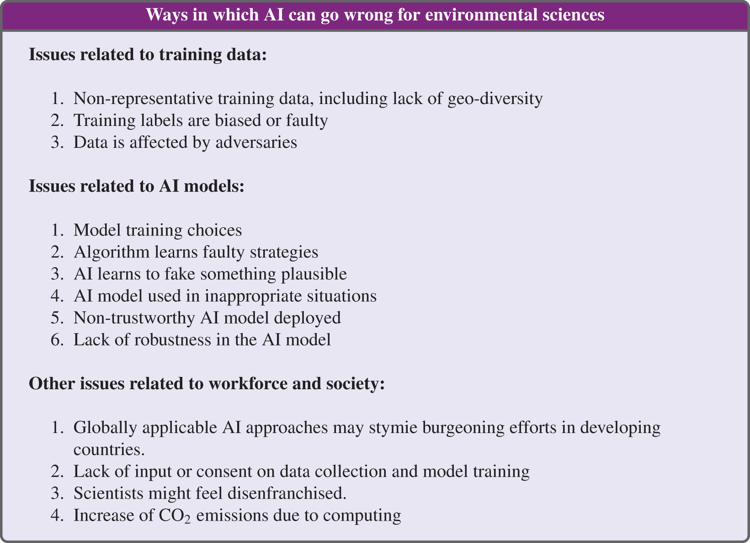
Readings
McGovern et al. (2022)

Slide 41
Guiding Questions
Boté and Térmens (2019) present some technical and ethical challenges researchers may face when using pre-existing data. Based on the lecture and our group discussion on day 3, in what ways do you think the technical challenges highlighted in this paper can also have ethical implications?
Can you think of ways some of the ethical concerns presented by Boté and Térmens (2019) can affect other stages of the data lifecycle other than reuse?
Based on concrete examples, McGovern et al. (2022) discuss how AI and ML can go wrong for environmental sciences. While the community is still grappling with these challenges, what responsible and ethical data management practices could help to minimize such problems?
Reflecting on both settings of readings, can you identify any ethical concerns that resonate with your capstone project? How have you or do you plan to mitigate them?

