Slide 1
Data Licensing
EDS213 - Databases & Data Management
Week 10
Renata Curty & Greg Janée
Research Data Services, UCSB Library
rds@library.ucsb.edu

Slide 2
Learning Objectives
Become familiar with data licensing-related terms and regulations in the academic context.
Distinguish which research deliverables can or cannot be subject to copyright and explore alternatives to that.
Gain an understanding of the Creative Commons license family and the differences in their applicability.

Slide 3
Disclaimer
The legal landscape can be tricky and is constantly evolving
We are not lawyers and can’t provide legal advice
Our work with researchers requires familiarity with some best practices to make more informed decisions

Slide 4
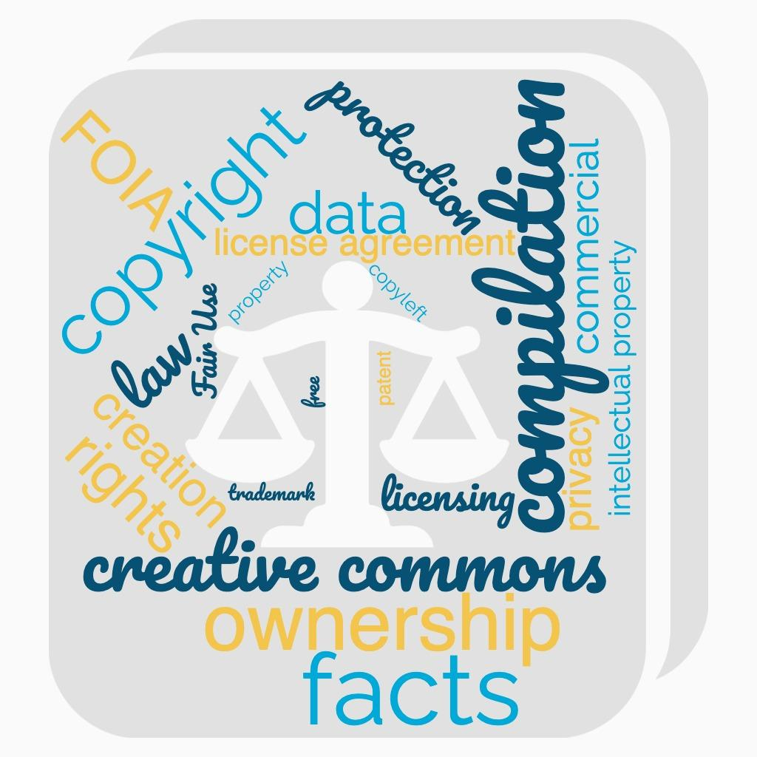
Key Terms
Glossaries:
https://www.copyright.gov/comp3/docs/glossary.pdf
https://wiki.creativecommons.org/wiki/Glossary

Slide 5
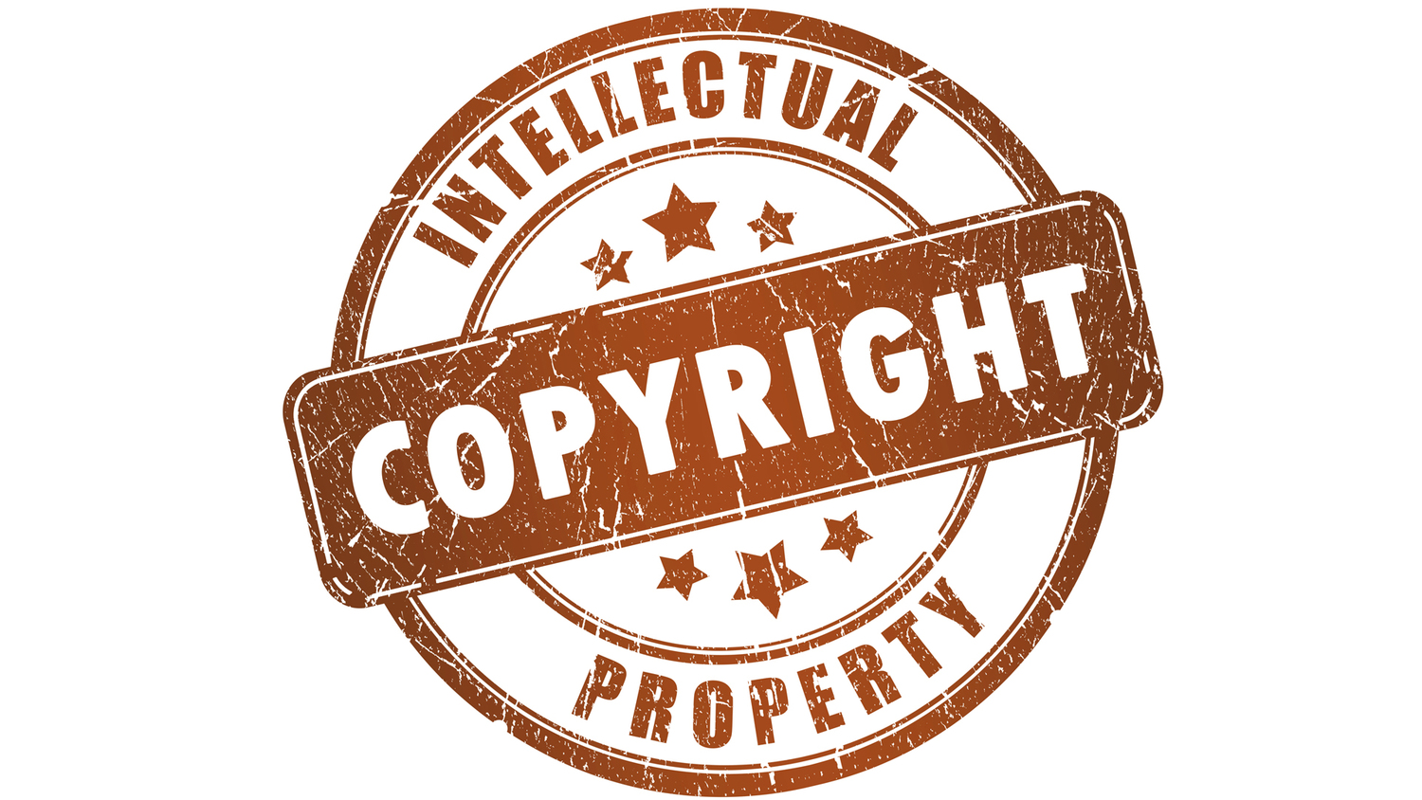
Copyright
Physical and digital artifacts subject to intellectual property law that protects original works so that the author/owner has exclusive rights to reproduce, publicly display, and publicly disseminate their work.
It is one of the types of intellectual property, as there is also trademarks, patents, utility models, etc.
In academic research:
Software
Databases
Dissertations
Books
Papers
Presentations
Data viz…
Unless OA, Commercial publishers retain the copyright
Most OA business models relies on APC charges
How long? 70 years after author's death
https://osc.universityofcalifornia.edu/for-authors/publishing-discounts/

Slide 6
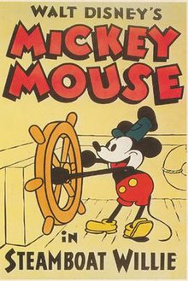
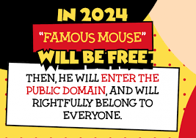
Why that long?
Fantasia
(2036)
Copyright Term Extension Act aka Mickey Mouse Protection Act
!Most Disney characters are trademarked, and trademarks do not have expiration date!
Sonny Bono Copyright Term Extension Act, Title I of Pub. L. No. 105-298, 112 Stat. 2827 (amending chapter 3, Title 17, United States Code, to extend the term of copyright protection for most works to life plus 70 years), enacted October 27, 1998.

Slide 7
2022, a big year for public domain
See: https://news.temple.edu/news/2022-01-24/winnie-pooh-and-hundreds-other-works-are-now-public-domain

Slide 8
Can data be copyrighted?
Generally speaking, data are considered discoverable "facts," not original works in themselves, and are thus not copyrightable.
However…
The methods of compilation, analysis, annotation arrangement, or selection of data, which may be novel, unique, or proprietary, can be protected under copyright.
See: https://www.copyright.gov/title17

Slide 9
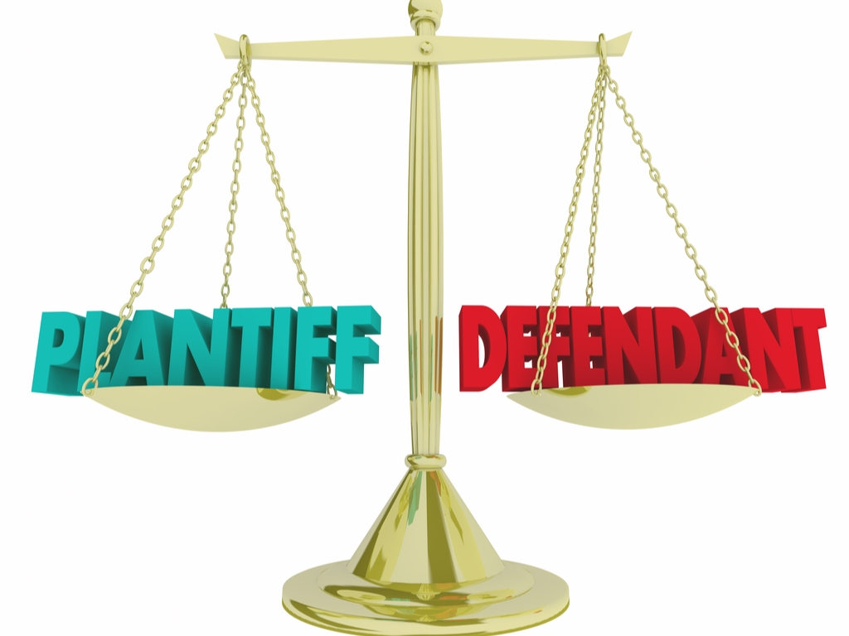
Guess who won this case?
A Landmark decision (1991)
Defendant’s copied plaintiff’s telephone directory (monopoly market) without consent after licensing was denied
Rural Telephone
Service Co.
Feist Publications
Organizing data alphabetically does not constitute enough creativity and originality.

Slide 10
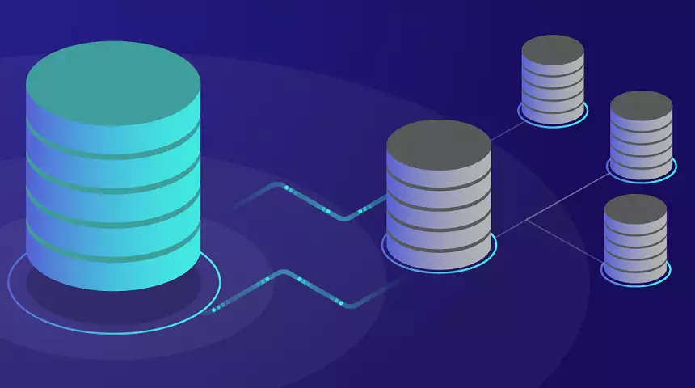
Databases
Databases as a whole can be protected by copyright as a compilation, but only under certain conditions. The first is that mere collection of data is not enough. The arrangement and selection of data must be sufficiently creative or original.
database structure – a literary work, including:
a schema being a table and compilations
a database model (relational or other)
database management system (DBMS) – a computer program.
Accessed solely through an integrated information retrieval program or system that:
Uses a query function to access the content
Yields a subset of the content or organizes the content based on the parameters specified in each query

Slide 11
No separate protection for underlying data
Key points:
While a sufficiently creative and/or original arrangement or selection of data can be protected as a compilation by copyright, the underlying factual content will not be.
What if I curated, combined, transformed, cleaned and wrangled the underlying data? Copyright does not protect hard work, it protects creative and innovative expression, and does not apply to facts.
https://www.bitlaw.com/copyright/database.html
https://www.copyright.gov/reports/db4.pdf

Slide 12
DB Licensing - Alternatives to Copyright
Open Database License (ODbL)
To Share: To copy, distribute and use the database.
To Create: To produce works from the database.
To Adapt: To modify, transform and build upon the database.
Creative Commons (CC)
CC does not recommend use of its NonCommercial (NC) or NoDerivatives (ND) licenses on databases intended for scholarly or scientific use.
https://wiki.creativecommons.org/wiki/data#Can_databases_be_released_under_CC_licenses.3F

Slide 13
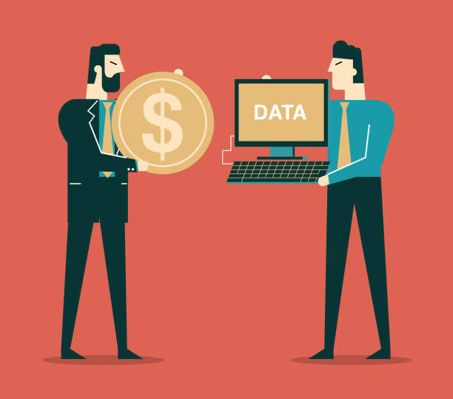
Data Markets
How can datasets be commercialized then?
Creative compilation
Trade secret
Value-added services
Glazer, D., Lebowitz, H., & Greenberg, J. (2017). Data as IP and Data License Agreements. 20(1).

Slide 14
Data License Agreements
A contract between an individual or company and another party when someone wants to gain access and use some type of data. The agreement can include clauses about how to share data with others not involved in the licensing agreement.
License grant
Sublicensing
Derived and usage data Delivery of data
Confidentiality and security
Data controls and audits Disclaimers
Representations and warranties Indemnification
Treatment of data post-termination

Slide 15
What is the purpose of it?
What are the core provisions?
Who is allowed to use the data?
Is the data license exclusive?
Is there any location restriction?
Any privacy and security issues?
What are your rights?
What data quality standards are specified?
What is the term and termination of it?
DLA - Questions you should get answered
https://www.thomsondata.com/article/9-questions-to-answer-before-obtaining-data-from-third-party.php

Slide 16
Federally-funded data?
If not subject to exemptions, should be publicly available.
Drawbacks:
Oversight?
Some publishers accept vague data availability statements “upon request”

Slide 17
FOIA Request
If the information you want is not publicly available, you can submit a FOIA request to the agency's FOIA Office. The request simply must be in writing and reasonably describe the records you seek.
NSF
USGS
NOOA…
https://www.foia.gov/faq.html

Slide 18
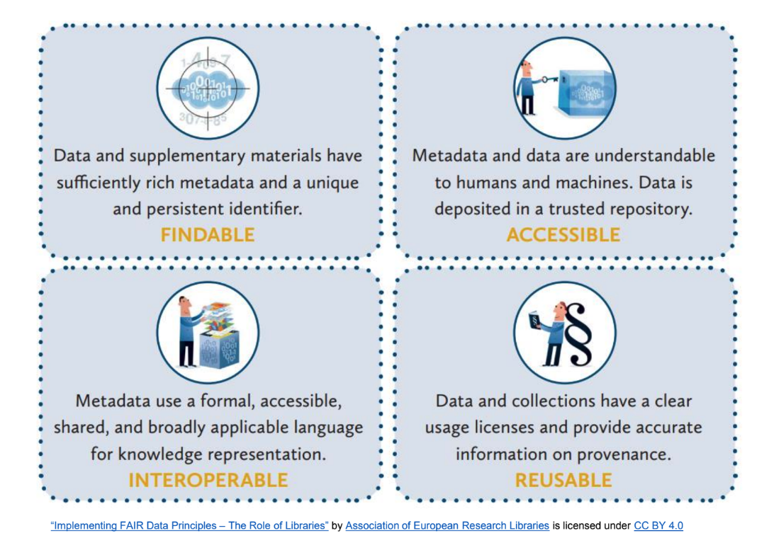
Why license research data and research deliverables?
Eliminate uncertainties
Ensure others will reuse it accordingly
Compliance with funders, publishers or institutions

Slide 19
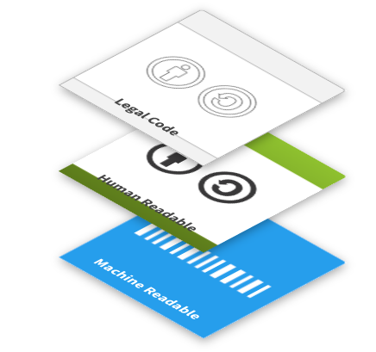
How to license research data and related deliverables?
Three-layer approach:
Legal code that is both human and machine-readable
Free
Widely adopted
X Not designed for software or computer code

Slide 20
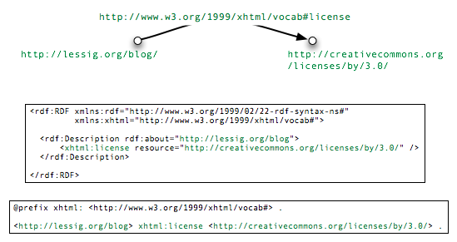

Slide 21
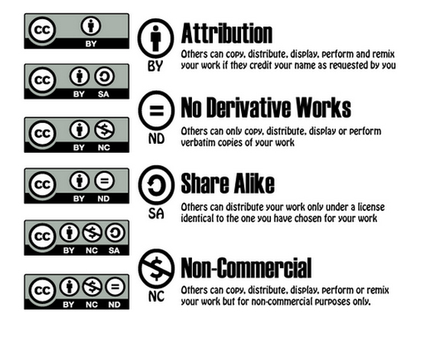
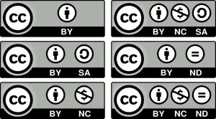
The CC Family
Public Domain

Slide 22
Can you guess what is the recommended CC license for research data?

Slide 23
Your license options are conditioned by the terms of use of your chosen data repository/archive!
Citation/attribution stacking may be problematic in the reuse chain*
Prevents researchers from sharing all their hard work and contributions to a pre-existing dataset
Can be conflicting if reusers aggregate data from multiple sources.
Restricts:
Any financial compensation (e.g., published book)
A paper on a commercial journal
Public-private partnerships
NGOs
See: https://osc.universityofcalifornia.edu/2016/09/cc-by-and-data-not-always-a-good-fit/

Slide 24
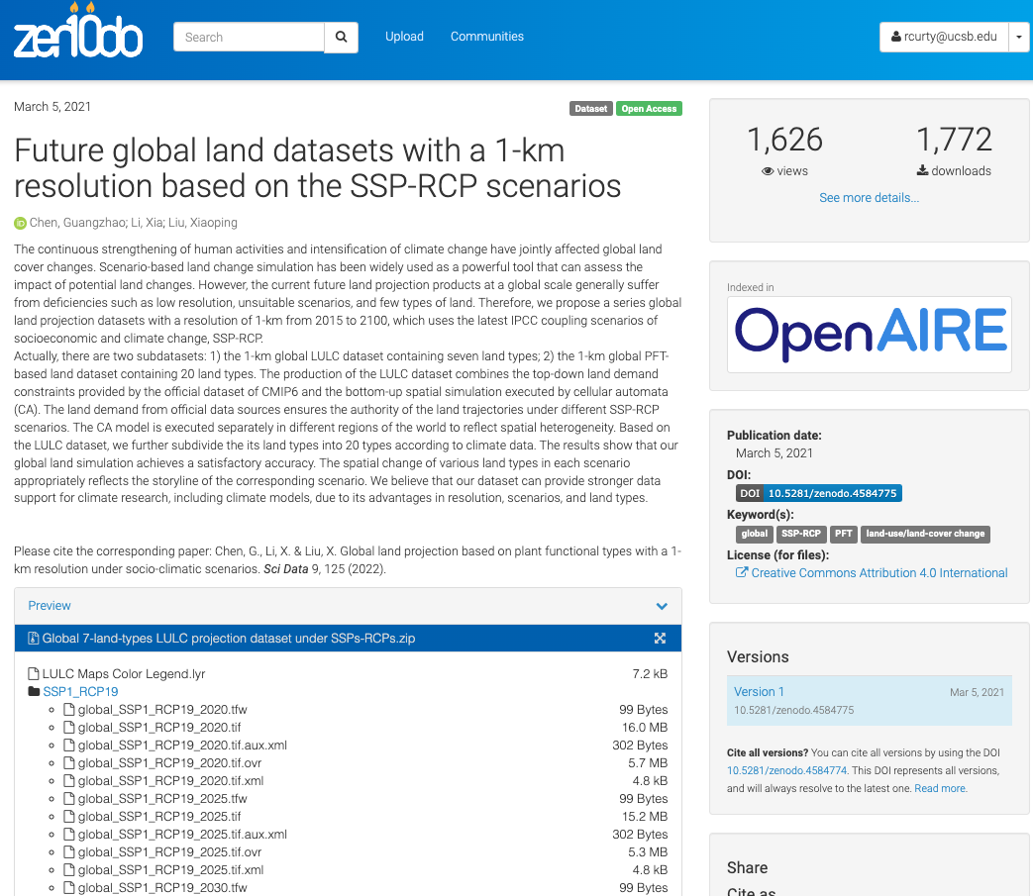
Exemplifying the stacking effect with CC-BY
Could someone share this dataset anywhere else?
Could someone remix and reuse this dataset?
What if some of the reusers share the original dataset in other CC-BY repos?
Re-users may have to cite too many contributors to a dataset, and many source datasets can make attribution difficult. Granularity and the level of work to not require the citation to the original dataset may also be an issue.
See: https://blog.datadryad.org/2023/05/30/good-data-practices-removing-barriers-to-data-reuse-with-cc0-licensing/

Slide 25
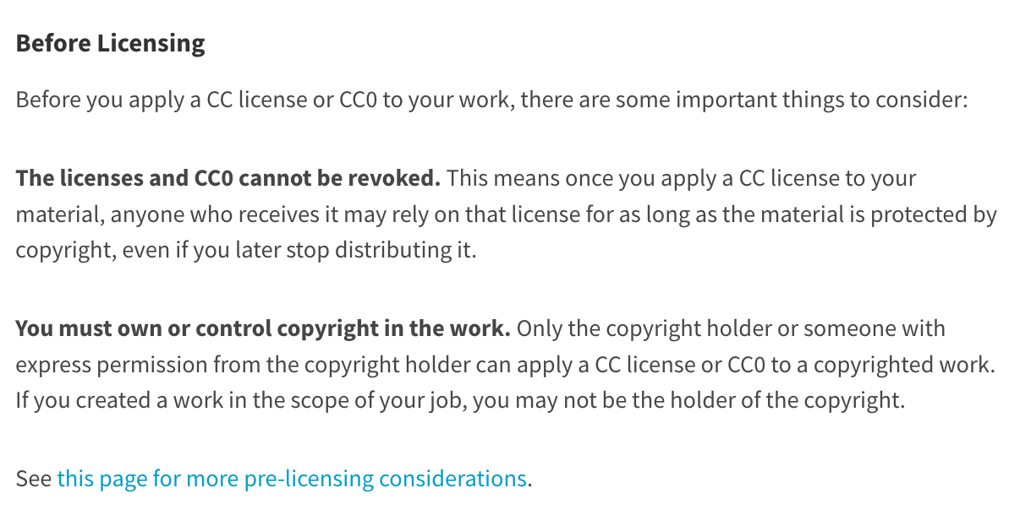
A Source of Confusion (Copyright?)
Creative Commons offers licenses and tools to the public free of charge and does not require that creators or other rights holders register with CC in order to apply a CC license to a work.
See: https://creativecommons.org/about/cclicenses/

Slide 26
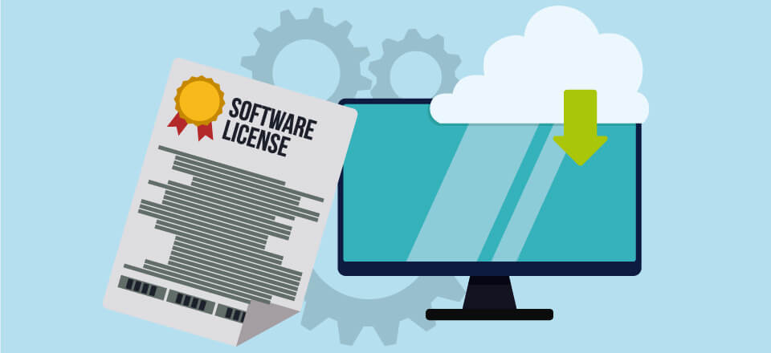
What about software/code?
Not CC!
Consider any constraints
Who owns the rights?
Any third-party restrictions?
Any stakeholder mandate?
Consider your intentions
Allow others to modify and redistribute?
Encourage commercialization?
Require others to release source code of changes they make?
Explore license options
Assess potential license
Michael Jackson. (2018). Software Deposit: How to choose a software licence (1.0). Zenodo. https://doi.org/10.5281/zenodo.1327316

Slide 27
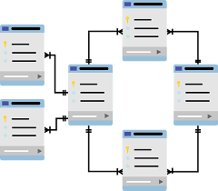
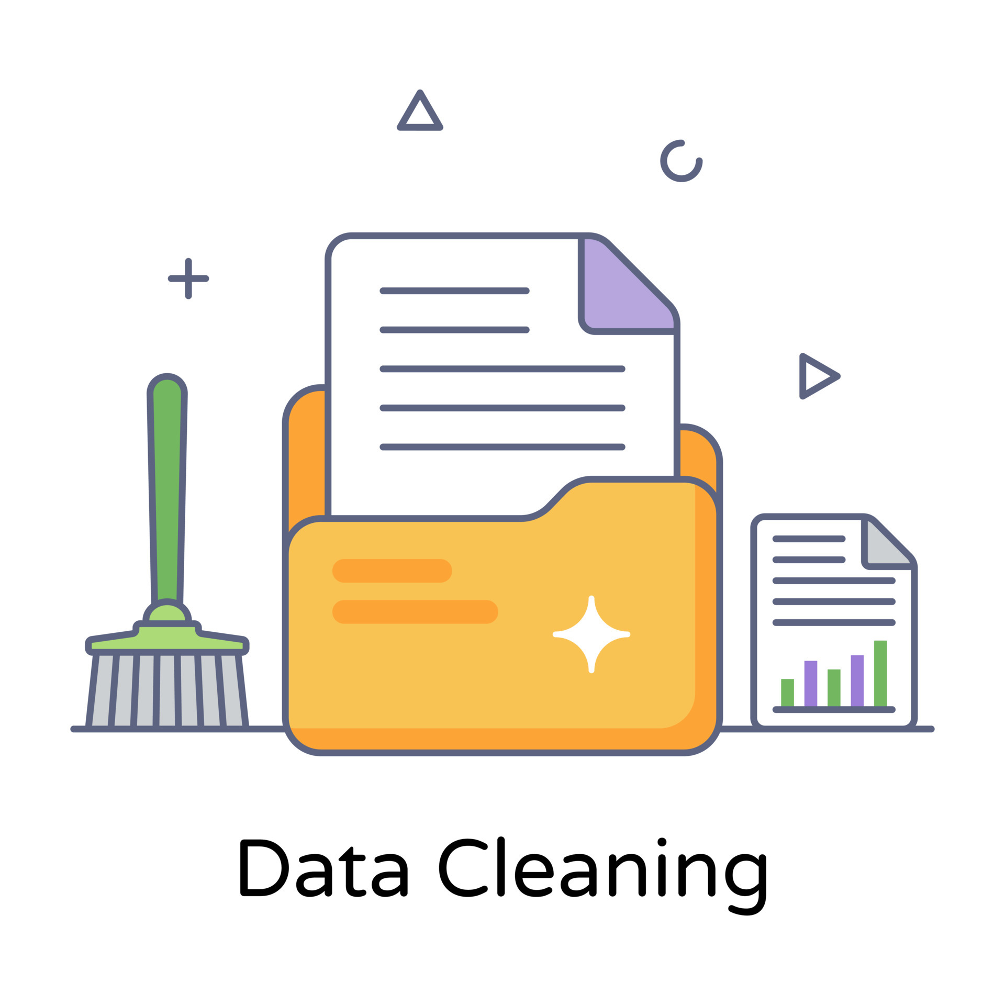
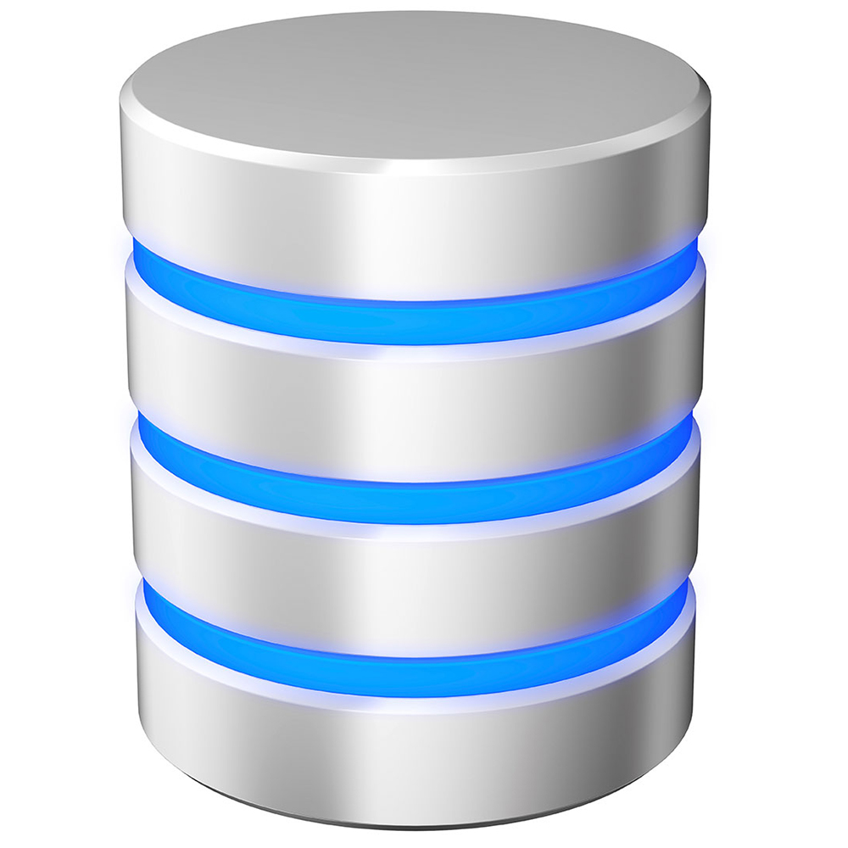
Case 1: The Shorebird Database
Greg discovered a publicly available dataset that served as a valuable resource for the SQL portion of his course. While he only needed a portion of the files included in the data package, he encountered the need for several data transformations and rounds of cleaning to ensure its usability. After successfully refining the data into a clean and organized format, Greg proceeded to establish primary and foreign keys, develop a schema, and create the database.
Now, Greg is contemplating the possibility of licensing the database. Such a move would provide researchers with a more efficient and potent means of interacting with the data, enabling them to execute queries and extract meaningful insights more easily. However, Greg wonders about the legality and potential avenues for licensing the database. In addition, Greg also places great importance on ensuring his decision is ethical. What options are available to him? What would be your recommendations?
data files + documentation
Richard B Lanctot, Stephen Brown, & Brett K Sandercock. (2016). Arctic Shorebird Demographics Network. Arctic Data Center. doi:10.18739/A2222R68W.
Greg’s work

Slide 28
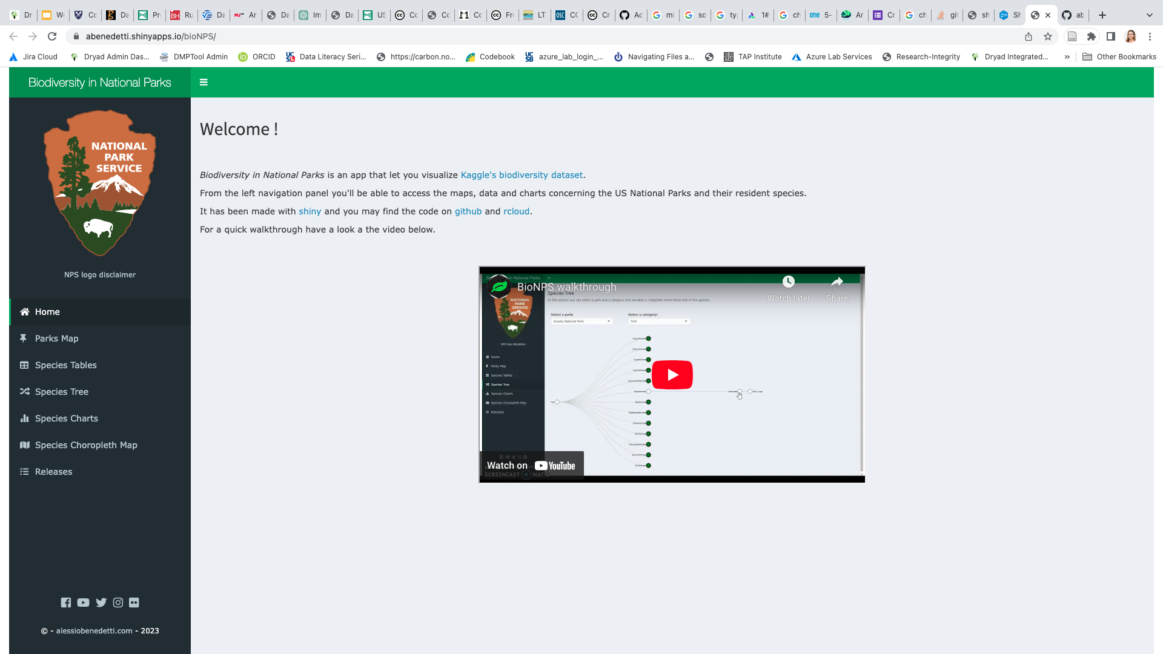
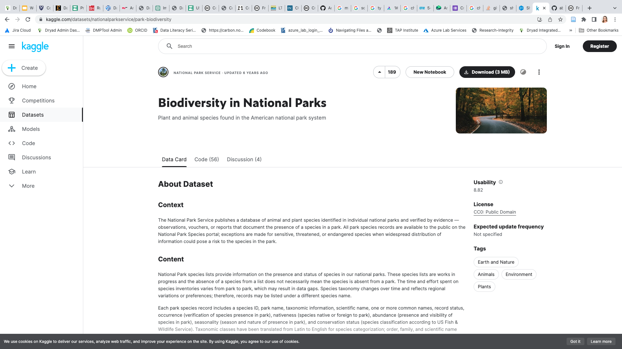
Case 2: This big data of mine, I’m gonna let it Shiny!
An environmental researcher has developed a remarkable Shiny app that effectively visualizes the biodiversity in National Parks. The app utilizes the Biodiversity in National Parks dataset, which is publicly available on Kaggle under the CC0 license. Let's determine which license governs the code and whether it is suitable for reuse. Additionally, we'll examine if any potential issues exist with the researcher's choice of license.
https://github.com/abenedetti/bioNPS

Slide 29
Recapping
Data is copyrightable only as compilations under certain conditions.
Data, databases, and software are considered separate entities.
Not all data can be public domain, but if federally funded and no exemption applied, you can request it.
Data produced can be commercialized under data license agreements. Read them carefully!
Databases and code can be subject to copyright, but in academia, open licenses are more commonly considered.
Creative Commons does not imply copyright filling but is an expansion of the "all rights reserved" idea.
Creative Commons licenses should not be used for software/code.
Many repositories operate under CC0 for data, but attribution is still endorsed.

