Slide 1
Sensitive Data
EDS213 - Databases & Data Management
Week 8-9
Renata Curty & Greg Janée
Research Data Services, UCSB Library
rds@library.ucsb.edu

Slide 2
Learning Objectives
Understand the importance of protecting sensitive data and ensuring privacy and confidentiality.
Identify and evaluate established approaches and techniques for de-identifying and anonymizing data to mitigate the risk of re-identification.
Apply the acquired techniques while utilizing an R package to quantify the information loss and utility.

Slide 3
Sensitive Data
Any data that can potentially disclose and damage individual or collective reputations, rights, or best interests.
Data that, if made public, would result in an adverse effect on a taxon or a living individual or data that may have significant economic implications if disclosed prior to public release.
It also includes data, which, if disclosed without precaution, may infringe upon ethical agreements and threaten the ownership, representation, and existence of vulnerable communities and protected lands.

Slide 4
Why should you care?
Handle sensitive data ethically and responsibly
Maximize data sharing and reuse while preserving privacy and confidentiality
We have tools to support that!

Slide 5
Data Sharing/Withholding
Data and metadata should be placed in a repository, in a secure and retrievable format. However, the push for public archiving does not contradict the need for privacy or sensitivity associated with some datasets.
Most environmental data should be openly accessible upon archiving, with some exceptions (e.g., threatened species, indigenous data sovereignty, etc.)
It is possible to publicly archive most environmental-related data while maintaining access restrictions on when and how the data are accessed, or adopting data de-identification and anonymization techniques.
Bledsoe, E. K., Burant, J. B., Higino, G. T., Roche, D. G., Binning, S. A., Finlay, K., ... & Srivastava, D. S. (2022). Data rescue: saving environmental data from extinction. Proceedings of the Royal Society B, 289(1979), https://doi.org/10.1098/rspb.2022.0938

Slide 6
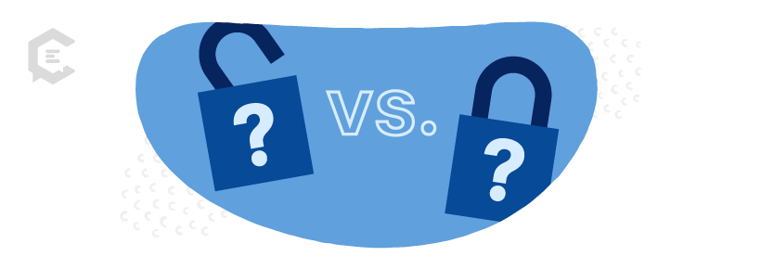
As open as possible, as closed as necessary
Open with no restrictions
Open with access restrictions
Data Use Agreements (confidentiality compliance)
Closed (Metadata Only)

Slide 7
USGS Recommendation
Wherever possible, environmental information should be freely available to all as means to promote awareness, better decision-making and reducing risk of damage.
In a small number of cases, public access to information can result in environmental harm or unfairness (e.g., threatened or endangered species data, and mineral and energy resource data) and availability may need to be restricted or controlled; although the presumption remains in favor of release and any restrictions should be interpreted rigorously.
See: https://www.usgs.gov/data-management/proprietary-and-sensitive-data#proprietary

Slide 8
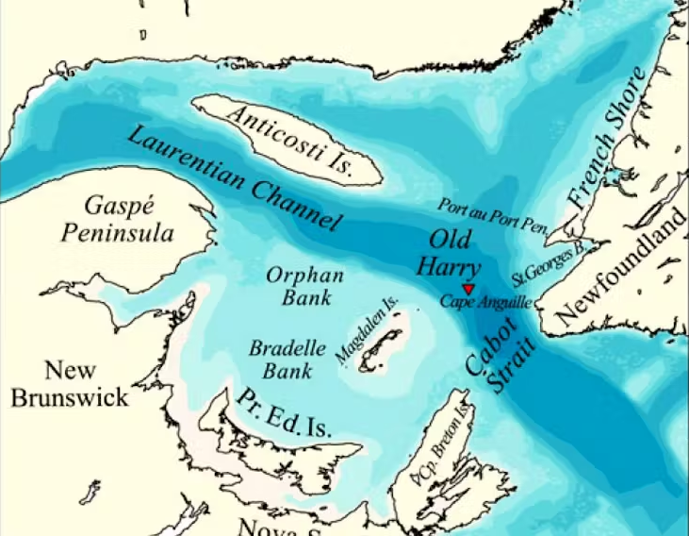
Commercially Sensitive (Proprietary)
We contacted Corridor's management to obtain more information on these seeps. We were informed that they were not allowed to disclose further details because they were constrained by an exclusivity contract with Airbus Defence and Space Company which produced the seeps analyses and sold them to Corridor. In fact, Airbus produced the databases on hydrocarbon seeps in the Gulf as part of a contract granted by Nalcor, an independent provincial corporation with a statutory mandate as agent of the Newfoundland and Labrador provincial government to invest in, engage in, and carry out activities in all areas of the energy sector in the province. We then contacted Airbus and were informed that the data in question were “commercially sensitive” and could not be publicly shared.
Lack of methods used for the analysis or the data to report “six oil seeps have been detected”. What exactly do the terms “commercially sensitive” mean in this context? Sensitive for whom and for what? Why would Corridor disseminate the conclusions if commercially sensitive? Is it to convince governments, investors, and the public that there is a substantial hydrocarbon reserve at Old Harry? Or, even to minimize the impact of accidental spills by arguing that natural leaks already existed?
Daniel Bourgault, Hugo Tremblay, Irene R. Schloss, Steve Plante and Philippe Archambault. “Commercially Sensitive” Environmental Data: A Case Study of Oil Seep Claims for the Old Harry Prospect in the Gulf of St. Lawrence, Canada. Case Studies in the Environment. September 2017, https://doi.org/10.1525/cse.2017.sc.454841

Slide 9
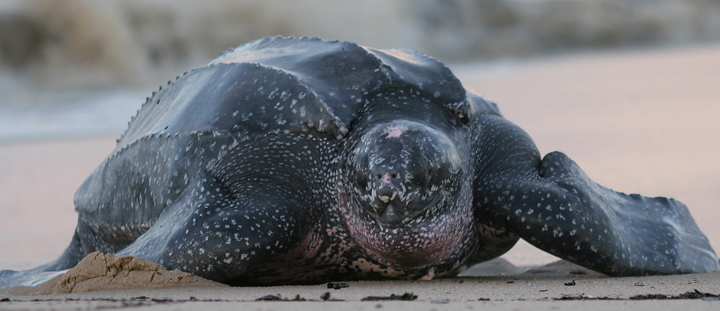
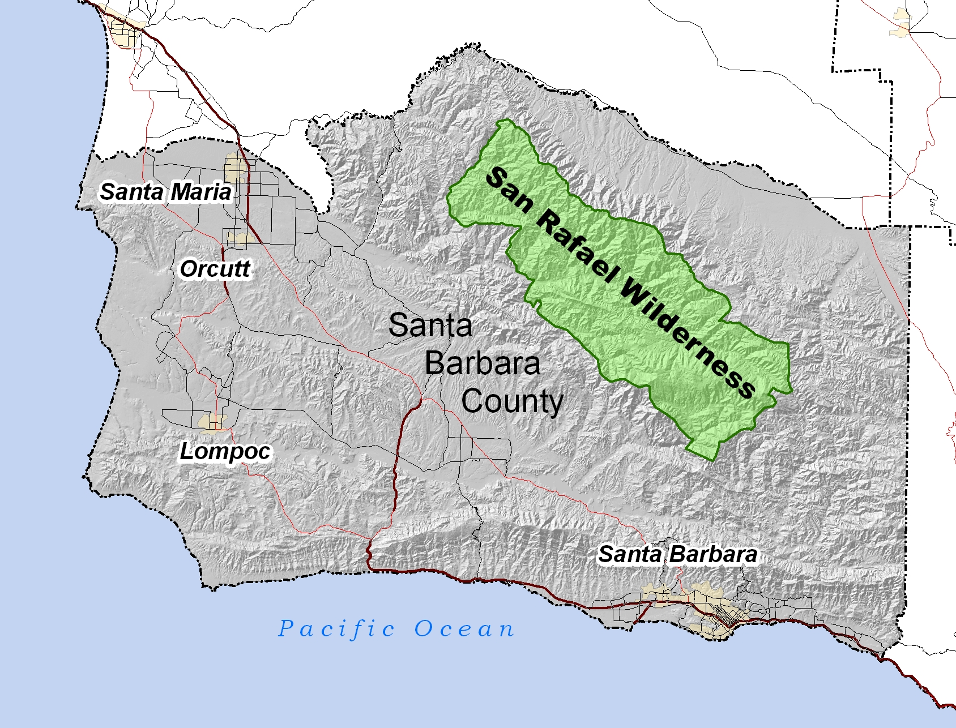
Endangered Species
Threatened or Commercially Exploited Plants
Protected Research Sites
Sensitive Data
Four levels of sensitivity (extreme to low) according to biological significance and exploitation threat.
Key recommendations:
Generalize the spatial locality or geographic coordinates.
Avoid randomization!
Leatherback Turtle
Eelgrass
US. Fishery and Wildlife Service
Endangered Species Library
USGS - PAD-US
Terrestrial and Marine Protected Areas
Chapman AD (2020). Current Best Practices for Generalizing Sensitive Species Occurrence Data. Copenhagen: GBIF. https://doi.org/10.15468/doc-5jp4-5g10

Slide 10
Sensitive Data
Micro Data
Unit-level data obtained from sample surveys, censuses, and administrative systems.
Provide information about characteristics of individual people or entities such as households, business enterprises, facilities, farms or even geographical areas such as villages or towns.

Slide 11
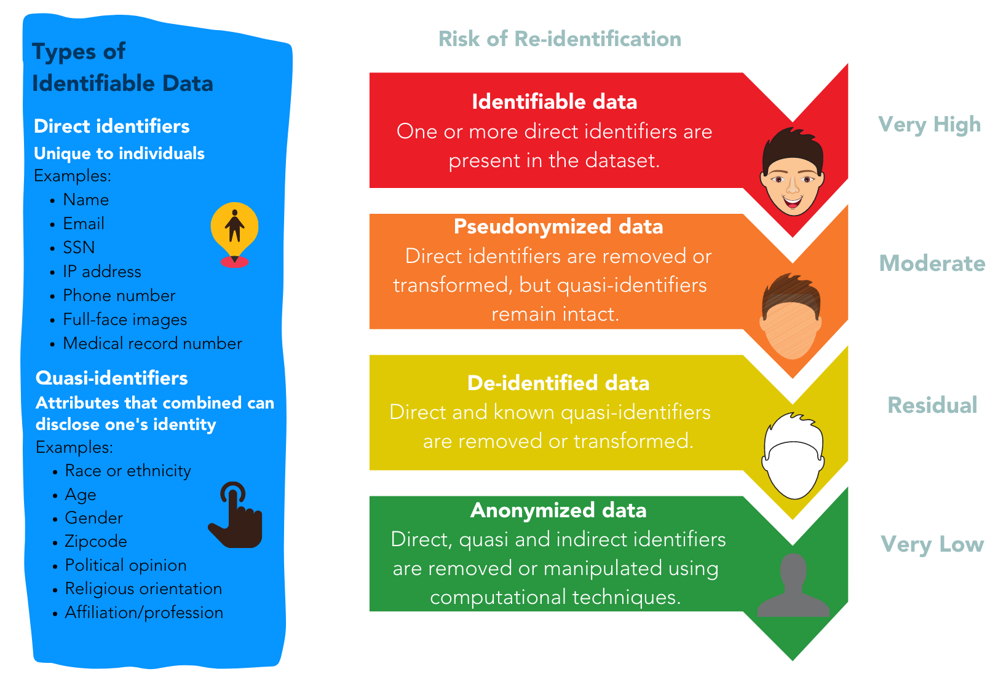
From De-Id to Anonymization
An spectrum throughout the project lifecycle!
See: https://osf.io/7fpmw
Source: https://www.library.ucsb.edu/sites/default/files/dls_n3_dataprivacy_navy_0.pdf

Slide 12
HIPAA (identifiers)
Safe Harbor Methods
Name
Address (all geographic subdivisions smaller than state)
All elements (except years) of dates (e.g., birthdate, admission date, discharge date, date of death)
Telephone numbers
Fax numbers
Email address
Social Security Number
Medical record number
Health plan beneficiary number
Account number
Certificate or license number
Vehicle identifiers
Device identifiers and serial numbers
Web URL
Internet Protocol (IP) Address
Finger or voice print
Photographic image
Any other characteristics that could uniquely identify individuals
Recommended reading: https://doi.org/10.1136/bmj.c181

Slide 13
Techniques to mitigate the risk of unwanted disclosure
If a variable might act as an indirect identifier you may also consider:
Aggregation reducing the precision of the variable or the detail of its characteristics (e.g., remove last 4 digits of a zip code, or recode as county name)
Top and bottom-coding restricting the upper and lower range of a variable. (e.g., income or revenue variables).
Collapsing and/or combining variables merging data recorded in two or more variables into a single category (e.g., tribal, recreational and commercial fisheries -> non-commercial and commercial).
Bracketing/Categorization the process of transforming continuous variables into categorical variables by reporting a variable range rather than its specific value (e.g., number of years in the institution, range of years)
See: https://www.sjsu.edu/research/docs/irb-deidentification-techniques-table.pdf
Recommended reading: https://doi.org/10.1136/bmj.c181

Slide 14
Redaction
(Suppression)
Randomization
(Swapping/Shuffling)
Pseudonymization
(Tokenization/Hashing)
Noising
(Disturbing)
Techniques to mitigate the risk of unwanted disclosure
Removal of identifiers that can put subjects’ identities and privacy at risk.
Data for one or more variables are switched with another record, so that the data does not know whether the real data values correspond to certain records.
Slightly modification of the original dataset by applying techniques that round numbers and add random variation.
Meaningful piece of data are turned into a into an alias or a random string of characters which serves as reference to the original data, but cannot be used to guess those values.
Non-perturbative methods: reduces the detail or precision in the data with no distortion to the data structure
Perturbative methods: creates uncertainty around the true values
Recommended reading: https://doi.org/10.1136/bmj.c181

Slide 15
Other Recommended Measures
Avoid sharing tables with small cell sizes (i.e., fewer than 5 respondents)
Be cautious when slicing the data into small subgroups or small areas
Avoid listings of cases with outliers
Make sure to document the rationale behind the data transforms

Slide 16
NOT as anonymous as you think!
Dr. Latanya Sweeney (k-Anonymity)
~ 90% of the U.S. population could be easily identified by ZIP code, date of birth, and gender, in combination with any secondary health data sold by pharmacies and data analytics companies.

Slide 17
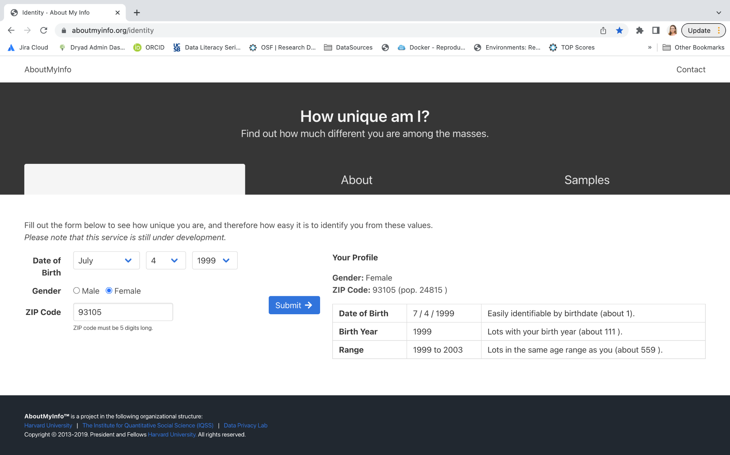
aboutmyinfo.org

Slide 18
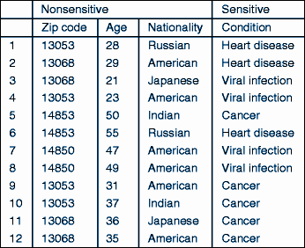
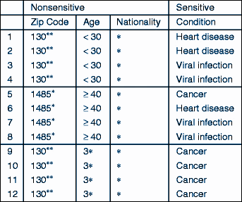
k-Anonymity
RISK ASSESSMENT AND MITIGATION
“Hiding in the crowd”
At least k rows in the dataset sharing the same set of attributes.
* 4-5 / 11-20 “matching cases” are desired depending on access permissions.
Suppression + Global recoding/generalization
Samarati, P., & Sweeney, L. (1998). Protecting privacy when disclosing information: k-anonymity and its enforcement through generalization and suppression. https://dataprivacylab.org/dataprivacy/projects/kanonymity/paper3.pdf

Slide 19
k-Anonymity
Limitations
Yumi, 13068, 21, Japanese
Lower-risk of heart condition
Background Knowledge Attack
Homogeneity Attack
k-anonymity does a very good job ensuring that someone can’t re-identify a specific record.
However, it’s possible to extrapolate sensitive information and violate privacy about a given case without necessarily accessing specific records.

Slide 20
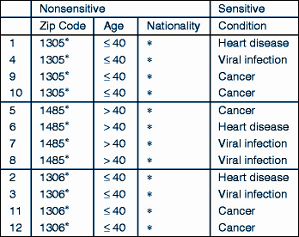
l-Diversity
An extended privacy property that measures the diversity of sensitive values within each column of a dataset.
For any group of rows with identical quasi-identifiers, there must be at least l distinct values for each sensitive attribute.
Makes it harder to identify specific sensitive values associated with individuals or smaller groups within the dataset.
Machanavajjhala, A., Kifer, D., Gehrke, J., & Venkitasubramaniam, M. (2007). l-diversity: Privacy beyond k-anonymity. ACM Transactions on Knowledge Discovery from Data (TKDD), 1(1), 3-es. https://doi.org/10.1145/1217299.1217302
Gehrke, J., Kifer, D., Machanavajjhala, A. (2011). ℓ-Diversity. In: van Tilborg, H.C.A., Jajodia, S. (eds) Encyclopedia of Cryptography and Security. Springer, Boston, MA. https://doi.org/10.1007/978-1-4419-5906-5_899

Slide 21
Tools
Many existing tools, supporting different de-identification techniques/methods.
sdcMicro package
R-based (open and free)
Robust and widely used/cited
Reproducibility!
De-id tools:
anonypy
https://dataservices.library.jhu.edu/resources/applications-to-assist-in-de-identification-of-human-subjects-research-data/
https://amnesia.openaire.eu/download.html
Recommended reading: https://doi.org/10.1136/bmj.c181

Slide 22
Statistical Disclosure Control
SDC is a method for risk estimation and adjustment considering the utility of the data, having responsible and ethical data sharing in mind.
A three-step process:
Assess the risk of re-identification
Reduce the risk of re-identification
Quantify information loss
∝
Disclosure Risk
Data Utility
Recommended reading: https://doi.org/10.1136/bmj.c181

Slide 23
sdcMicro (anonymized microdata for public and scientific use)
Method | Classification | Data Type
Global recoding | non-perturbative, deterministic | continuous and categorical
Top and bottom coding | non-perturbative, deterministic | continuous and categorical
Local suppression | non-perturbative, deterministic | categorical
PRAM | perturbative, probabilistic | categorical
Micro aggregation | perturbative, probabilistic | continuous
Noise addition | perturbative, probabilistic | continuous
Shuffling | perturbative, probabilistic | continuous
Rank swapping | perturbative, probabilistic | continuous
https://cran.r-project.org/web/packages/sdcMicro/sdcMicro.pdf
https://sdcpractice.readthedocs.io/en/latest/sdcMicro.html
Recommended reading: https://doi.org/10.1136/bmj.c181

Slide 24
Closing Thoughts
Datasets can undergo de-identification and anonymization processes while still being shareable and reusable.
There are techniques and robust software and packages available to facilitate effective de-identification and anonymization of datasets.
During the de-identification process, it is essential to strike a balance between preserving the utility of the dataset and minimizing information loss.
Sensitive data can still be safely shared among trusted partners or using controlled access.

Slide 25
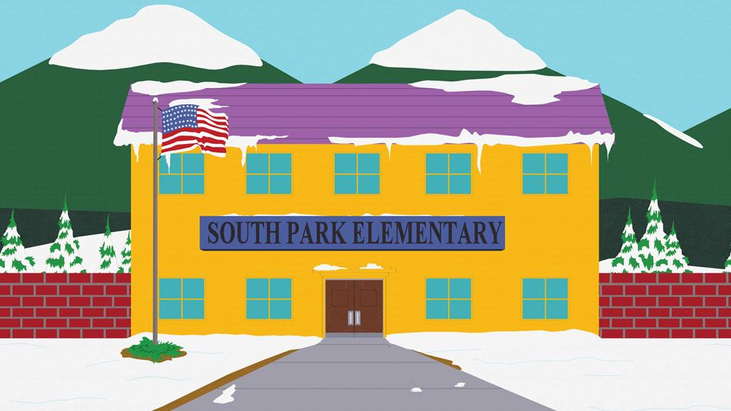
Let’s see how that works!
Mayor McDaniels and Peter Charles (aka PC Principal) need our help!
Survey with 100 students from South Park Elementary School:
What is the level of disclosure risk of this dataset?
How the risk of re-identification can be considerably reduced?
What would be the utility loss after implementing these strategies?

