Slide 1
Sensitive Data
(part I)
EDS213 - Databases & Data Management
Week 8
Renata Curty
Research Data Services, UCSB Library
rcurty@ucsb.edu
Notes:
Well-being (ethics), Bad actors, data misuse

Slide 2
Learning Objectives
Identify the major sources of sensitive data and evaluate the risks associated with open data sharing
Articulate the importance of protecting sensitive data within relevant legal, ethical, and regulatory frameworks
Distinguish between direct and indirect identifiers and explain their role in privacy risk

Slide 3

Open Data
Data that can be accessed, retrieved, freely used, and redistributed by anyone - subject only, at most, to the requirement to attribute and sharealike.
Transparency | Reproducibility | Accountability

Slide 4





Openness depends on…
Balance against legal and ethical constraints
Contractual agreements
Trade secrets
Institutional and federal policies
Data Sensitivity

Slide 5



Commons Sources of Sensitivity
Human Subjects
Protected Lands
Endangered Species
Common Rule (45 CFR 46)· HIPAA Privacy Rule· FERPA (student data)
IRB, CARE Principles, GDPR
NHPA (16 U.S.C. §470), ARPA (archaeological sites), FLPMA (BLM lands), National Park Service, Clean Water Act §404
NEPA (impact assessment)
ESA (16 U.S.C. §§1531–1544), 50 CFR Part 17 (FWS rules), CITES (via ESA §8), Marine Mammal Protection Act (1972), Migratory Bird Treaty Act,· Lacey Act (trafficking)
*References at the last slides

Slide 6
Sensitive Data
Data that could harm individual or group reputations, rights, or best interests if disclosed
Data that may negatively impact species or living individuals if made public
Data that may violate ethical agreements or threaten the rights and representation of vulnerable communities or protected lands
Do no harm | Protect the vulnerables | Avoid misuse | Follow protocols

Slide 7

Why should you care?
Handle sensitive data ethically and responsibly
Assess and consider viable data sharing options while preserving privacy and confidentiality
Minimize inadvertent misuse by poachers and exploiters
Balancing Open Access and Ethical Responsibility: The Sensitivity of Sharing Endangered Species Data

Slide 8

Speaking of care…
CARE Principles for Indigenous Data Governance (Global Indigenous Data Alliance)
Collective Benefit: Data activities should create benefits for Indigenous communities and support their well-being, development, and self-determination.
Authority to Control: Indigenous peoples have the right to control data about their peoples, lands, cultures, and resources, including how it is accessed and used.
Responsibility: Researchers, institutions, and governments have a responsibility to engage respectfully with Indigenous communities and support Indigenous capacity and relationships.
Ethics: Data practices must prioritize Indigenous rights, dignity, values, and cultural protocols, ensuring fairness and minimizing harm.
perma.cc/3ZHR-6JAG

Slide 9
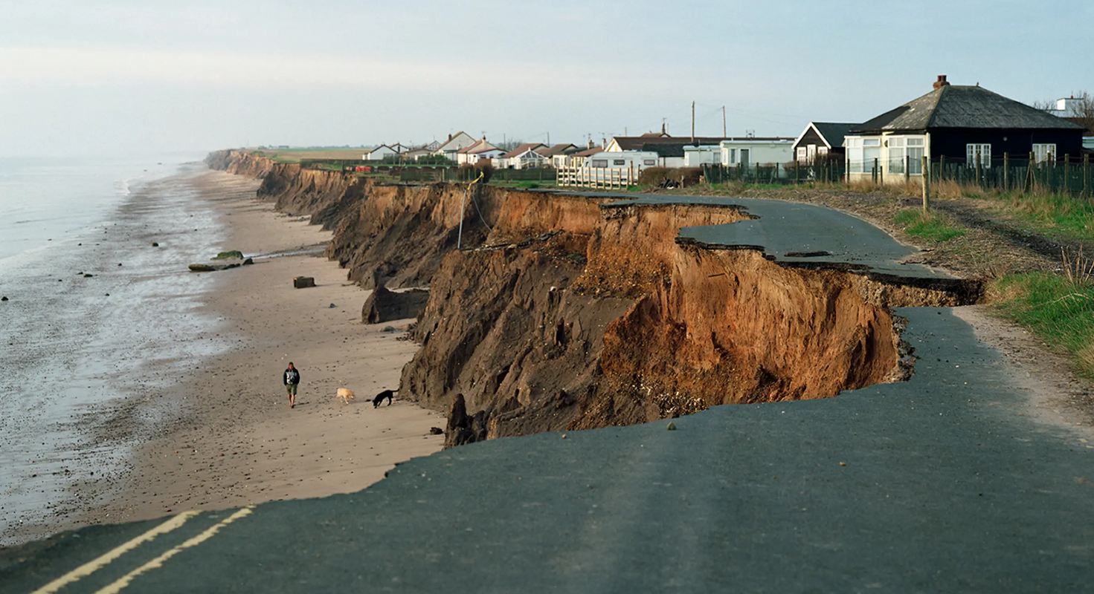
Can the new data be shared openly?
A research lab at a coastal university uses satellite imagery, drone surveys, and GPS benchmarks to produce high-resolution shoreline change maps across a 200km stretch of coastline. The goal is to support dune restoration, sediment management, and climate adaptation planning in collaboration with local municipalities and conservation NGOs.
The dataset includes:
Annual shoreline position change (meters/year) at 5m intervals
Sediment volume loss estimates
Storm surge vulnerability scores
Property parcel boundaries overlaid with erosion rates

Slide 10

Can the new data be shared openly?
A team of researchers studying environmental policy participation is developing a public-comment ShinyApp called OpenDocket Insight. The researchers collect more than a hundred thousand publicly available submitted to the United States Environmental Protection Agency during rulemaking periods over the past 5 years. Comments are legally public and accessible through federal dockets.
They have annotated and classified these comments to identify:
recurring policy themes,
health and exposure narratives,
organizational affiliations,
institutional participation patterns,
and relationships between commenters, facilities, chemicals, and geographic regions.
Researchers applied for a grant and need to make their best effort to share the data openly.

Slide 11
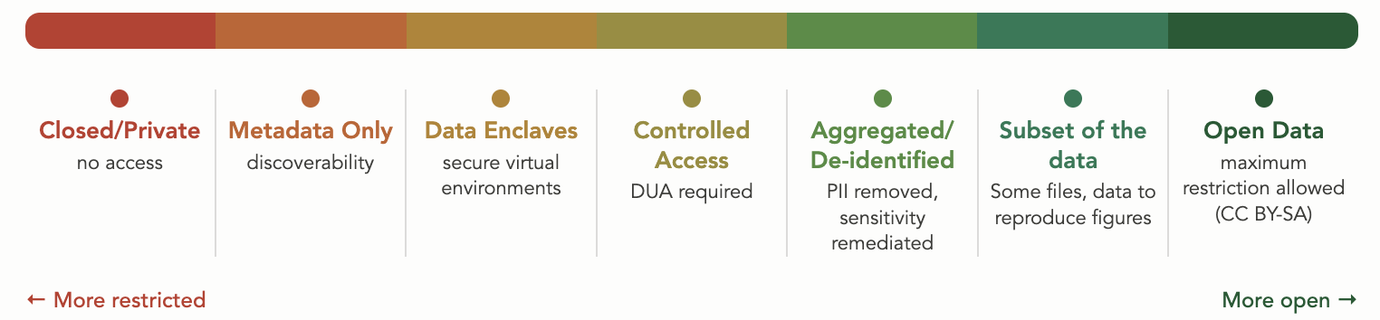
Data Sharing Continuum
Data sharing exists on a spectrum, with multiple options available depending on context, disclosure risk assessment, and purpose.
As open as possible, as closed as necessary
Protection measures
Granularity
Infrastructure

Slide 12
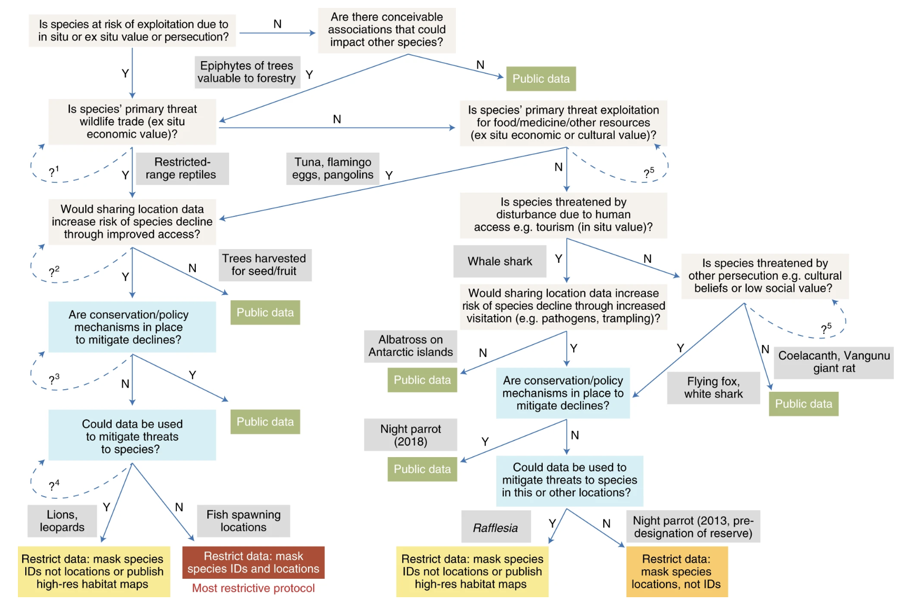
A multi-step determination
Assessment of both direct and indirect associations
May require multiple individuals and stakeholders
Legal & ethical considerations!
Tulloch, A. I. T., Auerbach, N., Avery-Gomm, S., & others. (2018). A decision tree for assessing the risks and benefits of publishing biodiversity data. Nature Ecology & Evolution, 2(8), 1209–1217. https://doi.org/10.1038/s41559-018-0608-1

Slide 13
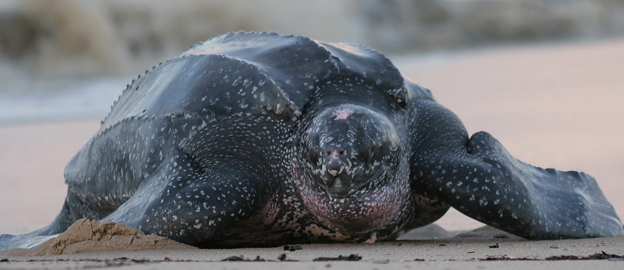
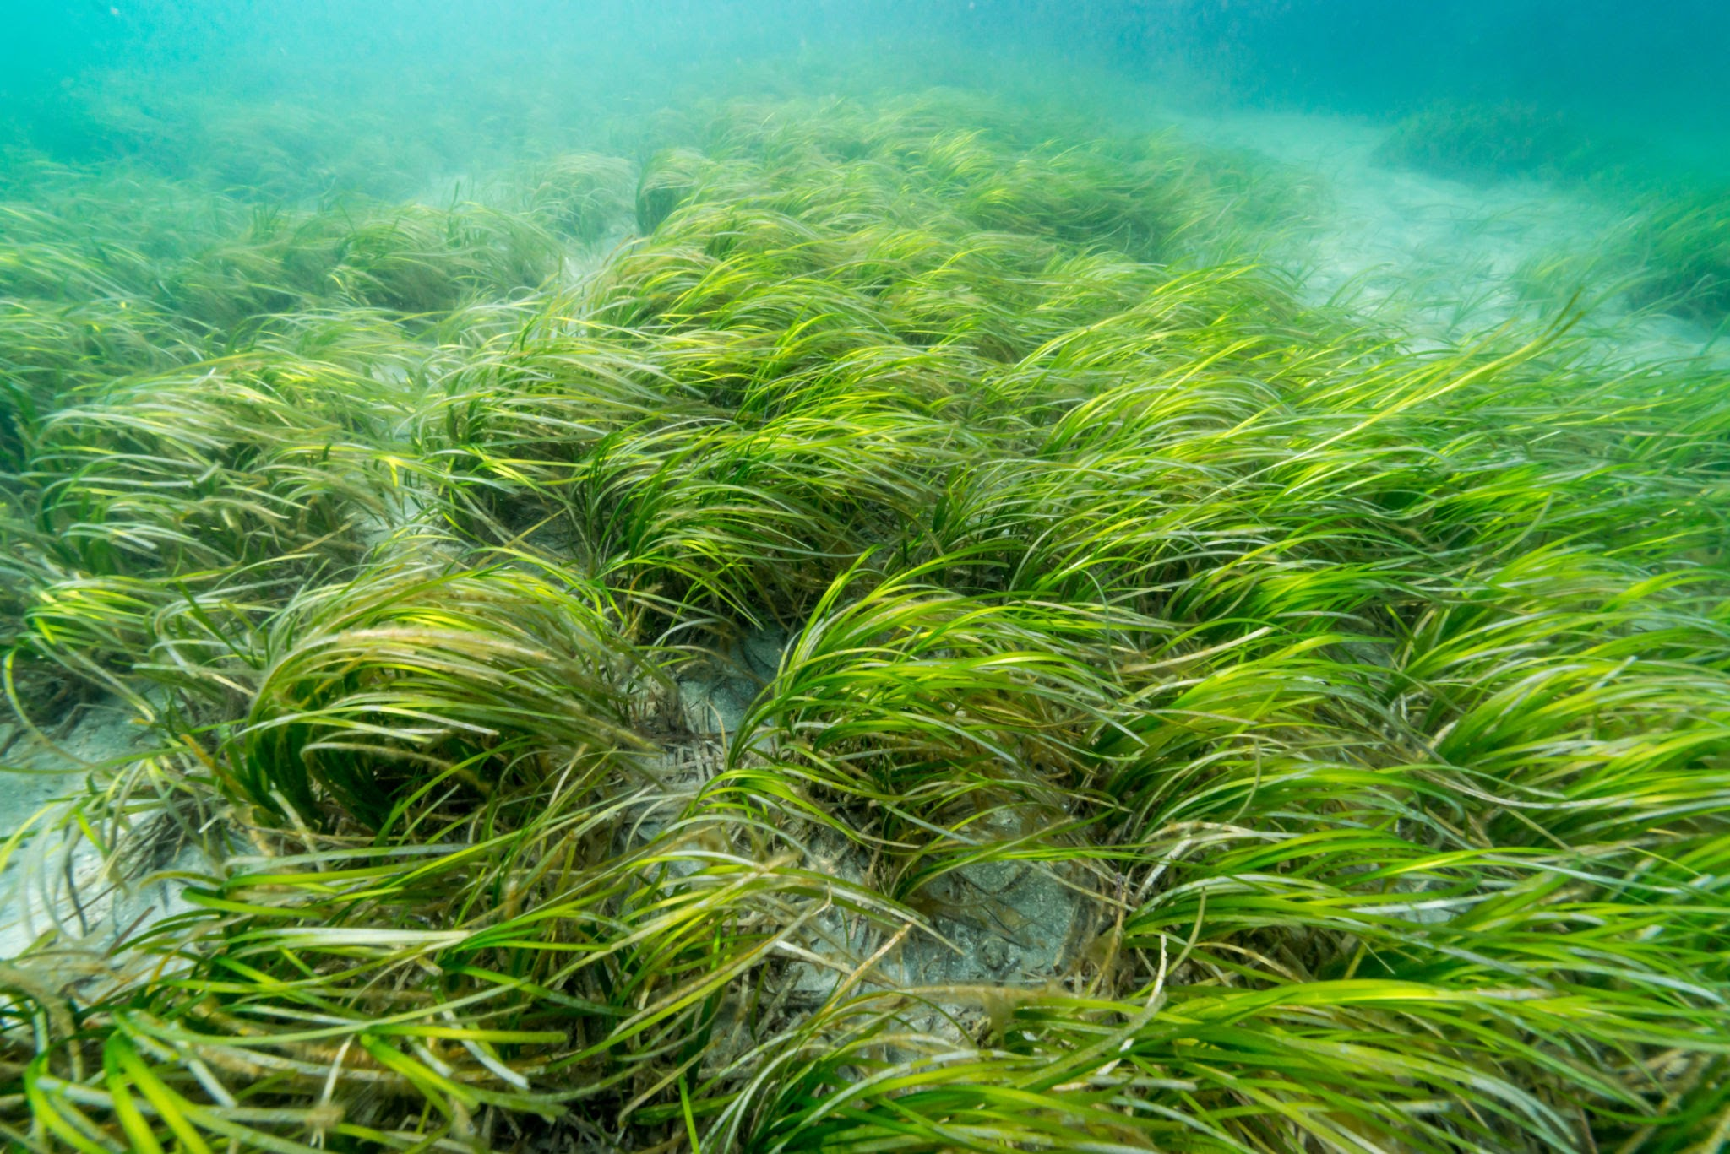
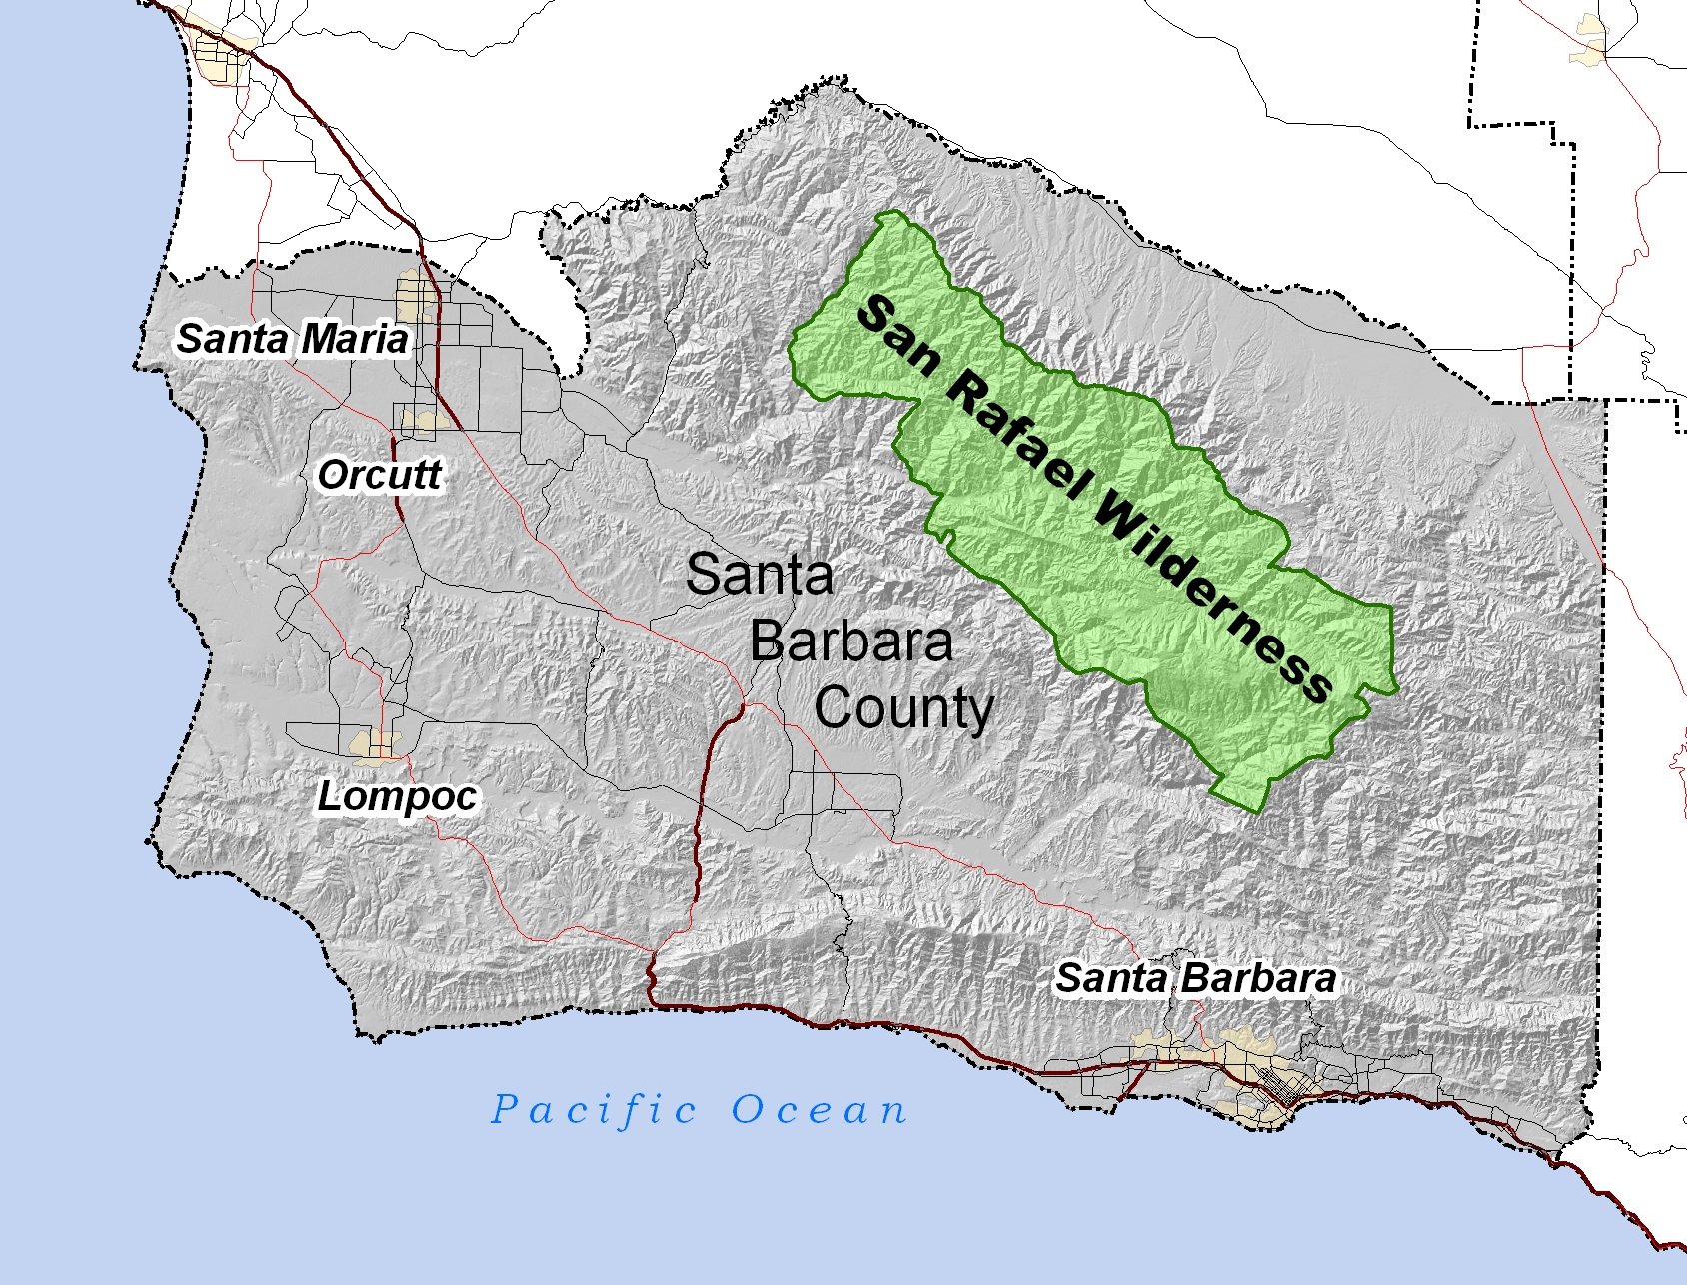
Endangered Species
Threatened or Commercially Exploited Plants
Protected Research Sites
Define the Level of Sensitivity
Consider biological significance and exploitation threat.
Key recommendations:
Generalize the spatial locality or geographic coordinates.
Avoid randomization!
Leatherback Turtle
Eelgrass
US. Fishery and Wildlife Service
Endangered Species Library
USGS - PAD-US
Terrestrial and Marine Protected Areas
Chapman AD (2020). Current Best Practices for Generalizing Sensitive Species Occurrence Data. Copenhagen: GBIF. https://doi.org/10.15468/doc-5jp4-5g10

Slide 14
USGS Recommendation
Environmental information should be freely available to promote awareness, better decisions, and reduce harm
In rare cases (e.g., endangered species, resource data), access may be restricted to prevent harm or unfairness
Restrictions should be limited and applied only when strictly necessary, with a presumption in favor of open release
See: www.usgs.gov/data-management/proprietary-and-sensitive-data#proprietary

Slide 15
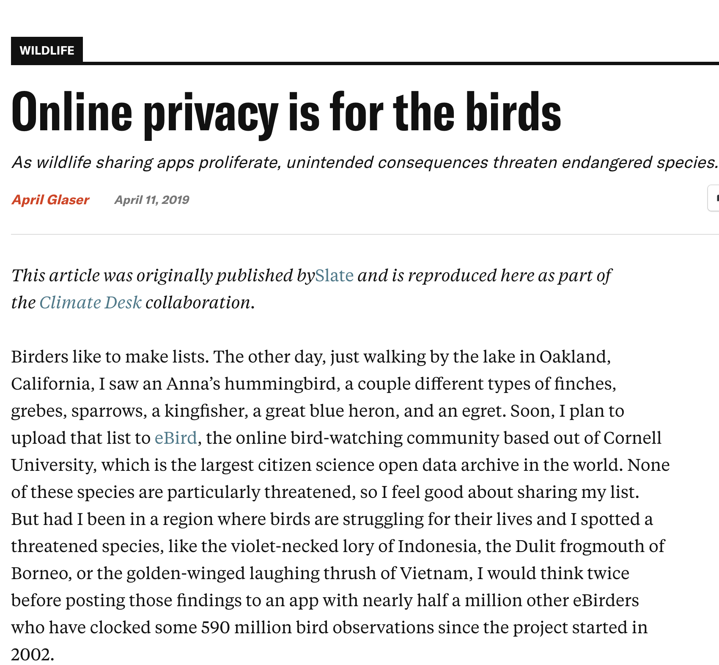
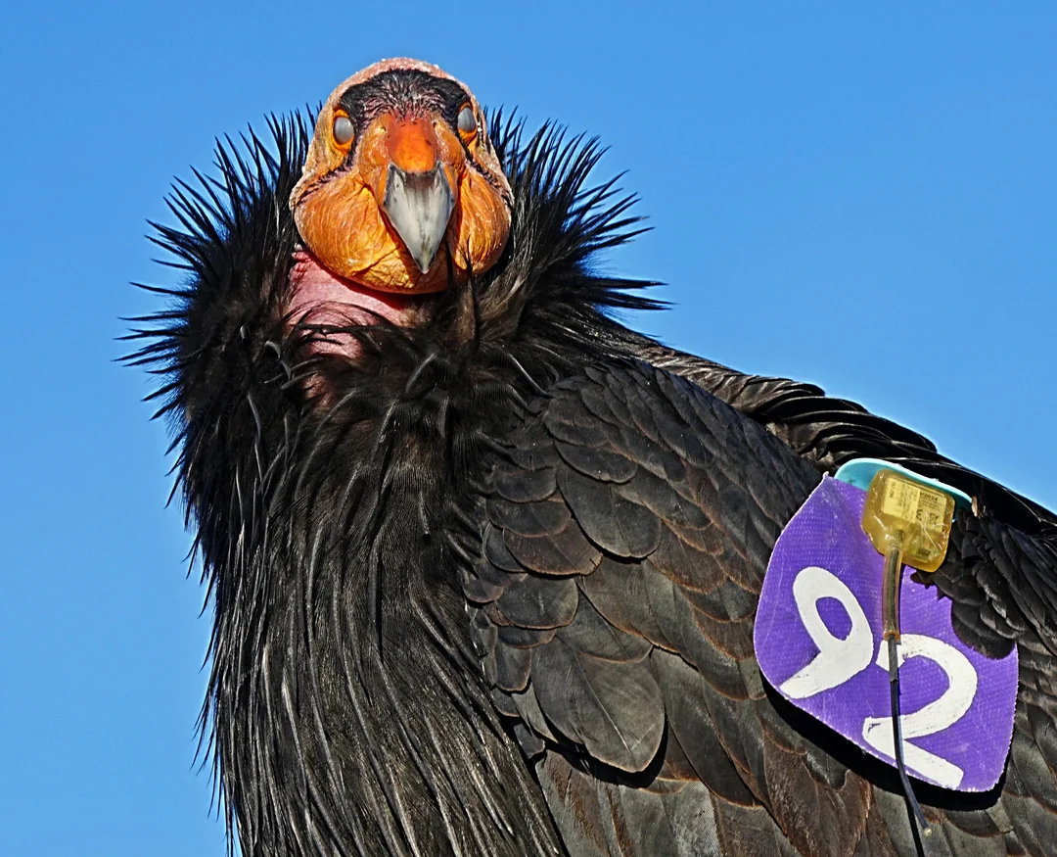
Sensitive Data - eBird
Delay reporting: Wait until the breeding or migration season ends before adding sensitive species (like owls) to eBird. You can edit your checklist later.
Avoid exact locations: Use general area names (e.g., a state park) rather than specific spots (like a certain tree grove) to protect the species' location.
Postpone submissions: Delay submitting rare bird sightings by about a week to avoid immediate alerts that could draw crowds.
Hide checklists: You can hide sensitive checklists after submission through the “Manage My Observations” section on eBird.
r/wildlifephotography
Glaser, A. (2019, April 11). Online privacy is for the birds: As wildlife sharing apps proliferate, unintended consequences threaten endangered species. High Country News. https://www.hcn.org/articles/climate-desk-online-privacy-is-for-the-birds
ebird.org/region/GR/post/reporting-what-is-sensitive-enjoying-sensitive-and-other-species

Slide 16
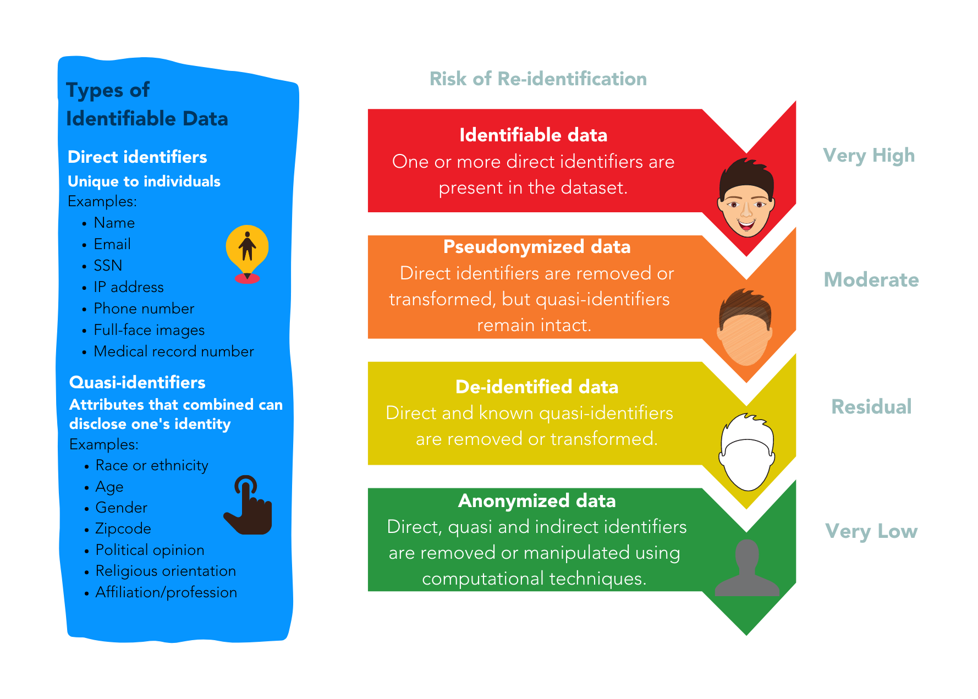
Direct vs. Indirect Identifiers (HS)
Source: perma.cc/YEN7-XBDY

Slide 17
HIPAA Compliant
Safe Harbor Methods
Names
Address (geographic subdivisions smaller than state)
All elements (except years) of dates (e.g., birthdate, admission date, discharge date, date of death)
Telephone numbers
Fax numbers
Email address
Social Security Number
Medical record number
Health plan beneficiary number
Account number
Social media handle
Certificate or license number
Vehicle identifiers
Device identifiers and serial numbers
Internet Protocol (IP) Address
Finger or voice print
Photos…
www.hhs.gov/hipaa/for-professionals/special-topics/de-identification

Slide 18

How about other categories?
Pair, Share & Note:
bit.ly/sensitivity-eds213
Vulnerable Communities
Protected Lands
Endangered Species
Exact Coordinates Zip Code
Direct
Indirect

Slide 19
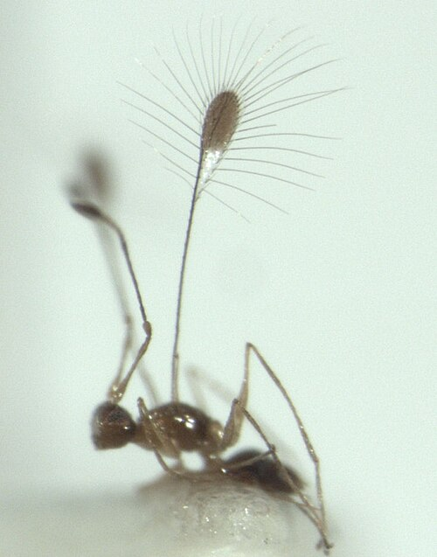
Micro Data
Refers to granular, individual-level observations recorded at the finest unit of measurement
The single, atomic observation unit can be anything: a person, a sensor, a forest, a geological event, a tribe, a species…
You can always aggregate micro data upward, but you can't recover it from summary statistics (e.g, county-level average rainfall ≠ per-station hourly reading)
Presents higher disclosure risk
Fairfly
(0.039 in max width)

Slide 20
Mitigating the risk of unwanted disclosure
When a variable is considered an indirect identifier you may also consider:
Aggregation reduces the precision of the variable or the detail of its characteristics (e.g., recode zips to county name)
Top and bottom-coding restricts the upper and lower range of a variable (e.g., transforming exact revenue values into income bracket)
Collapsing and/or combining categorical variables merges two or more variables into a single category (e.g., tribal, recreational and commercial fisheries -> non-commercial and commercial).
Bracketing/Categorization transforms continuous variables into categorical variables by reporting a variable range rather than its specific value
See: https://www.sjsu.edu/research/docs/irb-deidentification-techniques-table.pdf
Recommended reading: https://doi.org/10.1136/bmj.c181

Slide 21
Redaction
(Suppression)
Randomization
(Swapping/Shuffling)
Pseudonymization
(Tokenization/Hashing)
Noising
(Disturbing)
Techniques to mitigate the risk of unwanted disclosure
Removal of identifiers that can put subjects’ identities and privacy at risk.
Data for one or more variables are switched with another record, so that the data does not know whether the real data values correspond to certain records.
Slightly modification of the original dataset by applying techniques that round numbers and add random variation.
Meaningful piece of data are turned into a into an alias or a random string of characters which serves as reference to the original data, but cannot be used to guess those values.
Non-perturbative methods: reduces the detail or precision in the data with no distortion to the data structure
Perturbative methods: creates uncertainty around the true values
Recommended reading: https://doi.org/10.1136/bmj.c181

Slide 22
Other Recommended Measures
Avoid sharing tables with small cell sizes (i.e., fewer than 5 cases/rows)
Be cautious when slicing the data into small subgroups or areas
Avoid listings of cases with outliers
Make sure to document the rationale behind the data transforms

Slide 23
Regulations & Principles
Carroll, S. R., Garba, I., Figueroa-Rodríguez, O. L., Holbrook, J., Lovett, R., Materechera, S., Parsons, M., Raseroka, K., Rodriguez-Lonebear, D., Rowe, R., Sara, R., Walker, J. D., Anderson, J., & Hudson, M. (2020). The CARE principles for Indigenous data governance. Data Science Journal, 19(1), 43. https://doi.org/10.5334/dsj-2020-043
Department of Education. (1974). Family Educational Rights and Privacy Act. 20 U.S.C. § 1232g; 34 C.F.R. Part 99. https://studentprivacy.ed.gov/faq/what-ferpa
European Parliament & Council of the European Union. (2016). Regulation (EU) 2016/679 on the protection of natural persons with regard to the processing of personal data and on the free movement of such data (General Data Protection Regulation). Official Journal of the European Union, L 119, 1–88. https://eur-lex.europa.eu/eli/reg/2016/679/oj
National Commission for the Protection of Human Subjects of Biomedical and Behavioral Research. (1979). The Belmont report: Ethical principles and guidelines for the protection of human subjects of research. U.S. Department of Health, Education, and Welfare. https://www.hhs.gov/ohrp/regulations-and-policy/belmont-report/index.html
U.S. Department of Health and Human Services. (2018). Federal policy for the protection of human subjects ("Common Rule"). 45 C.F.R. § 46. https://www.ecfr.gov/current/title-45/subtitle-A/subchapter-A/part-46
U.S. Department of Health and Human Services. (2000). Standards for privacy of individually identifiable health information. 45 C.F.R. Parts 160 & 164. https://www.hhs.gov/hipaa/for-professionals/privacy/laws-regulations/index.html

Slide 24
Regulations & Principles
U.S. Congress. (1916). National Park Service Organic Act. Act of August 25, 1916, ch. 408, 39 Stat. 535, 54 U.S.C. § 100101 et seq. https://www.doi.gov/ocl/nps-organic-act
U.S. Congress. (1966). National Historic Preservation Act of 1966. Pub. L. No. 89-665, 54 U.S.C. §§ 300101 et seq. (originally codified at 16 U.S.C. § 470). https://www.achp.gov/digital-library-section-106-landing/national-historic-preservation-act
U.S. Congress. (1969). National Environmental Policy Act of 1969. Pub. L. No. 91-190, 42 U.S.C. §§ 4321–4370j. https://www.govinfo.gov/content/pkg/COMPS-10352/pdf/COMPS-10352.pdf
U.S. Congress. (1976). Federal Land Policy and Management Act of 1976. Pub. L. No. 94-579, 43 U.S.C. §§ 1701 et seq. https://www.blm.gov/sites/default/files/AboutUs_LawsandRegs_FLPMA.pdf
U.S. Congress. (1979). Archaeological Resources Protection Act of 1979. Pub. L. No. 96-95, 16 U.S.C. §§ 470aa–470mm. https://www.nps.gov/subjects/archeology/archaeological-resources-protection-act.htm
U.S. Environmental Protection Agency. (1972). Clean Water Act, Section 404: Permits for dredged or fill material. Pub. L. No. 92-500, 33 U.S.C. § 1344. https://www.epa.gov/cwa-404/overview-clean-water-act-section-404

Slide 25
Regulations & Principles
Convention on International Trade in Endangered Species of Wild Fauna and Flora. (1973, March 3). CITES. [Implemented in U.S. law via Endangered Species Act § 8, 16 U.S.C. § 1537; 50 C.F.R. Part 23]. https://cites.org/eng/disc/text.php
U.S. Congress. (1918). Migratory Bird Treaty Act. Act of July 3, 1918, ch. 128, 40 Stat. 755, 16 U.S.C. §§ 703–712. https://www.fws.gov/law/migratory-bird-treaty-act-1918
U.S. Congress. (1973). Endangered Species Act of 1973. Pub. L. No. 93-205, 16 U.S.C. §§ 1531–1544. https://www.law.cornell.edu/uscode/text/16/chapter-35
U.S. Congress. (1972). Marine Mammal Protection Act of 1972. Pub. L. No. 92-522, 16 U.S.C. §§ 1361–1423h. https://www.fisheries.noaa.gov/national/marine-mammal-protection/marine-mammal-protection-act
U.S. Fish and Wildlife Service. (1975). Endangered and threatened wildlife and plants. 50 C.F.R. Part 17. https://www.ecfr.gov/current/title-50/chapter-I/subchapter-B/part-17
U.S. Congress. (1981). Lacey Act Amendments of 1981. Pub. L. No. 97-79, 16 U.S.C. §§ 3371–3378. https://www.fws.gov/law/lacey-act

Slide 26
Sensitive Data
(part II)
EDS213 - Databases & Data Management
Week 9
Renata Curty
Research Data Services, UCSB Library
rcurty@ucsb.edu
Notes:
Well-being (ethics), Bad actors, data misuse

Slide 27

NOT as anonymous as you think!
Dr. Latanya Sweeney (k-Anonymity)
~ 90% of the U.S. population could be easily identified by ZIP code, date of birth, and gender, in combination with any secondary health data sold by pharmacies and data analytics companies.

Slide 28
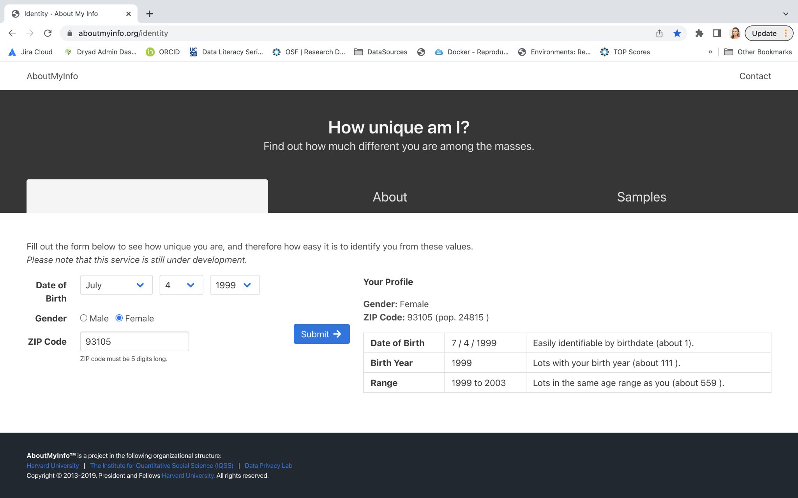
aboutmyinfo.org

Slide 29
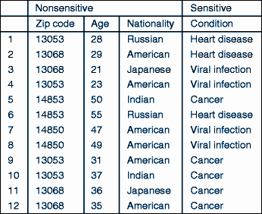
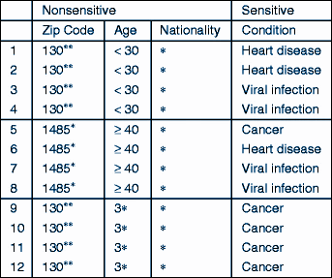
k-Anonymity
RISK ASSESSMENT AND MITIGATION
“Hiding in the crowd”
At least k rows in the dataset sharing the same set of attributes.
* 4-5 / 11-20 “matching cases” are desired depending on access permissions.
Suppression + Global recoding/generalization
Samarati, P., & Sweeney, L. (1998). Protecting privacy when disclosing information: k-anonymity and its enforcement through generalization and suppression. https://dataprivacylab.org/dataprivacy/projects/kanonymity/paper3.pdf

Slide 30
k-Anonymity
Limitations
Yumi, 13068, 21, Japanese
Lower-risk of heart condition
Knowledge Attack
Homogeneity Attack
Even without accessing individual records, an attacker can still infer sensitive attributes about a given case

Slide 31
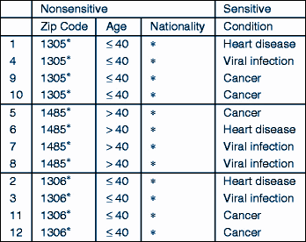
l-Diversity
An extended privacy property that measures the diversity of sensitive values within each column of a dataset.
For any group of rows with identical quasi-identifiers, there must be at least l distinct values for each sensitive attribute.
Makes it harder to identify specific sensitive values associated with individuals or smaller groups within the dataset.
Machanavajjhala, A., Kifer, D., Gehrke, J., & Venkitasubramaniam, M. (2007). l-diversity: Privacy beyond k-anonymity. ACM Transactions on Knowledge Discovery from Data (TKDD), 1(1), 3-es. https://doi.org/10.1145/1217299.1217302
Gehrke, J., Kifer, D., Machanavajjhala, A. (2011). ℓ-Diversity. In: van Tilborg, H.C.A., Jajodia, S. (eds) Encyclopedia of Cryptography and Security. Springer, Boston, MA. https://doi.org/10.1007/978-1-4419-5906-5_899

Slide 32
Knowledge Check
Case | Zip | Year Built | Property Type | Floor Level | Claim Amount
1 | 12345 | 1995 | Apartment | 1st | $12,000
2 | 12346 | 1995 | Apartment | 2nd | $15,000
3 | 12347 | 2000 | House | Ground | $20,000
4 | 12348 | 2000 | House | Ground | $22,000
5 | 12349 | 1990 | Apartment | 2nd | $11,000
6 | 12346 | 1995 | Apartment | 1st | $14,000
How many quasi-identifiers are present in this dataset?
Does this dataset violate k-anonymity assumption?
How can we mitigate disclosure risk?

Slide 33
Knowledge Check
Case | Zip | Year Built | Property Type | Floor Level | Claim Amount
1 | 123** | 1990–1999 | Apartment | Low | $12,000
2 | 123** | 1990–1999 | Apartment | Low | $15,000
3 | 123** | 2000–2009 | House | Ground | $20,000
4 | 123** | 2000–2009 | House | Ground | $22,000
5 | 123** | 1990–1999 | Apartment | Low | $11,000
6 | 123** | 1990–1999 | Apartment | Low | $14,000
Does this version of the dataset satisfy l-diversity?

